Slide 1
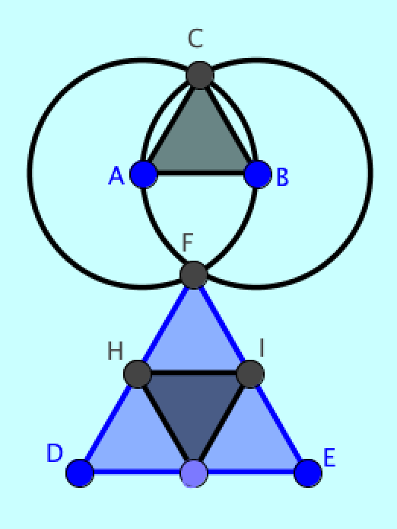
Analyzing virtual math teams enacting geometric practices
LinCS Seminar, Göteborg
October 11, 2013
Gerry Stahl
Notes:
In today’s data session, I would like to take a look at how a team of three students progressed
In their online work, collaboration, use of GeoGebra and understanding of dependencies in dynamic geometry

Slide 2
Background of Data
Virtual Math Teams (VMT) with GeoGebra: online chat collaborative problem solving and dynamic-geometry construction environment
3 girls in same 7th grade algebra class (about 13 years old); 8 one-hour sessions after school
Ch 7 in Translating Euclid
Chat log excerpts in slides
Complete log excerpts, can be filtered for chat, etc.
Replayer files & replayer for 8 cereal-girls sessions
2
Notes:
In the past two days, I described the goals and design of the VMT environment and educational software design
Today we will look at one of the best examples of students using VMT across 8 sessions
This is the students’ first major introduction to geometry
They used VMT with multi-user GeoGebra

Slide 3
Data Session
1. Discuss background of data
2. Quickly go through data from topic 1 to get a feel of how the students started in VMT as a team
3. Look at data from “high point” where they solved a hard problem and demonstrated understanding of dynamic-geometry dependencies (topics 5 & 6)
4. Consider in more detail the discourse in the final section about constraints & dependencies (topic 13)
3
Notes:
I will quickly take you through their first session
And then a double session where they did some impressive work
Then we will focus on looking carefully at their final session to see how they progressed

Slide 4
Notes:
Here is their first online topic
It is intended to introduce them to VMT, online collaboration, the use of GeoGebra software tools, chatting about what they are doing and the basic elements of geometry (points, lines, etc.)
Go to Replayer for Topic1.jno – jump to start

Slide 5
Notes:
Scroll thru first chat lines of Replayer
The students greet each other and look around

Slide 6
Notes:
They do not know what to do
No one wants to take control of GeoGebra

Slide 7
Notes:
They are floundering and feel lost
But they keep trying and start to focus on step #3 of the instructions as their guide

Slide 8
Notes:
They go thru the steps
And chat about what they are doing
They start to volunteer to do steps

Slide 9
Notes:
Here they discuss what they have noticed – scroll to end of drawing in first tab
The topic was designed to get them to notice characteristics of points and lines in dynamic geometry
Instead, they discuss characteristics of the shape they have constructed
*** skip ahead to slide 17 inscribed triangles

Slide 10
Notes:
Close Replayer and Open with Topic5.jno
This is a challenging dynamic-geometry problem
Students should explore the given figure to notice its dependencies as they drag it
Then they should figure out how to design a construction to duplicate the figure with the same dependencies

Slide 11
Notes:
Go to Replayer at 4:23:39 and center triangles and set history to complete
Cheerios chats the key reasoning: notice dependency and says how to construct it with compass tool
But Cheerios uses circles not compass; Cornflakes constructs the new points with compass and Fruitloops constructs the inscribed triangle

Slide 12
Notes:
3 days later, the team returns and explains what they did in the chat – also in class at request of teacher
Cheerios correctly explains the procedure and Cornflakes agrees with it
Fruitloops wonders about the colors signifying some points are more dependent than others
The group explains that the compass circles are still constraining the points, even though the circles have been hidden

Slide 13
Notes:
This problem is similar to the inscribed triangles, but the students have not yet worked with squares or quadrilaterals.
*** got to tab Squares at 4:04:40

Slide 14
Notes:
The team spent a lot of time and exploration
But finally they constructed a square similarly to how Euclid constructed an equilateral triangle

Slide 16
Topic 13: Quadrilaterals
Notes:
Open Replayer with Topic13.jno

Slide 17
Notes:
The team now very efficiently gets started, regulates their group work,
Discusses how the figure was constructed based on its lack of restrictions
The students all agree and then move on

Slide 18
Notes:
Discussion of dependency, constraint, restriction, invisible circles

Slide 19
Notes:
Reference back to previous topics and dependencies and hidden circles

Slide 20
Notes:
Bring in color of points and order (labeled alphabetically) or construction
Do they understand how to design constructions to have desired dependencies???
Do they understand that this quadrilateral has two equal sides – that is what is special about it?
They are efficient and notice many features related to dependency – but do they get the main point?

Slide 21
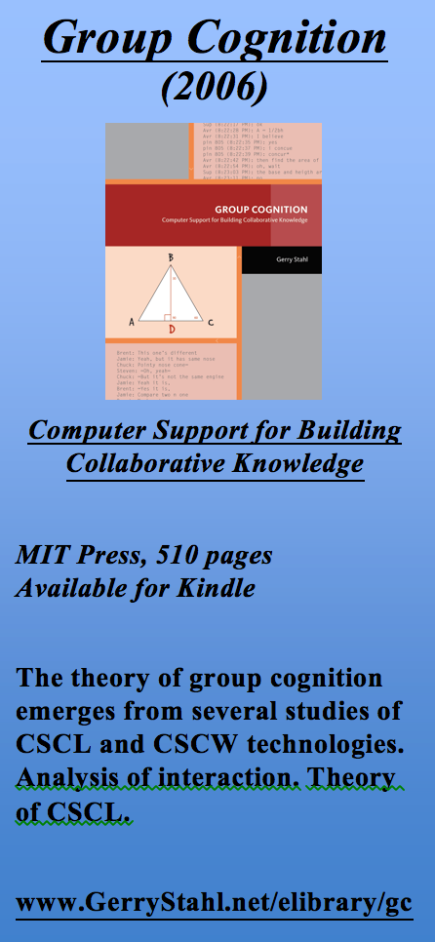
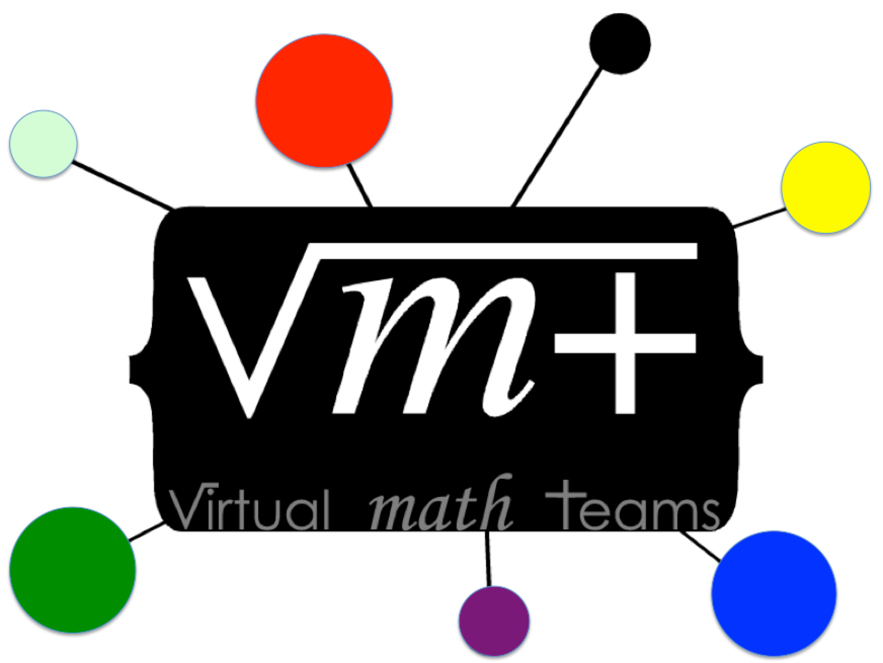
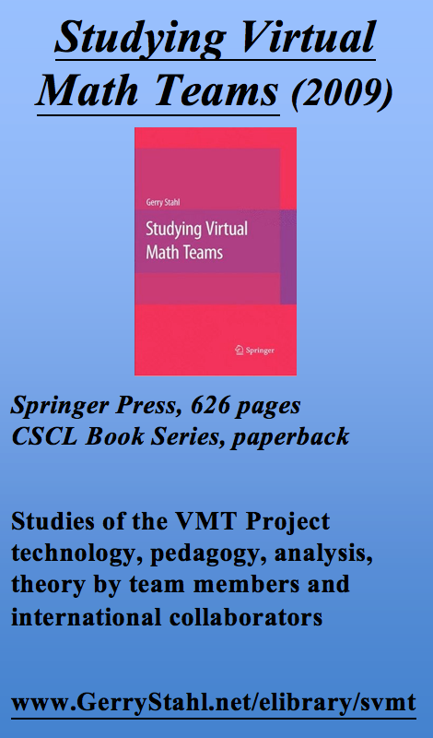
The VMT trilogy
Notes:
These three books include analyses of collaborative math interaction
They report on the VMT Project at 2006, 2009 and 2013

Slide 22
For further info…
Email:
Gerry@GerryStahl.net
Website:
www.GerryStahl.net
Topics in Dynamic Geometry for VMT:
www.GerryStahl.net/elibrary/topics
Translating Euclid:
www.GerryStahl.net/elibrary/euclid
Studying Virtual Math Teams:
www.GerryStahl.net/elibrary/svmt
Group Cognition:
www.GerryStahl.net/elibrary/gc
Slides:
www.GerryStahl.net/pub/didactics.pdf www.GerryStahl.net/pub/designing.pdf www.GerryStahl.net/pub/analyzing.pdf
Notes:
Here are links to further information, including the trilogy of books and the workbook with curricular resources.
Also links to the slides for my presentations here.

