Slide 1
International Summer School of Doctoral Candidates in Educational Technology, Beijing, China, July 15, 2011
Research in CSCL:
Two Case Studies
Gerry Stahl

Slide 2
“Seeing what we mean:
Co-experiencing a
shared virtual world”
Gerry Stahl, Nan Zhou, Murat Perit Cakir, Johann W. Sarmiento-Klapper

Slide 3
Overview
This paper is based on the Virtual Math Teams project, including the 3 dissertations of the co-authors
We present an alternative to the view of Common Ground based on convergence of mental models
We present a case study from VMT Spring Fest 2006, Team C, Session 3.
We analyze how 3 students establish and maintain intersubjective understanding of a math problem, which they solve as a group

Slide 4
An infant & adult share a meaningful gesture at a shared object

Slide 5
The Problem of Intersubjectivity and Common Ground
The precondition of collaborative learning is that the participants understand each other enough to accomplish their work
This includes tacit background knowledge and explicit shared understanding of the current topic
In cognitive science, grounding of shared understanding is treated as the explicit comparison of mental models or internal opinions; in our analysis, it is the result of interactional work in which a shared world is created and various methods are used to ensure a sharing of this world

Slide 6
The Grounding of Intersubjectivity : Physically Embodied Being-in-the-World
We all find others and ourselves within one world.
We learn about and experience the many dimensions of this world together, as we mature as social beings.
The “problem” of establishing intersubjectivity is a pseudo-problem in most cases.
Human existence is fundamentally intersubjective from the start.
We understand the world in which we are embodied with other people and cultural artifacts as a shared world.

Slide 7
The Issue of Intersubjectivity
in Virtual (CSCL) Worlds

Slide 8
The Practical Issue of
Intersubjectivity Online
How do people who meet online create a shared world in which they can understand things the same?
How do their online actions (chat and drawing) build a joint problem space of actors, places, times, social relations, semantics, artifacts and group members?
How do they raise issues of understanding, repair misunderstandings, share perspectives?
How does the group interaction establish a shared discourse context to support intersubjectivity without physical embodiment?

Slide 9
Opening a Shared World

Slide 10
Opening a Shared World

Slide 11
Orienting to a Shared Object

Slide 12
Seeing “As” a Shared Pattern

Slide 13
Building Knowledge Together

Slide 14
Group Cognition in Math
Open a shared world with an external representation – establish a joint problem space that is visually shared
Orient everyone to a specific object for mutual discussion
Make a particular pattern visually relevant
Discuss the pattern in words
Signify the pattern in mathematical symbols and manipulate them
Indicate that everyone is together at each step

Slide 15
Conclusions about Group Cognition in this CSCL Case
The group works on maintaining a shared view of a joint problem space
They use questions, proposals, requests, repairs, pointing, outlining, visual emphasis, verbal description, terminology, math symbols
They confirm mutual understanding by agreement or by demonstration
The problem solving is accomplished by the group
Each participant understands the resources, methods and steps well enough to potentially use them individually in the future
They learn effective ways of “seeing-as”

Slide 16
Implications for CSCL
It is possible to observe and analyze in chat logs how groups establish and maintain intersubjectivity and accomplish group-cognitive tasks
Analysis can show how features and affordances of the CSCL media and environment are used to support intersubjectivity and group cognition: persistent text chat, shared drawing board, line color & thickness, pointing tool, etc.
CSCL environments can support virtual Being-in-the-World-Together in modes different from physical embodiment

Slide 17
“The Structure of Collaborative Problem Solving in a
Virtual Math Team”
Gerry Stahl

Slide 18
How does (group) cognition take place (and how can it be analyzed) in a (paradigmatic) CSCL setting?
Cognitive accomplishments can be achieved by small groups, mediated by technological media, tools, resources
Cognition can take place primarily as textual discourse
Research can now capture adequate traces of meaning making, problem solving, knowledge building, group cognition

Slide 19
Talk overview: show social construction of mathematical meaning through collaboration and argumentation
The hierarchy of levels of temporal structure for online collaboration
The sequential structure of collaborative math discourse
Virtual Math Teams case study
10 discourse moves (in detail)
Group cognition in math

Slide 20
Let there be meaning

Slide 21
Hierarchy of structural layers
1. Group event: E.g., Team B’s participation in the VMT Spring Fest 2006.
2. Temporal session: Session 4 of Team B on the afternoon of May 18, 2006.
3. Conversational topic: E.g., determining the number of sticks in a diamond pattern. (A longer sequence.)
4. Discourse move: A sequential accomplishment built on an elementary interchange.
5. Adjacency pair: A base interaction involving two or three utterances, which drives a discourse move.
6. Textual utterance: A text chat posting by an individual participant, which may contribute to an adjacency pair.
7. Indexical reference: An element of a textual utterance that points to a resource in the context.

Slide 22
The Problem of Intersubjectivity and Common Ground
The precondition of collaborative learning is that the participants understand each other enough to accomplish their work
This includes tacit background knowledge and explicit shared understanding of the current topic
In cognitive science, grounding of shared understanding is treated as the explicit comparison of mental models or internal opinions; in our analysis, it is the result of interactional work in which a shared world is created and various methods are used to ensure a sharing of this world

Slide 23
“Longer sequences” in CSCL
The sequential structure of collaborative math discourse
The problem of longer sequences
Between CA (conversation analysis – e.g., Sacks, Schegloff) and DA (discourse analysis – e.g., Gee)
Between utterances or adjacency pairs & identity or ideology issues
Science of small-group cognition between individual unit of analysis & communities of practice

Slide 24
“Longer sequences” in CA
Conversation Analysis (CA): Sacks (1962), Schegloff (2007), etc. looks at how people construct their interactions, e.g., with turn taking and adjacency-pair responses
Traditionally focused on adult, American, face-to-face, informal speech
Needs to be adapted to online text
Needs to be extended from adjacency pairs to longer sequences that accomplish cognitive tasks by groups

Slide 25
The VMT environment

Slide 26
Case study topic

Slide 27
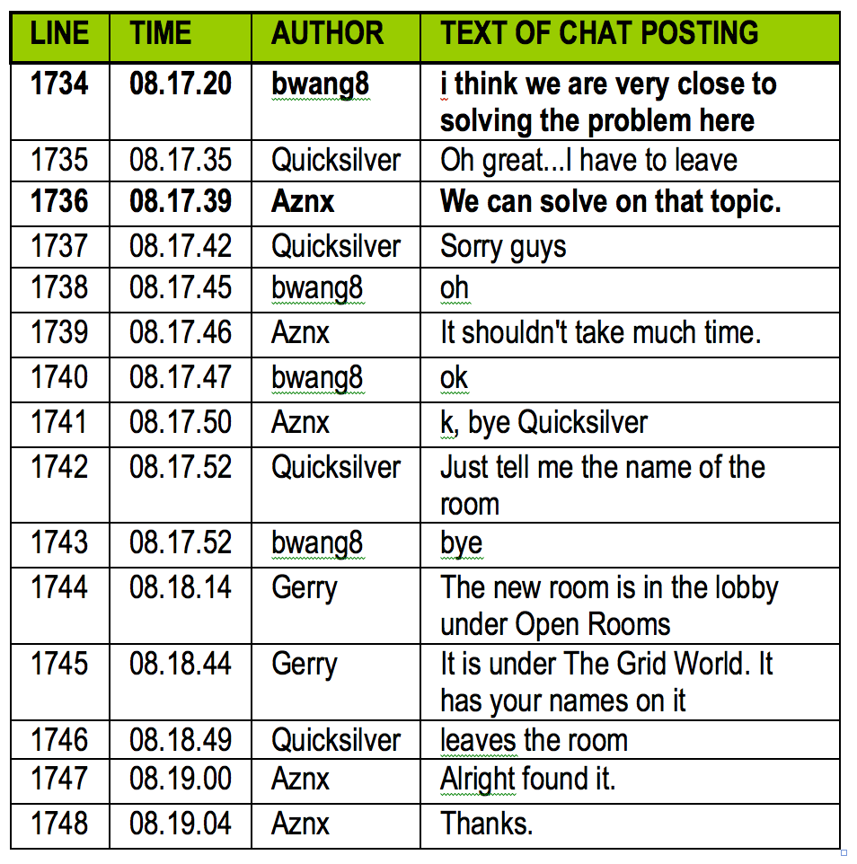
Select a problem

Slide 28
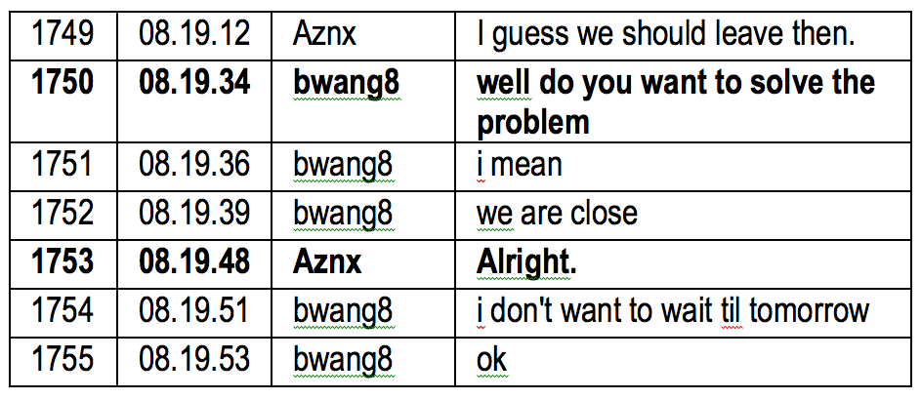
Decide to start

Slide 29
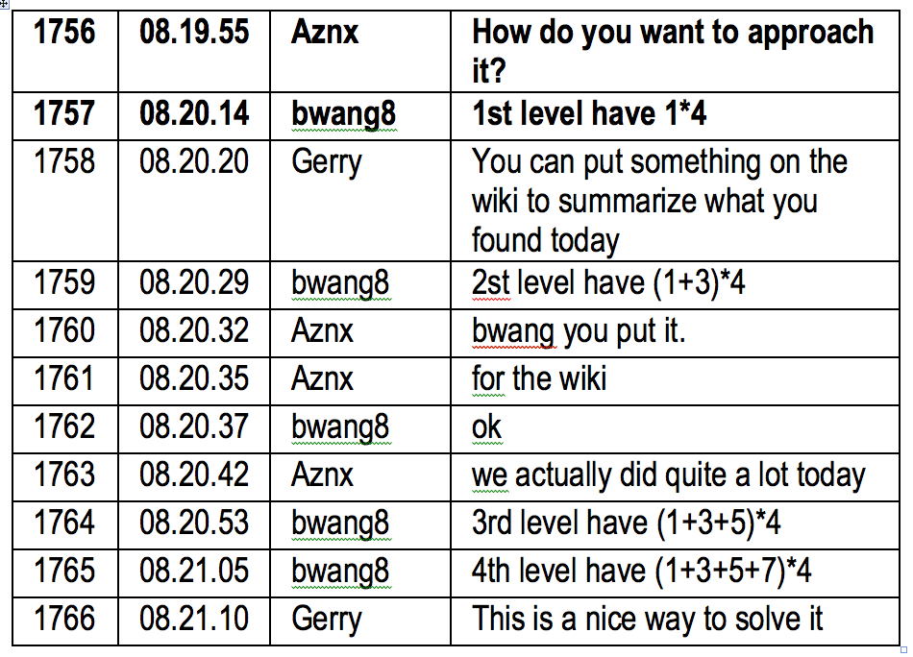
Pick an approach

Slide 30
Identify the pattern

Slide 31
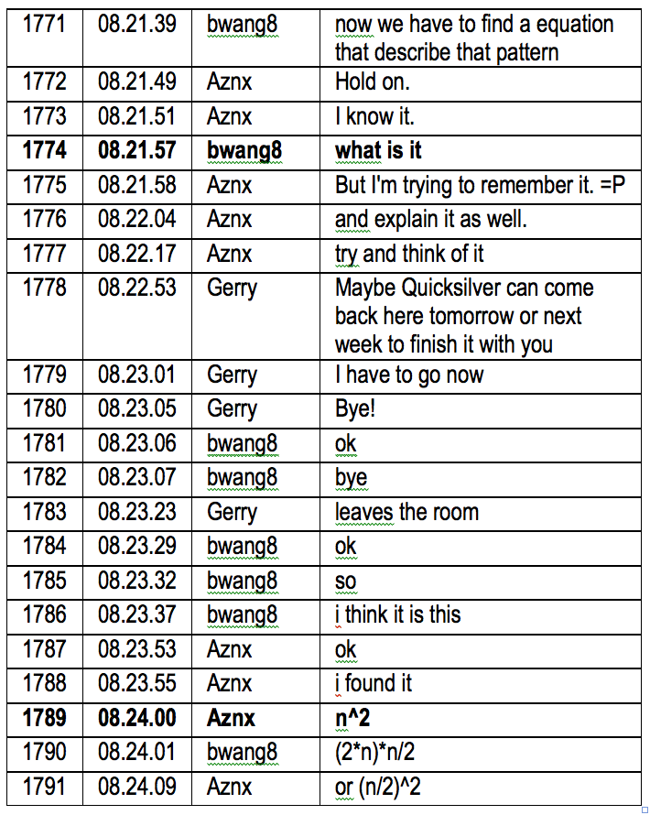
Seek the equation

Slide 32
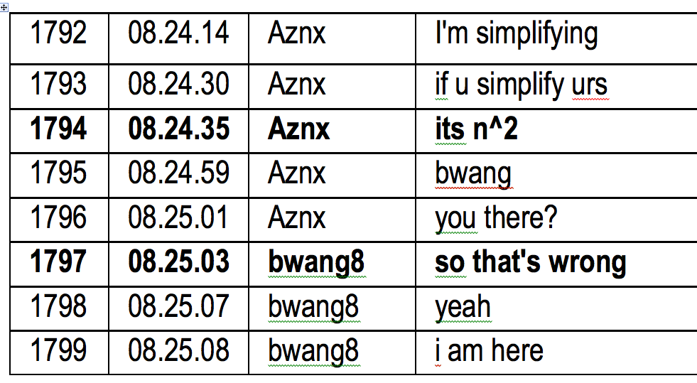
Negotiate the solution

Slide 33
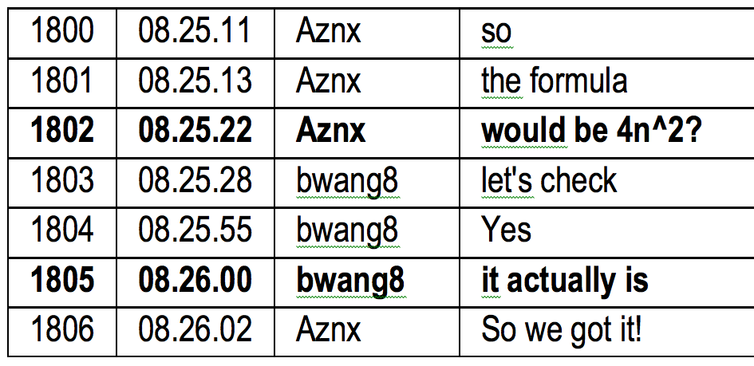
Check cases

Slide 34
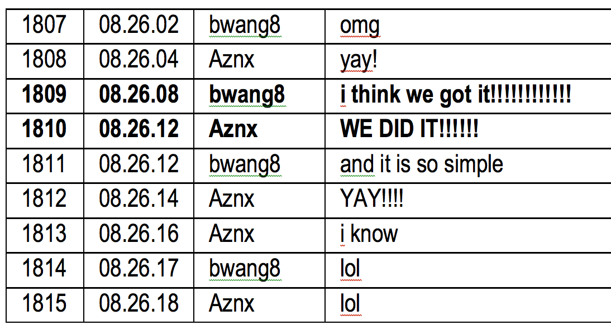
Celebrate the solution:
the “Aha” moment in math

Slide 35
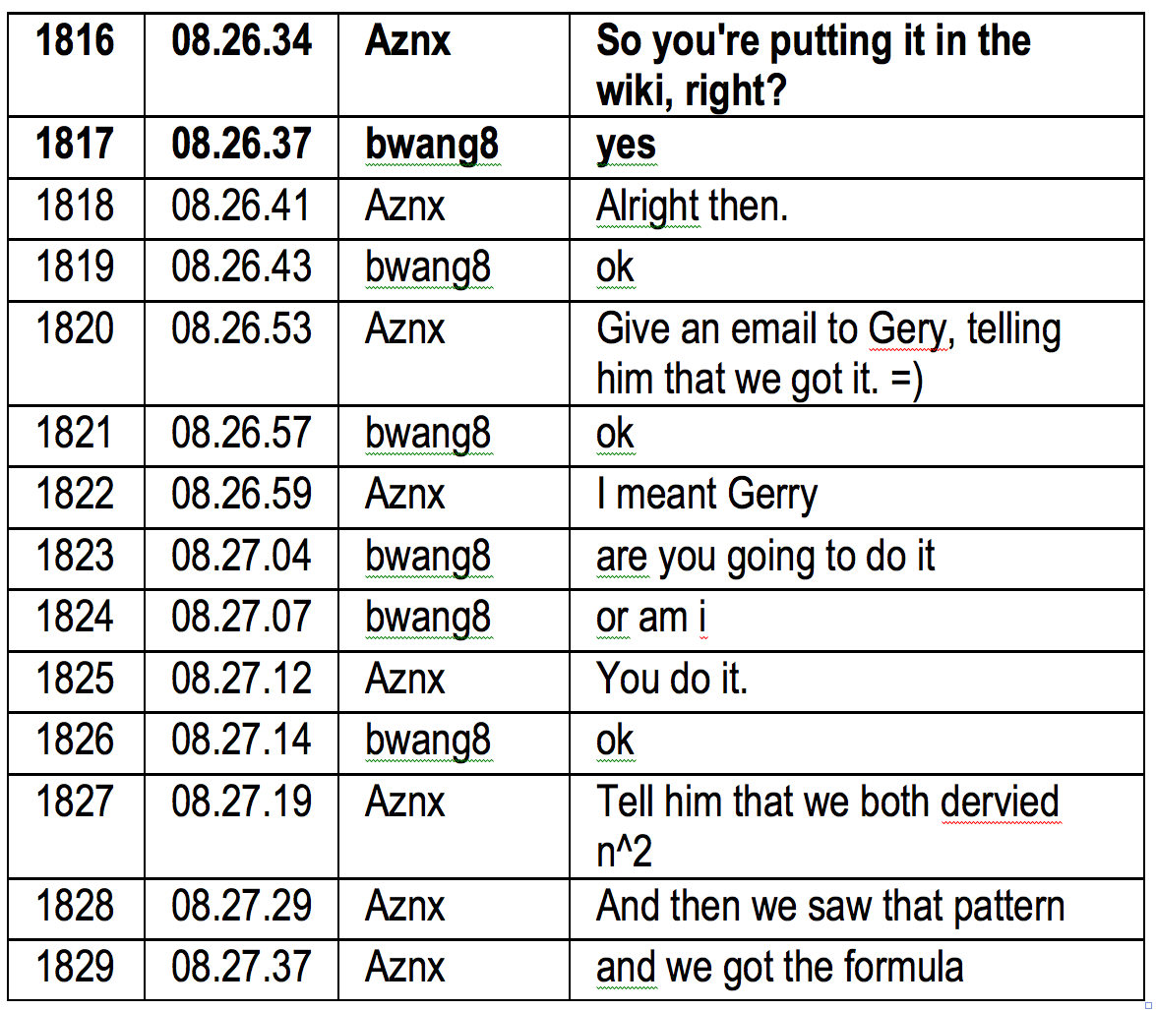
Present a formal solution (proof)

Slide 36
Close the topic

Slide 37
Group cognition in math:
The sequential structure
The sequential structure of collaborative math discourse?
Longer sequence is 10 discourse moves, each built on an adjacency pair
Together, they accomplish group cognitive problem solving
Structure of collaborative knowledge building: longer sequence of discourse moves, each at the group (interactional) unit of analysis

Slide 38
Group cognition in math:
The longer-sequence structure
Log 1. Open the topic
Log 2. Decide to start
Log 3. Pick an approach
Log 4. Identify the pattern
Log 5. Seek the equation
Log 6. Negotiate the solution
Log 7. Check cases
Log 8. Confirm the solution
Log 9. Present a formal solution
Log 10. Close the topic

Slide 39
Group cognition in math: the learning (knowledge building)
The group solved a math problem that had eluded the larger group and that another group had gotten wrong
They did this through a longer sequence of 10 interactional discourse moves
Each move was a mundane (everyday) practice of discourse
The problem solving took place in the discourse, not in private mental space
Knowledge building could be observed and analyzed in detail
Math facts and procedures were not the focus (happened “between the lines”)

Slide 40
Meaning making
Details of how the group co-constructs meaning:
The symbolic expression “4n²” as meaningful to the group
Analyzed from traces of the participants’ perspective (ethnomethodology)
Multi-modal movement: visual reasoning, narrative description, symbolic abstraction

Slide 41
Analysis of group cognition
First detailed analysis of a “longer sequence”
Showed how it is a sequence of discourse moves each built on an adjacency pair
Shows how the group – as a group, not as an expression of individual mental acts – accomplished problem solving in a socio-technical environment
An example of a microanalysis of group cognition in an online team of students discussing math

Slide 42
For Further Information:
“Group Cognition” (2006, MIT Press)
“Studying Virtual Math Teams” (2009, Springer)
Gerry Stahl’s e-Library (collections of papers free for iPad, Kindle, PDF or low-cost print-on-demand): GerryStahl.net/elibrary
Paper 1: GerryStahl.net/pub/cscl2011.pdf
Slides 1: GerryStahl.net/pub/cscl2011.ppt.pdf
Paper 2: GerryStahl.net/pub/cscl2011stahl.pdf
Slides 2: GerryStahl.net/pub/cscl2011stahl.ppt.pdf
website: GerryStahl.net
email: Gerry@GerryStahl.net

