Slide 1
International Summer School of Doctoral Candidates in Educational Technology, Beijing, China, July 14, 2011
CSCL: Past, present and future of research on educational technology in the West
Gerry Stahl
Drexel University, Philadelphia, USA
Gerry@GerryStahl.net
http://GerryStahl.net

Slide 2
Introduction
Past: The Roots of CSCL
Present: Alternative approaches within CSCL
Future: Lessons from CSCL Research and Theory

Slide 3
Past: The Roots of CSCL
Schematic histories of educational technology
The roles of technology in CSCL
The role of individual student learners in CSCL
The role of testing and assessment in CSCL
Supporting intersubjective meaning making

Slide 4
Present: Alternative approaches within CSCL
The theoretical divide
Dimensions of analysis
Multi-vocal methods

Slide 5
Future: Lessons from CSCL Research and Theory
Lesson 1: Learn collaboratively in multi-disciplinary labs
Lesson 2: Study different approaches to CSCL issues
Lesson 3: Conduct design-based research
Lesson 4: Engage in socio-technical design
Lesson 5: Leverage technological advances
Lesson 6: It takes a global village

Slide 6
Adapt Conversation Analysis (CA) to chat
speech → text
face-to-face → distant (computer-mediated)
turn-taking → simultaneous responses
visible production → finished postings
detailed transcript → chat log
social conversation → math discourse
informal → institutional
socialized methods → new methods
facial expression → emoticons, etc.

Slide 7
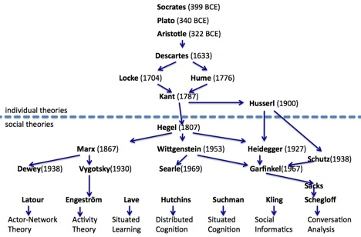
History of theory and the expanded unit of analysis

Slide 8
No longer really Conversation Analysis (CA)
But ethnomethodological Chat Analysis
How do participants in math chats “do math”, maintain chat, construct “social order”, define “member methods”?
How are shared meanings and math objects co-constructed by the group as inter-subjectively shared? (e.g., symbolic artifacts that are meaningful for the group, e.g., words, themes, symbols, procedures)

Slide 9
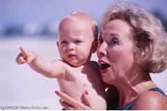
An infant and adult share a meaningful gesture at a shared object

Slide 10
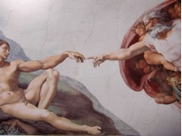
Let there be pointing

Slide 11
Conclusion
Focus on a specific project, artifact, intervention or experimental manipulation—but be aware of the multiple dimensions of alternative possibilities and issues.
Stay grounded in the specific focus and what you can find in your data, but consider how that data might look with other conceptualizations.
Build your argument, but take seriously counter-arguments from other perspectives.
Work respectfully with people from different intellectual traditions and invite them to collaborate and bring their approaches to your project.
Advances in CSCL will increasingly come from multidisciplinary research labs and from global collaborations.

Slide 12
Full paper: http://GerryStahl.net/pub/cts2011.pdf eLibrary of my writings: http://GerryStahl.net/pub/cts2011.pdf Journal of CSCL: http://ijCSCL.org

