Slide 1
“The Structure of Collaborative Problem Solving in a
Virtual Math Team”
Gerry Stahl

Slide 2
How does (group) cognition take place (and how can it be analyzed) in a (paradigmatic) CSCL setting?
Cognitive accomplishments can be achieved by small groups, mediated by technological media, tools, resources
Cognition can take place primarily as textual discourse
Research can now capture adequate traces of meaning making, problem solving, knowledge building, group cognition

Slide 3
Talk overview: show social construction of mathematical meaning through collaboration and argumentation
The hierarchy of levels of temporal structure for online collaboration
The sequential structure of collaborative math discourse
Virtual Math Teams case study
10 discourse moves (in detail)
Group cognition in math

Slide 4
Hierarchy of structural layers
1. Group event: E.g., Team B’s participation in the VMT Spring Fest 2006.
2. Temporal session: Session 4 of Team B on the afternoon of May 18, 2006.
3. Conversational topic: E.g., determining the number of sticks in a diamond pattern. (A longer sequence.)
4. Discourse move: A sequential accomplishment built on an elementary interchange.
5. Adjacency pair: A base interaction involving two or three utterances, which drives a discourse move.
6. Textual utterance: A text chat posting by an individual participant, which may contribute to an adjacency pair.
7. Indexical reference: An element of a textual utterance that points to a resource in the context.

Slide 5
The Problem of Intersubjectivity and Common Ground
The precondition of collaborative learning is that the participants understand each other enough to accomplish their work
This includes tacit background knowledge and explicit shared understanding of the current topic
In cognitive science, grounding of shared understanding is treated as the explicit comparison of mental models or internal opinions; in our analysis, it is the result of interactional work in which a shared world is created and various methods are used to ensure a sharing of this world

Slide 6
“Longer sequences” in CSCL
The sequential structure of collaborative math discourse
The problem of longer sequences
Between CA (conversation analysis – e.g., Sacks, Schegloff) and DA (discourse analysis – e.g., Gee)
Between utterances or adjacency pairs & identity or ideology issues
Science of small-group cognition between individual unit of analysis & communities of practice

Slide 7
“Longer sequences” in CA
Conversation Analysis (CA): Sacks (1962), Schegloff (2007), etc. looks at how people construct their interactions, e.g., with turn taking and adjacency-pair responses
Traditionally focused on adult, American, face-to-face, informal speech
Needs to be adapted to online text
Needs to be extended from adjacency pairs to longer sequences that accomplish cognitive tasks by groups

Slide 8
The VMT environment

Slide 9
Case study topic

Slide 10
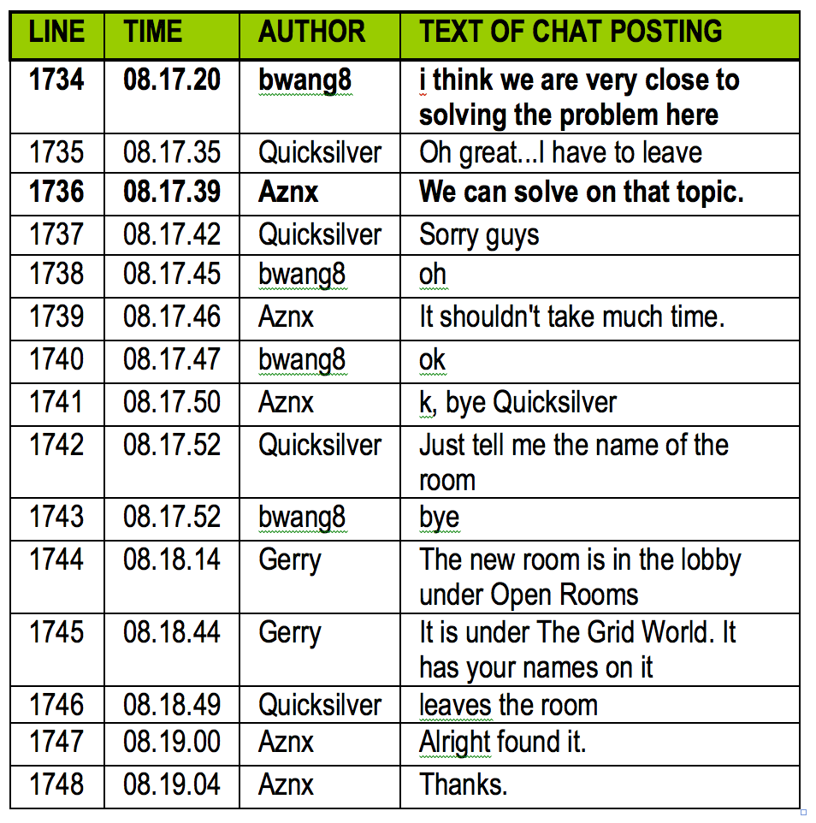
Select a problem

Slide 11
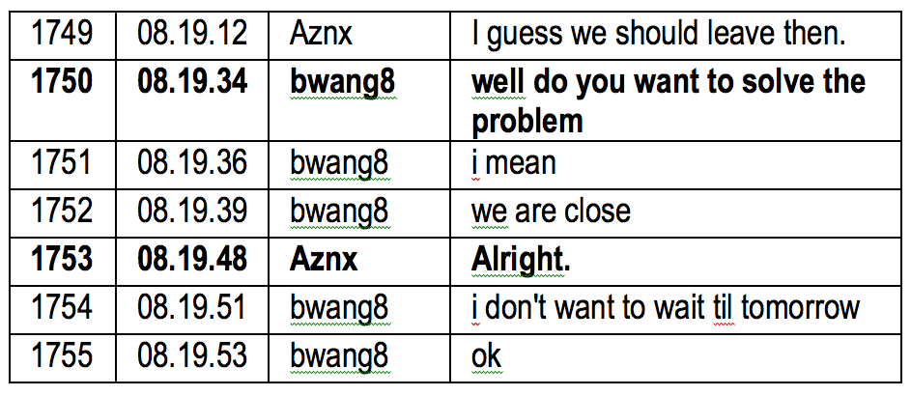
Decide to start

Slide 12
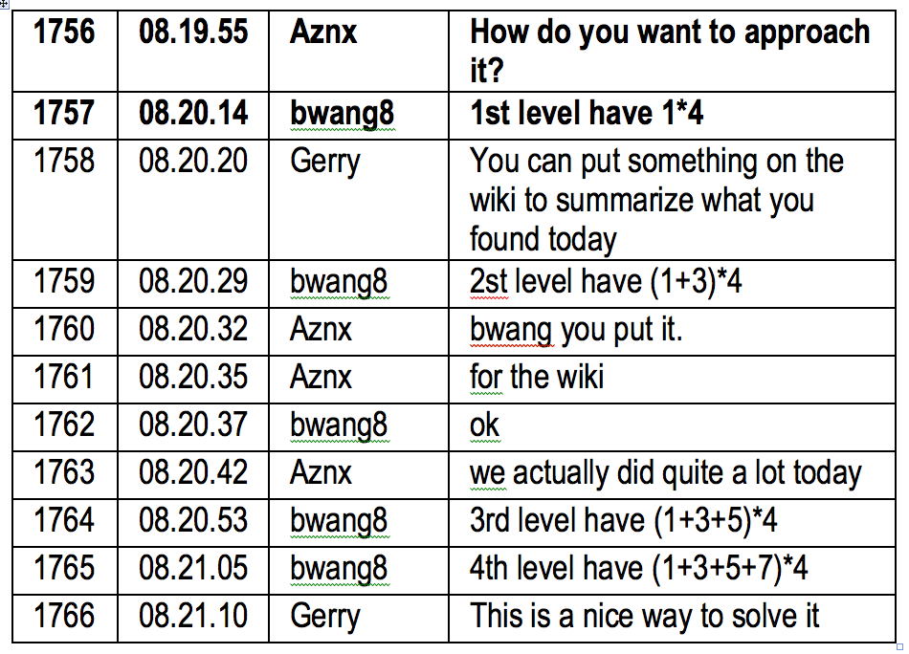
Pick an approach

Slide 13
Identify the pattern

Slide 14
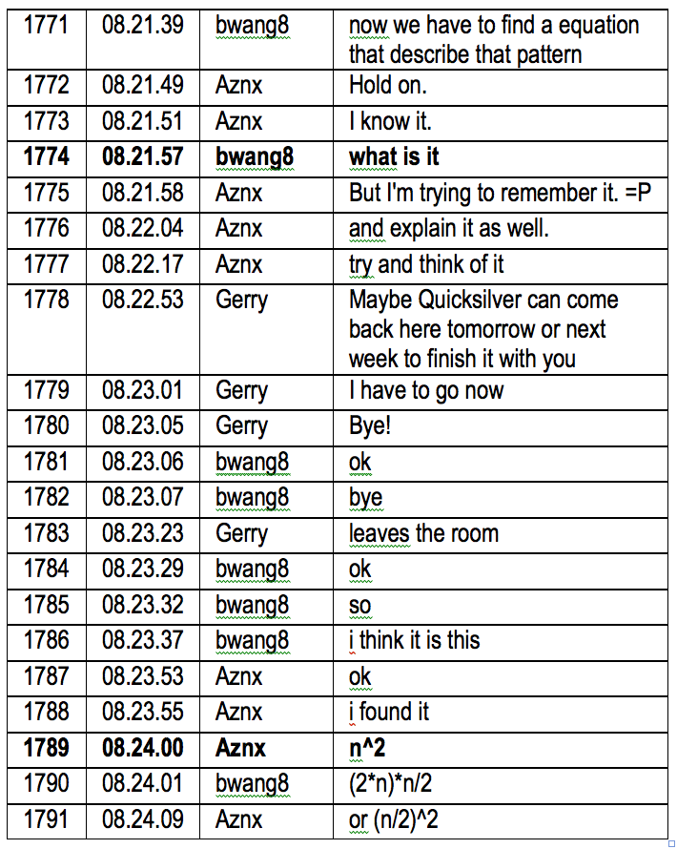
Seek the equation

Slide 15
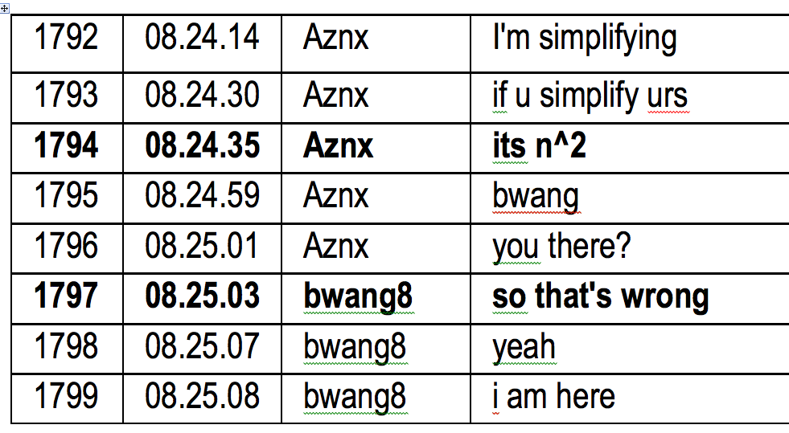
Negotiate the solution

Slide 16
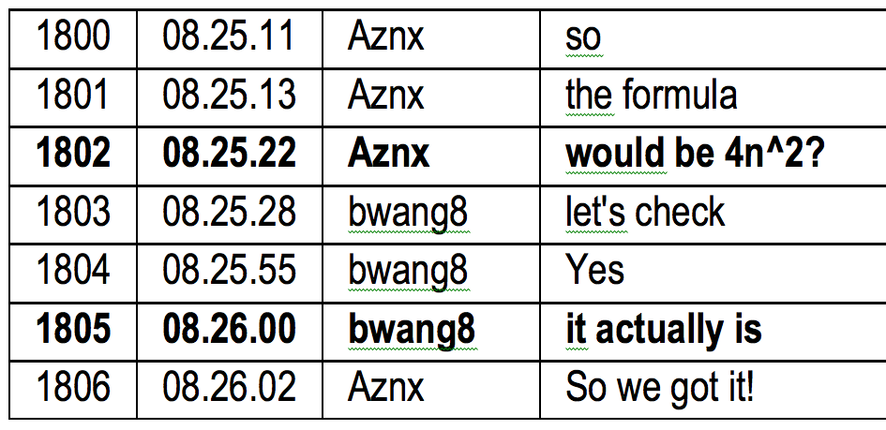
Check cases

Slide 17
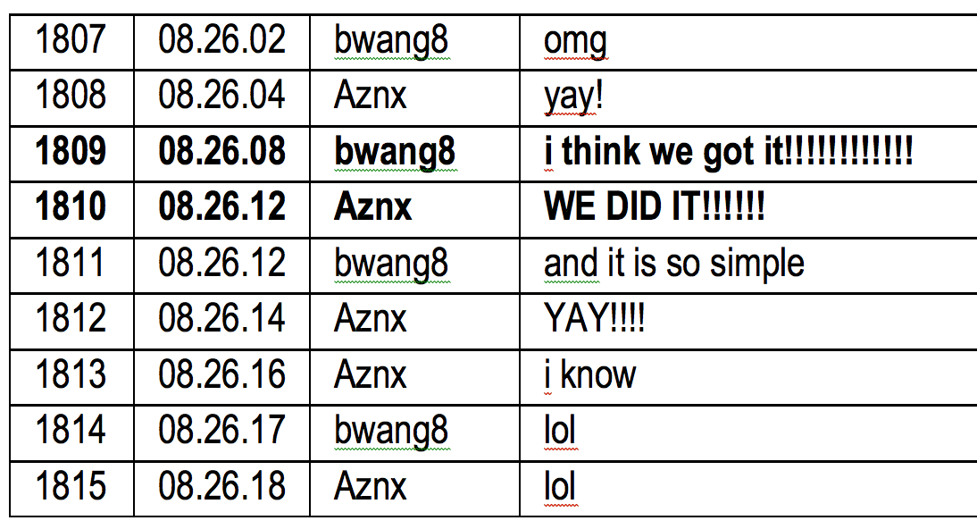
Celebrate the solution:
the “Aha” moment in math

Slide 18
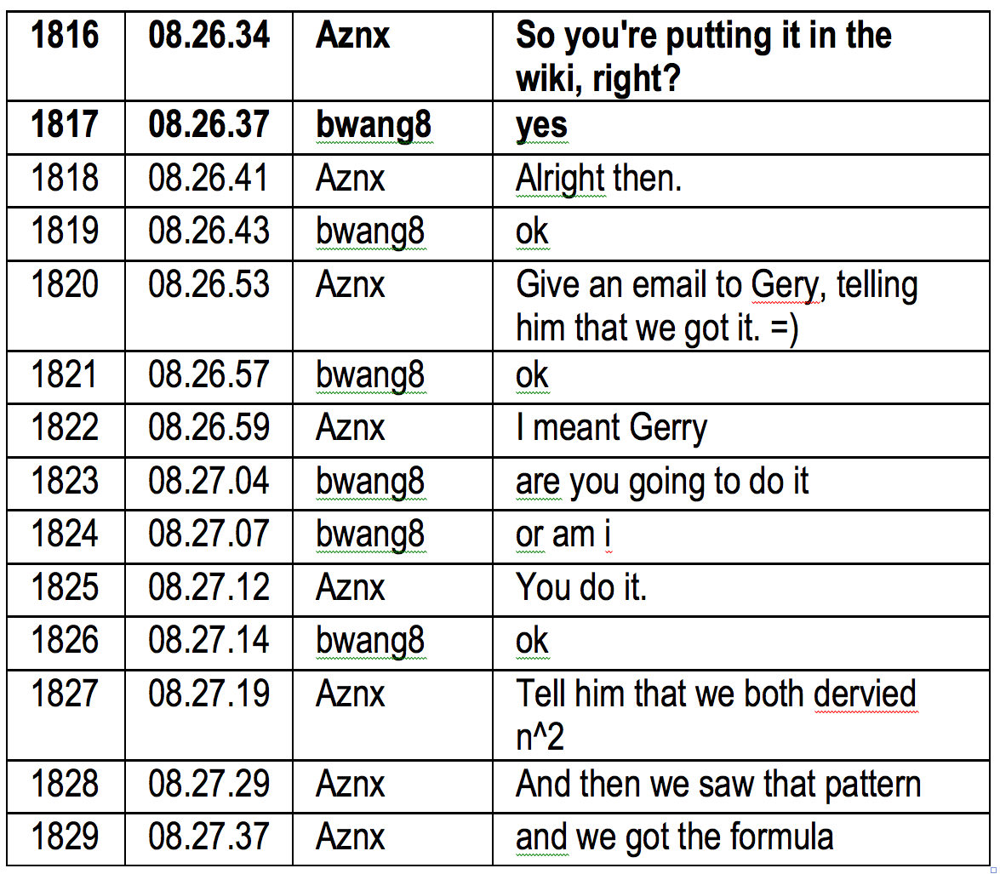
Present a formal solution (proof)

Slide 19
Close the topic

Slide 20
Group cognition in math:
The sequential structure
The sequential structure of collaborative math discourse?
Longer sequence is 10 discourse moves, each built on an adjacency pair
Together, they accomplish group cognitive problem solving
Structure of collaborative knowledge building: longer sequence of discourse moves, each at the group (interactional) unit of analysis

Slide 21
Group cognition in math:
The longer-sequence structure
Log 1. Open the topic
Log 2. Decide to start
Log 3. Pick an approach
Log 4. Identify the pattern
Log 5. Seek the equation
Log 6. Negotiate the solution
Log 7. Check cases
Log 8. Confirm the solution
Log 9. Present a formal solution
Log 10. Close the topic

Slide 22
Group cognition in math: the learning (knowledge building)
The group solved a math problem that had eluded the larger group and that another group had gotten wrong
They did this through a longer sequence of 10 interactional discourse moves
Each move was a mundane (everyday) practice of discourse
The problem solving took place in the discourse, not in private mental space
Knowledge building could be observed and analyzed in detail
Math facts and procedures were not the focus (happened “between the lines”)

Slide 23
Meaning making
Details of how the group co-constructs meaning:
The symbolic expression “4n²” as meaningful to the group
Analyzed from traces of the participants’ perspective (ethnomethodology)
Multi-modal movement: visual reasoning, narrative description, symbolic abstraction

Slide 24
Analysis of group cognition
First detailed analysis of a “longer sequence”
Showed how it is a sequence of discourse moves each built on an adjacency pair
Shows how the group – as a group, not as an expression of individual mental acts – accomplished problem solving in a socio-technical environment
An example of a microanalysis of group cognition in an online team of students discussing math

Slide 25
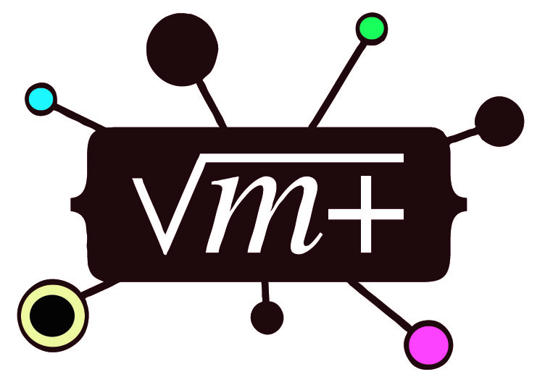
For Further Information:
“Group Cognition” (2006, MIT Press)
“Studying Virtual Math Teams” (2009, Springer)
*** now in paperback ***
This paper: GerryStahl.net/pub/cscl2011stahl.pdf
These slides: GerryStahl.net/pub/cscl2011stahl.ppt.pdf
website: GerryStahl.net
email: Gerry@GerryStahl.net

