Slide 1
“Group-Cognition Theory and Knowledge-Building Analysis”
Gerry Stahl

Slide 2
Overview
History of Theory
Role of Group-Cognition Theory
Analyses of Knowledge Building
Inquiries Concerning Knowledge Building

Slide 3
History of Theory
Platonic idea: good, truth, beauty, justice
(individual concept or “idea”)
Cartesian ego cogito
(individual mind)
Psychological individual
Situated, embodied action
Distributed cognition and artifacts
Communities of practice, social practices
Group cognition

Slide 5
Group Cognition
Small groups are the engines of knowledge building. The knowing that groups build up in manifold forms is what becomes internalized by their members as individual learning and externalized in their communities as certifiable knowledge” (Stahl, 2006, Group Cognition, p.16).
The level of the small group has a theoretical priority (Stahl, 2011, Theories of Collaboration)
We need a science of group interaction to complement – and ground – sciences of individuals and communities (Stahl, 2010, Science of Group)

Slide 7
Primary Levels of Analysis
of Knowledge Building
The small group interactions build knowledge through group practices of inquiry, elicitation, proposals, pointing out, seeing together, bringing different perspectives, clarifying, questioning, agreeing, ….
Individuals may subsequently internalize these inquiry methods as silent thinking
Communities may subsequently institutionalize these inquiry methods as artifacts

Slide 9
Some of My Analyses of How
Knowledge Building is “Done”
Baseline case study of face-to-face collaboration: Parallel talk
Face-to-face with computer simulation: Seeing an artifact as meaningfully structured
Pointing in an online environment: Being-there-together
The structure of problem solving: A sequence of mundane adjacency pairs
Co-experiencing a shared virtual world: Seeing a drawing as a mathematical object

Slide 10
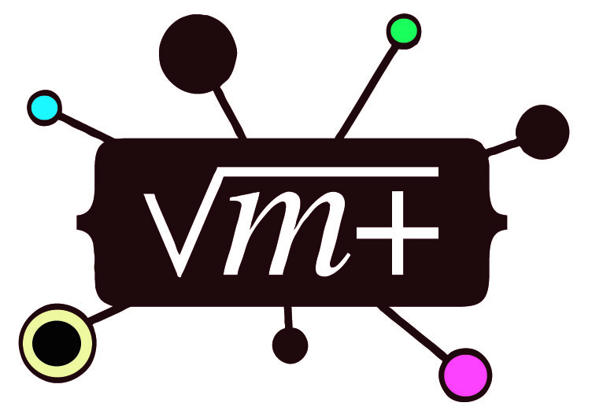
Baseline case study of face-to-face collaboration: Parallel talk
Stahl, 2009, Studying Virtual Math Teams, p. 516

Slide 11
Face-to-face with computer simulation: Seeing an artifact as meaningfully structured
Stahl, 2009, Group Cognition, p. 242

Slide 12
Pointing in an online environment: Being-there-together
Stahl, 2006, Supporting Group Cognition, JECR

Slide 13
The structure of problem solving: A sequence of mundane adjacency pairs
Log 1. Open the topic
Log 2. Decide to start
Log 3. Pick an approach
Log 4. Identify the pattern
Log 5. Seek the equation
Log 6. Negotiate the solution
Log 7. Check cases
Log 8. Confirm the solution
Log 9. Present a formal solution
Log 10. Close the topic
Stahl, 2011, How a VMT Structured, CSCL 2011

Slide 14
Co-experiencing a shared virtual world: Seeing a drawing as a mathematical object
Stahl, 2011, Seeing What We Mean, CSCL 2011

Slide 15
Inquiries concerning Knowledge Building and Epistemic Artifacts
The remaining slides try to push inquiry concerning knowledge building, design-mode learning and epistemic artifacts
They do not present answers; formulating the questions is hard enough ;-)

Slide 16
Inquiry #1
What is the most effective unit for supporting knowledge building with CSCL tools and environments?
The individual learner
The small group interaction
The community or classroom

Slide 17
Inquiry #2
What is the most effective medium for supporting knowledge building with CSCL tools and environments?
Synchronous – to provide immediate response and a sense of engaging dialog
Asynchronous – to provide time for individual reflection

Slide 18
Inquiry #3
Do we really want to improve individual ideas or do we want to develop more extended and refined networks of ideas?
Newton’s and Einstein’s concepts of “gravity” were defined in terms of networks of concepts of force, mass, acceleration, space, time, etc.

Slide 19
Inquiry #4
Should an inquiry concerning knowledge building aim to develop a single, comprehensive theory or should it aim to refine and consider a set of overlapping, but possibly incommensurable theories?
Knowledge building involves many actors, conditions, levels of analysis, temporal scales, disciplinary contents, etc.

Slide 20
Inquiry #5
Is it enough for analysis to establish that ideas are refined and that epistemological artifacts are produced?
How does this happen?
What are the group practices involved?
How can these be supported by CSCL tools?

Slide 21
Inquiry #6
In evolutionary terms, did the isolated individual mind come first, only later to be extended with external memory and epistemological artifacts (Donald)?
Are higher human cognitive functions internalizations of practices and artifacts first experienced intersubjectively?
VMT case studies tend to confirm Vygotsky’s hypothesis

Slide 22
Inquiry #7
How can we ensure that theory of knowledge building is grounded in actual group practices?
Theory can develop as reflection upon case studies of small-group interactions
Theoretical hypotheses can motivate focused analyses of actual interactions
When possible, theoretical presentations should include case study analyses

Slide 23
For Further Information:
“Group Cognition” (2006, MIT Press)
“Studying Virtual Math Teams” (2009, Springer, now in paperback)
Gerry Stahl’s e-Library (collections of papers free for iPad, Kindle, PDF or low-cost print-on-demand): GerryStahl.net/elibrary
This paper: GerryStahl.net/pub/cscl2011theories.pdf
These slides: GerryStahl.net/pub/cscl2011theories.ppt.pdf
website: GerryStahl.net
email: Gerry@GerryStahl.net

