Slide 1
The Integration of Cognitive Levels
Gerry Stahl

Slide 2
The Integration of Cognitive Levels Gerry Stahl
Main claim: a math topic can integrate individual skills, group collaboration & community knowledge.
Illustrative resource: a challenging dynamic-geometry topic (pattern of sticks in a diamond pattern, segments in a hexagon array, inscribed polygons).
Supporting data: Virtual Math Team session by teachers (100 hours) and students (800 hours).
Current status: analysis underway of 8-session series; sessions to be repeated next year.

Slide 3
Pattern of sticks in diamond

Slide 4
Longer sequence of interactions (adjacency pairs)
Persistent co-attention to problem-solving process
Shared understanding of problem & solution
Community contributes problem & standards of math discourse
Individual contributes computations, math content, candidate solutions
Group organizes, negotiates, accepts

Slide 5
Segments of a hexagon array

Slide 6
Being-there-together at the math object as seen by the group
Wait!!! The group cannot continue until everyone sees the same
The group has a shared understanding from the same perspective
The shared view is locally created and repaired constantly
The group develops group practices to see the same: deictic pointing, highlighting with colors, lines, arrows, names, ….
Math: “hexagon”; group: inscription; individual: understanding

Slide 7
Inscribed polygons

Slide 8
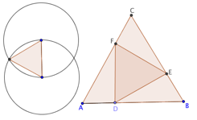
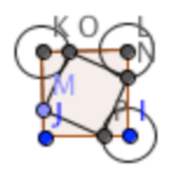
Community: Euclid’s 1st proposition (construct equilateral triangle), problem of inscribed triangles, definitions of regular polygons.
Individual: perception of equal lengths, coordinated movements, explorative dragging, memory of similar problem solutions
Small group: group practices of taking turns, dragging, coloring, naming, discussing
Group cognition: shared attention, collaborative discourse, joint solution

Slide 9
Further Reading
Stahl, G. (2012). Traversing planes of learning. ijCSCL. 7(4), 467-473.
Stahl, G. (2013). Learning across levels. ijCSCL. 8(1), 1-12.
Stahl, G. (2013). Transactive discourse in CSCL. ijCSCL. 8(2).
Stahl, G. (2013). Translating Euclid: Creating a human-centered mathematics: Morgan & Claypool Publishers. Web: http://gerrystahl.net/elibrary/euclid.
Stahl, G. (2013). Workshop presentation: The integration of cognitive levels. Presented at CSCL 2013. Web: http://GerryStahl.net/pub/cscl2013levels.pdf.

Slide 10
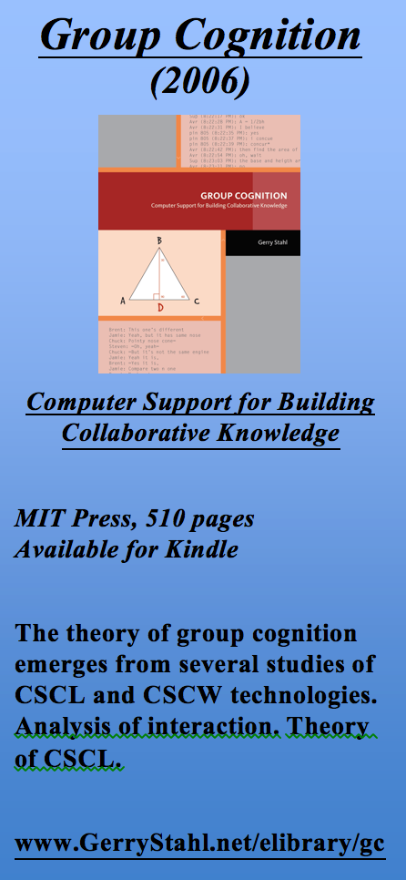
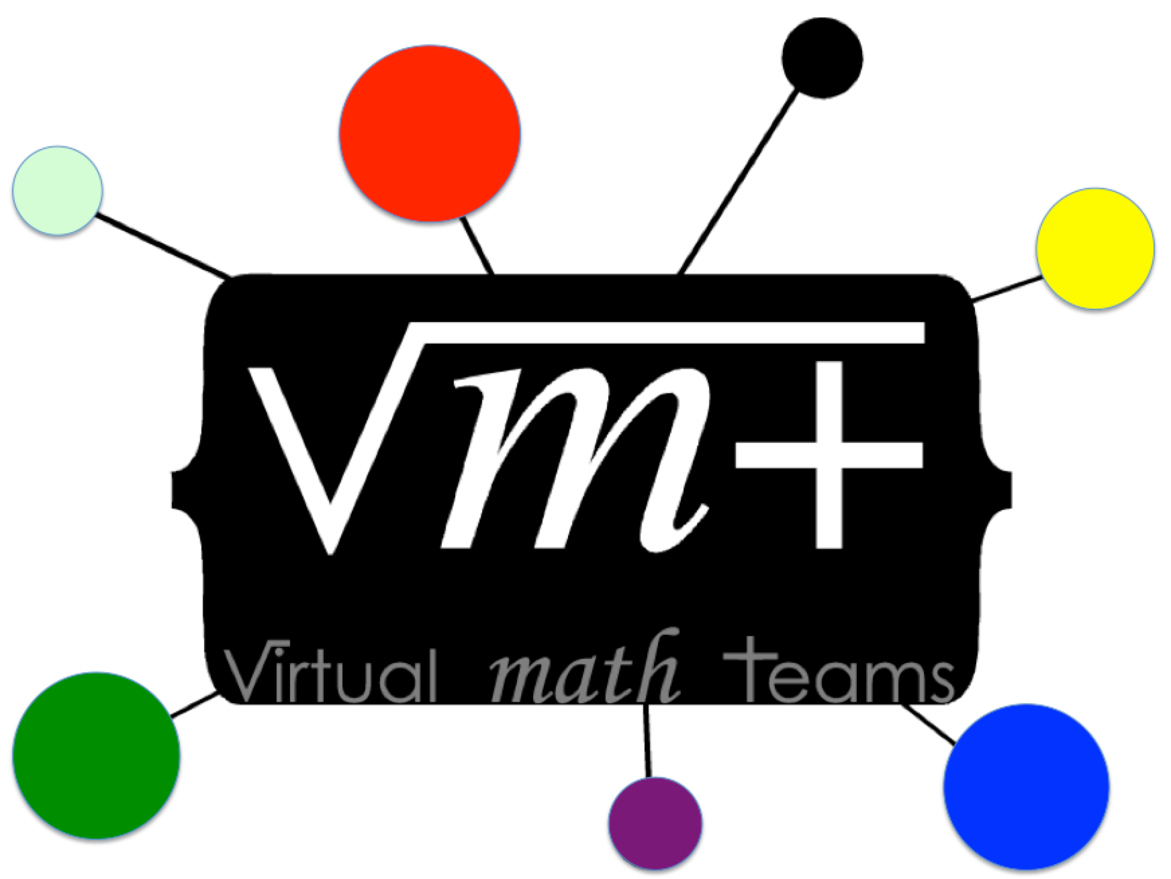
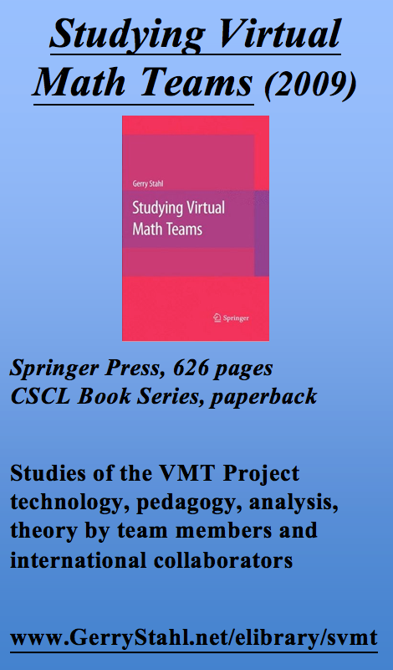
The Virtual Math Teams Trilogy

