Slide 1
CSCL in North America
Gerry Stahl

Slide 2
Origins and Early Stages
1989 in Maratea, Italy
largely AI in Ed
BBN, Bank Street, educational software
ENFI Project at Gallaudet University
Scardamalia & Bereiter’s CSILE project
Cole’s Fifth Dimension Project at UCSD
Brown and Campione’s guided discovery
Bransford’s Jasper Project
CSCL in North America (Bloomington, Toronto, Stanford, Boulder)
ISLS established in 2002 at Boulder

Slide 3
Research Questions, Concepts and Methods
Use CSCL innovations as lever to transform education: student-centered (Papert), inquiry-based (Dewey) or constructivist (Vygotsky, edited translation)—by promoting collaborative learning
Research questions: design of technology, analysis of collaborative learning, evaluation of learning outcomes

Slide 4
Research Questions, Concepts and Methods
Methodology: traditions of quantitative and qualitative research in educational psychology and the social sciences
coding-and-counting
controlled experiments with pre and post tests
descriptive statistics of self-report surveys
qualitative case studies

Slide 5
Contributions to CSCL Research
collaborative learning vs. cooperative group work (Johnson & Johnson, Slavin)
Ethnomethodology & Conversation Analysis; Discourse Analysis
Institute for Research in Learning in Palo Alto in the 1980s: Lave, Wenger, Suchman, Roschelle, J.S. Brown, Pea, Greeno
Distributed cognition in San Diego
Learning Research and Development Center in Pittsburgh
Design studies, design-based research, qualitative case studies

Slide 6
Different Disciplines
CSCL requires interdisciplinarity and internationalization
Multi-methods, multi-vocality, integration of research at different units of analysis (e.g., individual, small group, community)
New methods to deal with the complexities of CSCL research agendas

Slide 7
Future Trajectories
CSCL is international; no special NA role
Perhaps the most important role for North American researchers is to train & mentor future CSCL researchers from underdeveloped parts of the world
Educational practice and CSCL expertise development is quite uneven, even within NA

Slide 8
While many elite universities in world capitals have recognized CSCL labs, whole continents (Africa, the Middle East, India and most of Asia, much of Latin America) do not
CSCL as a profession still generally requires apprenticeship experiences; NA CSCL researchers could mentor students and colleagues from other countries
CSCL technologies and approaches could be adapted for this

Slide 9
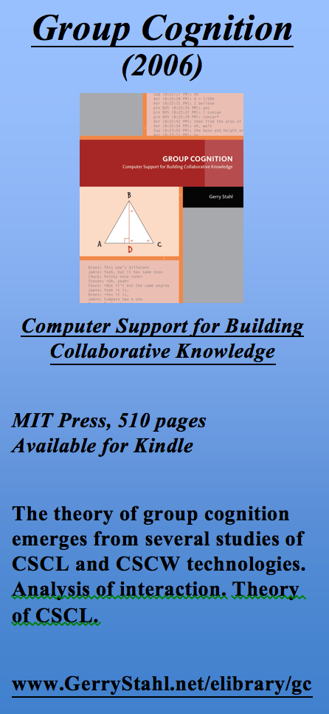
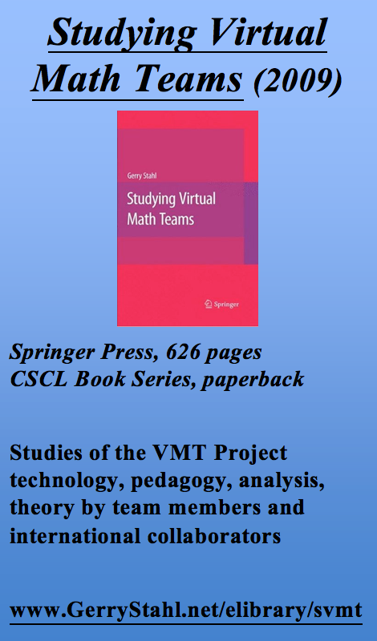
My own contribution: the VMT trilogy

