Slide 1
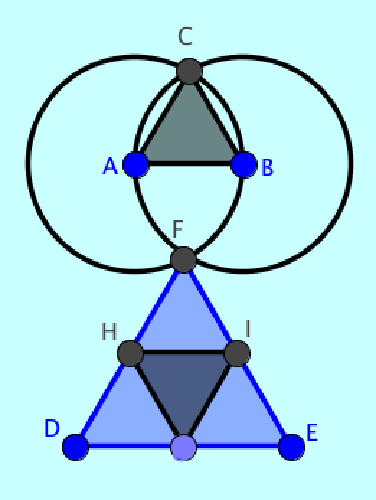
A Digital Didactic Design for
Group Cognition
University of Umea, Sweden
June 2015
Gerry Stahl

Slide 2
Beyond DDD studies of iPad usage
Learning is treated as an individual mental activity, pursued by students listening, reading, doing homework and taking tests on their own.
Geometry is taught as a collection of facts: definitions, theorems, procedures.
Teaching is primarily didactic, with presentations by a teacher and readings in a textbook.
Geometric figures are presented statically by the teacher or textbook.
Students seldom construct geometric figures themselves.
Students are rarely exposed to geometric proofs and deductive argumentation.

Slide 3
A Digital Didactic Design for Group Cognition
Virtual Math Teams as an example of DDD
DDD and CSCL as designing for group cognition
The socio-technical design of VMT
VMT as design-based research in group cognition
The centrality of group cognition to learning
Expanding VMT to CrossActionSpaces

Slide 4
1. Virtual Math Teams as an example of DDD
Teaching Aim: To provide students with hands on experience working on challenging geometry problems. (extend Math Forum problems-of-the-week)
Learning Activities: Collaborative math: co-constructing geometry figures and exploring them together. (networked computers, multi-user apps)
Process-based Assessment: Sequential interaction analysis of chat logs and geometry actions. (EM)

Slide 5
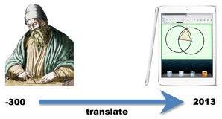
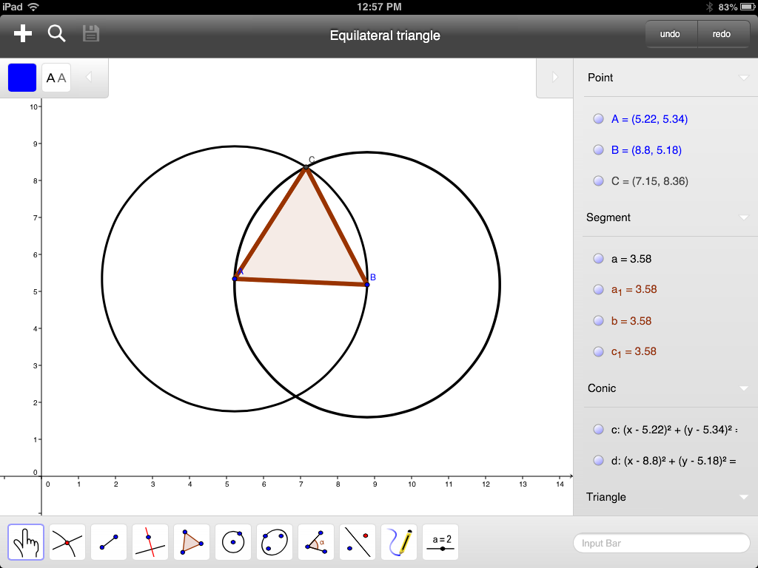
Translating geometry education from clay tablets to iPad tablets
Notes:
This image symbolizes my research question involving a translation from one point in time to another..
When I created this graphic in 2013, I had to photoshop the image of GeoGebra on an iPad.
By 2014, I was able to capture an image of GeoGebra on my iPad.
That is how fast this field is changing!

Slide 6
A specific DDD Research Question:
How should one translate the classic-education approach of Euclid’s geometry into the contemporary vernacular of social networking, computer visualization, and discourse-centered pedagogy?
VMT as a response:
A multi-dimensional, iteratively evolving design-based research (DBR) approach to designing a human-centered, 21st century geometry education using computer-supported collaborative learning (CSCL).
Notes:
This is how I formulate my Research Question.

Slide 7
VMT-mobile on an iPad

Slide 8
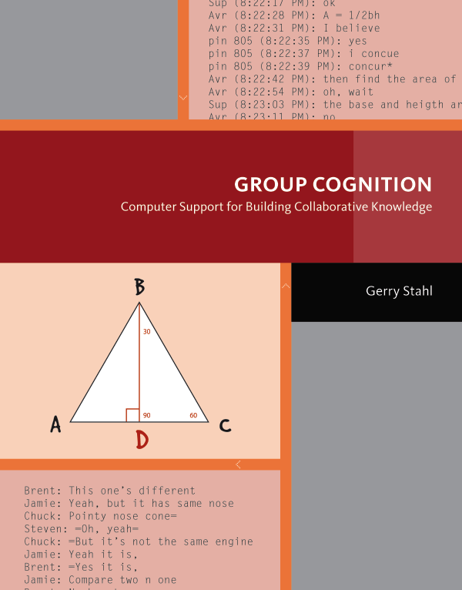
2. DDD and CSCL as designing for group cognition
Networked computers and tablets allows global collaborative learning – but need special apps, curriculum, pedagogy, incentives, social context.
Small group as engine of knowledge building!
VMT research project designed to demonstrate potential of CSCL.
Group Cognition: Computer Support for Building Collaborative Knowledge. 2006. MIT Press

Slide 9
Small-Group
Interactional resources
Group Outcomes
Group
Knowledge
Artifacts
Interaction
Context
Sequential
Small-Group
Interaction
Technology & Media
Community
Individual
Voices
Culture of
Discourse
Community
Individuals’
Resources &
Experiences
Individual
Levels of analysis connected by interactional resources
Notes:
The learning on all levels takes place largely through the small-group interaction
This is guided and supported by a variety of carefully designed “resources”

Slide 10
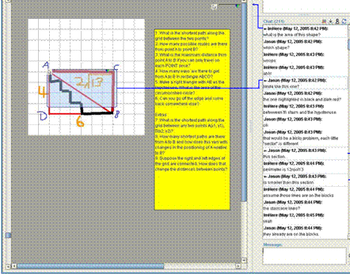
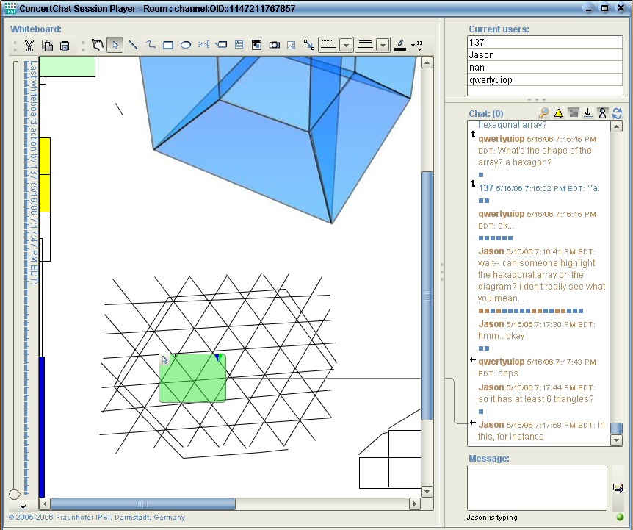
VMT with generic shared whiteboard

Slide 11
Notes:
Above, students are given more complicated constructions
And they are able to create their own custom tools, to package construction sequences

Slide 12
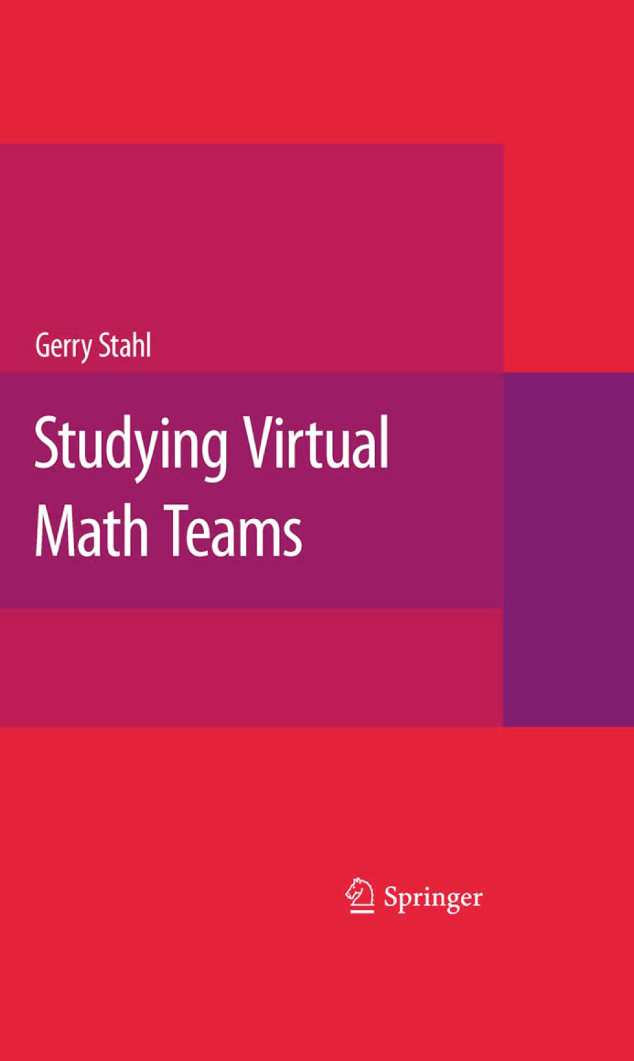
3. The socio-technical design of VMT
The development of VMT took a global team, a decade, many grants, countless trials.
DDD vision, group cognition theory, networked technology, collaboration pedagogy, dynamic-geometry curriculum, DBR iterations, trials by researchers, teachers, students, adoption of EM-CA to analysis of online math logs.
Studying Virtual Math Teams. 2009. Springer.

Slide 13
VMT with multiple GeoGebra tabs
Notes:
Now the VMT environment can include multiple GeoGebra tabs
They are integrated with the chat communication channel
And many other features for collaborative learning.

Slide 14
Building the technology
Geometer’s Sketchpad, Cabri, etc. pioneered the creation of dynamic geometry
GeoGebra makes it freely available and integrated with other math (3-d, algebra, statistics, spreadsheet, trig, calculus, etc.)
VMT provides a collaboration environment and integrates the first multi-user dynamic geometry
The next slides describe the design of the Virtual Math Teams (VMT) online environment
Notes:
To support collaborative learning (CSCL), we had to redesign GeoGebra to be multi-user
For online collaboration

Slide 15
Integration with GeoGebra
Remote students can synchronously work on a shared construction together.
Users can take turns manipulating the construction.
  Adding, deleting, modifying and moving objects
The construction will stay in sync on each user's screen.
Users can chat about the problem as they work.
Notes:
Students can collaborate in real time on a shared construction.

Slide 16
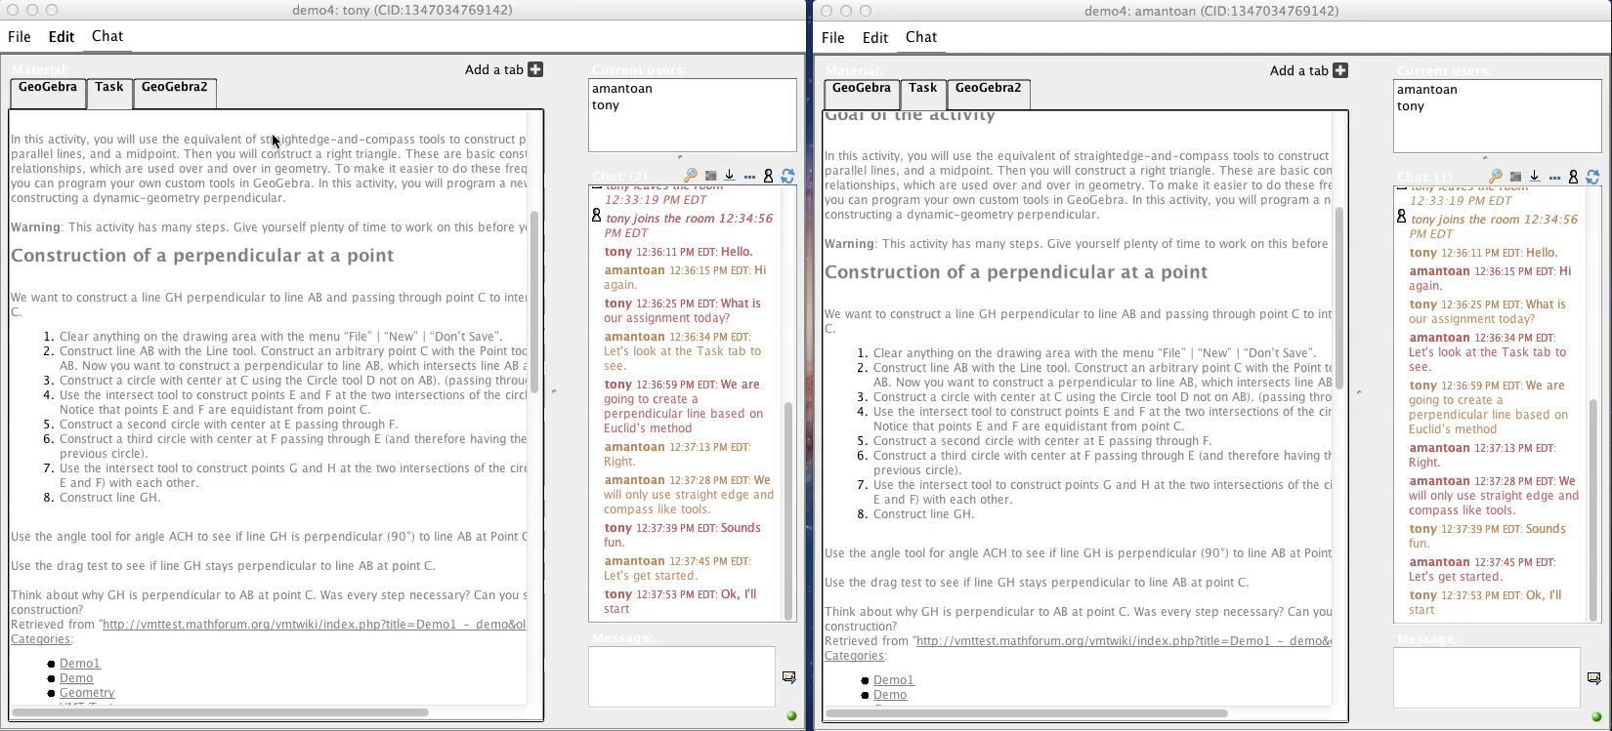
Multi-user GeoGebra
Notes:
Show movie

Slide 17
Other Shared Tools
Shared Whiteboard
  Users can doodle on the shared whiteboard
  Draw simple shapes
  Summarize work, draft shared statements, note observations or hypotheses in text boxes
  History of the whiteboard is also tracked.
Web browser
  Simple web browser
  Can be used to show instructions for the student's assignments or other related information on the web.
Notes:
There are several other kinds of tabs in VMT
To support individual, group and classroom-wide learning

Slide 18
History Tracker
Built-in history tracker allows users to scroll back and forth in time to see how the construction developed.
Shows everything that happened including style changes and object movements.
Each GeoGebra workspace is tracked separately.

Slide 19
VMT has built in tools for session analysis
VMT records every chat, and action in the session.
Provides a session replayer to go back and forth through the session step by step.
Chat, whiteboard, and GeoGebra events all playback in the order they occurred in the original session.
Notes:
Tools allow review by students, teachers, and researchers
For reflection, evaluation and analysis

Slide 20
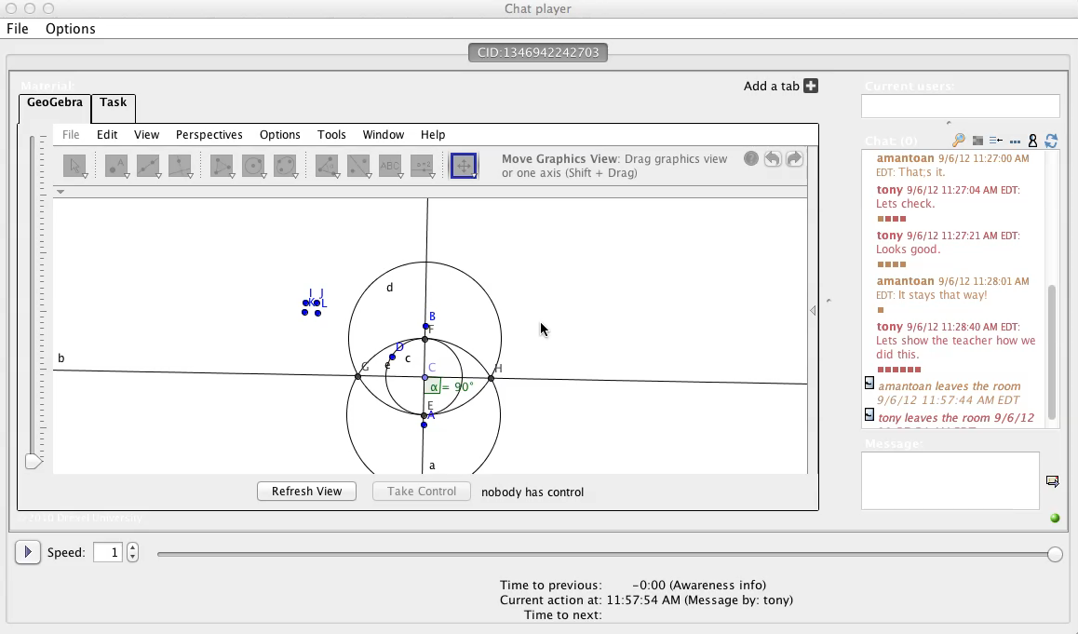
The VMT Session Replayer
Notes:
Play movie

Slide 21
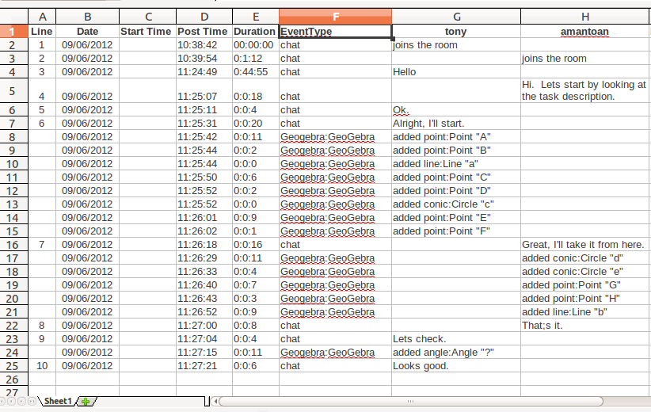
Session Log Files
Notes:
Logs can be displayed with a different column for each student’s chat postings
They can be filtered to display chat positings, GeoGebra events and system messages
Like a student entered or left the chat room or opened a different tab or chose a GeoGebra tool

Slide 22
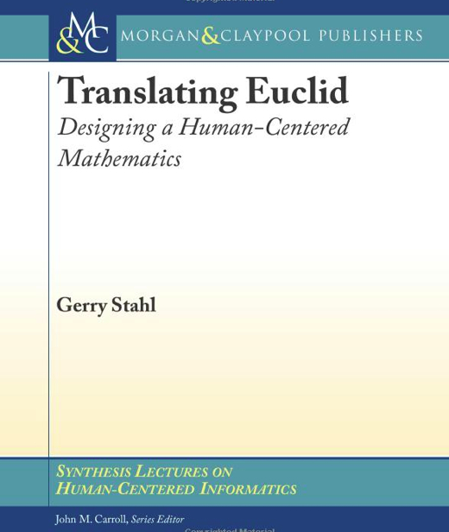
4. VMT as design-based research into group cognition
Pedagogic goals (translate Euclid)
Domain-specific curriculum (game)
Social practices of collaboration
Collaboration support technology
DBResearch of group cognition
Translating Euclid: Designing a Human-Centered Mathematics. 2013. Morgan & Claypool.

Slide 23
Design-based research of human-centered geometry
Discover: The curricular topics guide student teams and teacher teams to discover dependencies in dynamic-geometric figures
Create: The curricular topics guide student teams and teacher teams to creatively design and construct dependencies in dynamic-geometric figures
Understand, explain, prove: Students and teachers learn to view geometric truths in terms of constructed dependencies. They begin to see the causality of the world as human/social creative-discovery involving designed dependencies
The VMT Project evolves its pedagogical approach through iterative analysis of interactions among teams of researchers or teachers or students using the technology and resources. The research process is reflected in its publications and presentations.

Slide 24
Pedagogical focus
The approach emphasis includes:
The importance of experiencing first-hand the actual doing of mathematics: exploration, noticing, discovering, wondering, conjecturing, creating, designing, constructing, explaining, understanding, proving, teaching
Resisting the tradition of accepting on authority the definitions and understandings of geometric objects
Resisting the temptation to use GeoGebra just to illustrate geometric facts with pretty figures or flashy simulations
Guiding teachers and students to design their own constructions, including the definition of custom tools
Emphasizing the role of dependencies in dynamic geometry
Notes:
Our approach tries to realize the potential of dynamic geometry
It contrasts in several ways with how dynamic geometry is usually taught
Of course, ours is the first collaborative versions of dynamic geometry

Slide 25
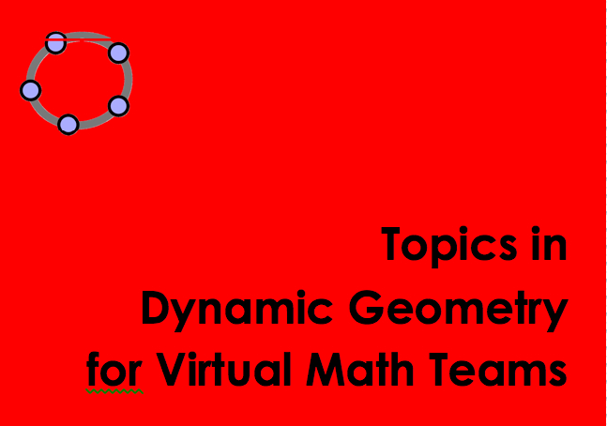
Developing the curricular resources
Although the VMT Project was funded to just develop the technology and analyze its effectiveness, the real problem is to design the pedagogy: approach & resources
We developed a set of about 18 “topics” in a workbook format that included tutorial “tours” of the technology. Each topic was intended for about a one-hour online, synchronous, collaborative session. Each topic included 3 to 10 GeoGebra tabs with guiding tasks
Notes:
We have about 100 GeoGebra tasks or resources designed to guide and support collaborative learning

Slide 26
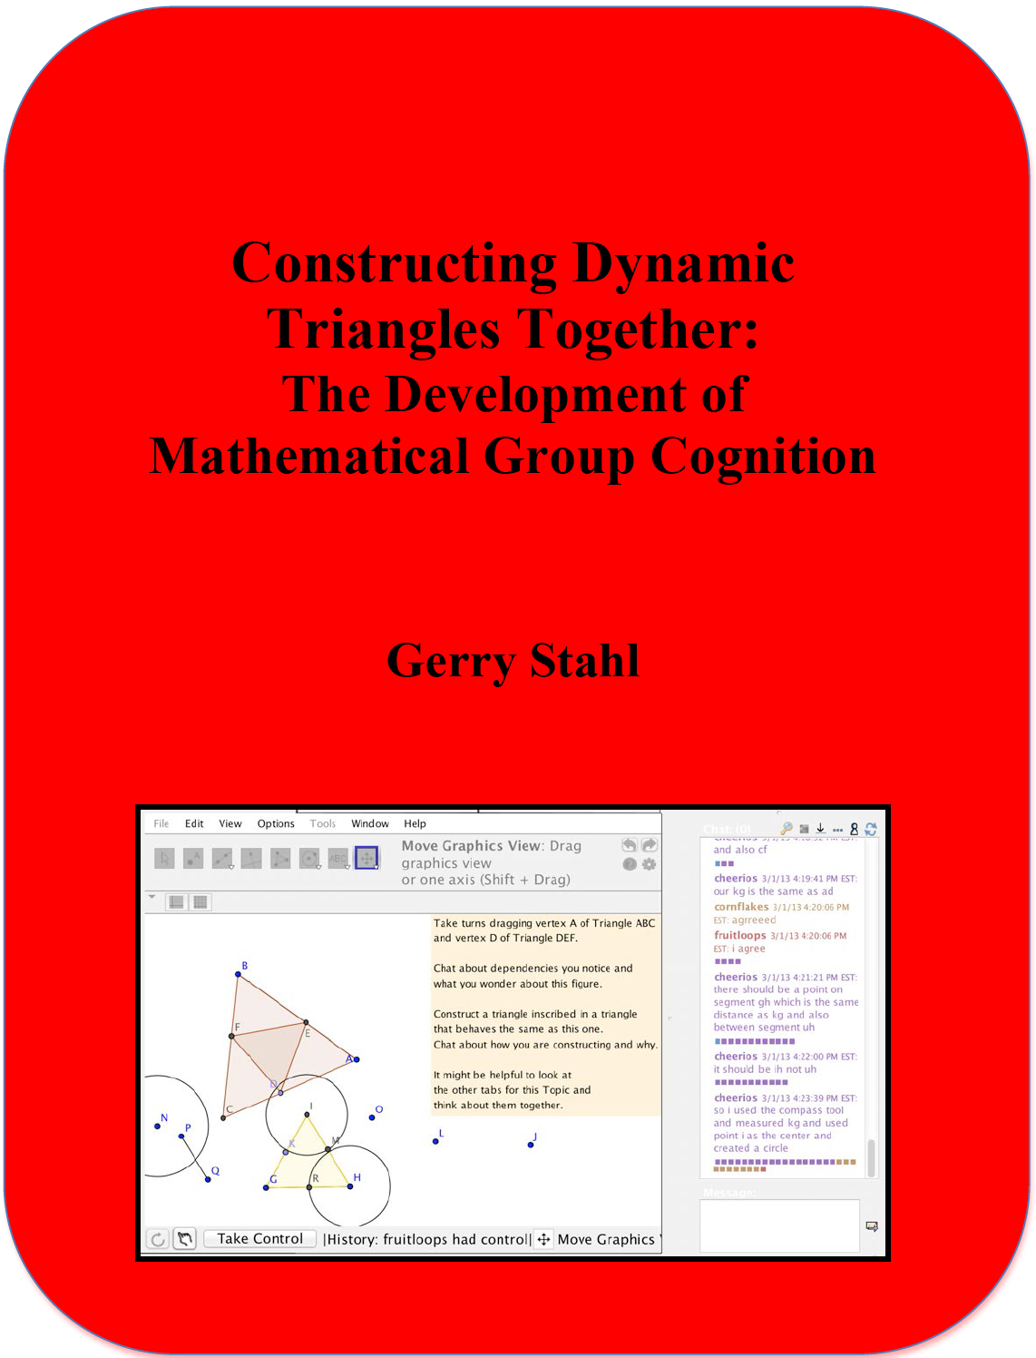
5. The centrality of group cognition to learning
I analyzed the complete process of a team of three 14-yr-old girls learning collaborative dynamic geometry. They worked together online for 8 hour-long sessions.
They learned how to collaborate in VMT, use GeoGebra, discuss math, drag/explore/construct dynamic-geometry figures.
Constructing Dynamic Triangles Together: The Development of Mathematical Group Cognition. 2015. Cambridge University Press

Slide 27
Group cognition as group practices
The Virtual math teams learned by adopting many “group practices”—I identified over 60 in the book.
The adoption process proceeds as follows:
The team is stuck; breakdown in group action
They express that they have a problem
Someone proposes a solution
They discuss it and all agree (explicit knowledge)
Then they adopt it and proceed (practical kn.)
In the future, they do it without discussion (tacit)

Slide 28
Adopting collaboration group practices
Notes:
I will now move from the technology to the collaboration itself

Slide 29
Adopting construction group practices
Notes:
I will now move from the technology to the collaboration itself

Slide 30
Students collaborate on inscribed squares
Notes:
Now Emily’s students do a similar construction with inscribed squares.
They learned how to design in the dependencies for inscribed triangles
And now generalize the design method for squares

Slide 31
6. Expanding VMT to CrossActionSpaces
VMT-mobile: on iPads, laptops, tabletop displays, smart boards
Integration of individual, group, classroom
Community of VMT game players
Community of analysis and discussion of excerpts from VMTeams

Slide 32
The Game
A GeoGebraBook
on GeoGebraTube:
http://ggbtu.be/b154045

Slide 33
DDD: Orchestrating a Collaborative MOOC
Math teacher professional development: VMT, readings, reflection on logs
Teachers form student groups and assign VMT MOOC
Student groups engage in level of VMT game
Individual students practice constructions
Student groups share experiences in class
Teachers reflect on student logs; give feedback
Teachers form, motivate, assign, orchestrate, feedback student teams
VMT provides MOOC content/ collab experience

Slide 34
Teachers collaborate on inscribed triangles
Notes:
A group of teachers during a professional development course explore a pair of inscribed equilateral triangles.
They discover its dependencies and then construct their own, designing in the same dependencies.

Slide 35
Researching the learning processes
Students are asked to identify chat log segments that show effective collaboration and to reflect on what they noticed and wondered about
Teachers are asked to select and reflect on student chat log segments – and to discuss how to improve the resources, approach and experience
Researchers analyze logs and replayer to understand strengths and weaknesses of resources and to investigate how student teams collaboratively master dynamic geometry practices, skills and understanding
Notes:
Students discuss their geometry design work
Their teachers reflect on the student discourse and collaboration
Researchers analyze the interaction to re-design the environment

Slide 36
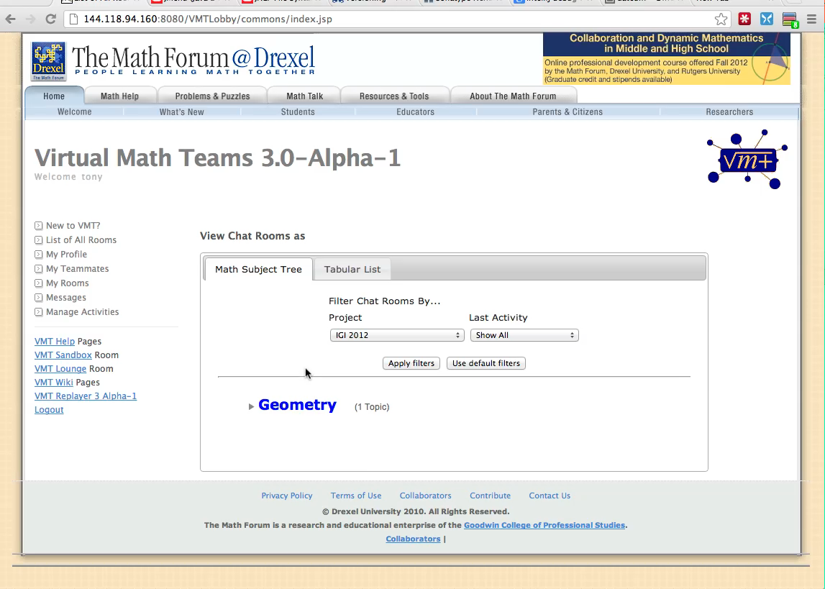
Create your own topic rooms
Notes:
Show movie

Slide 37
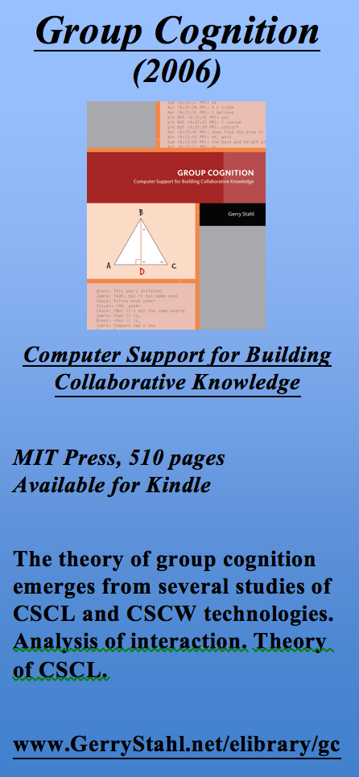
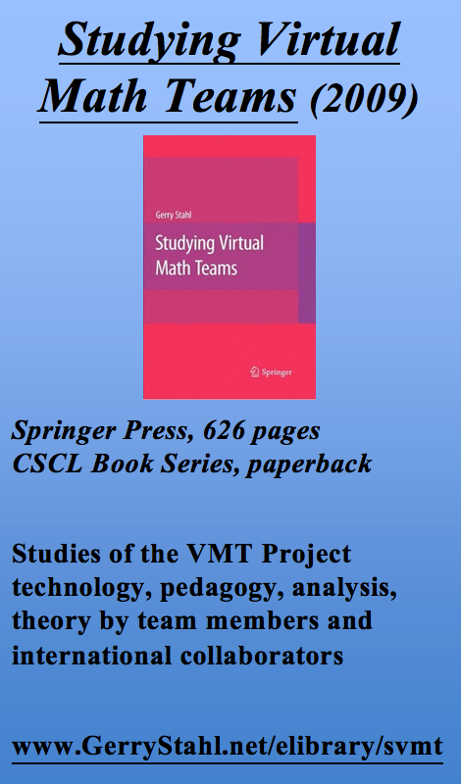
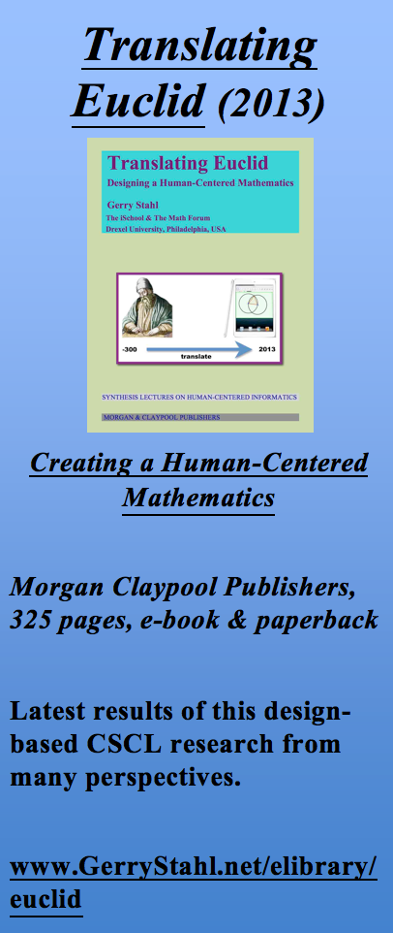
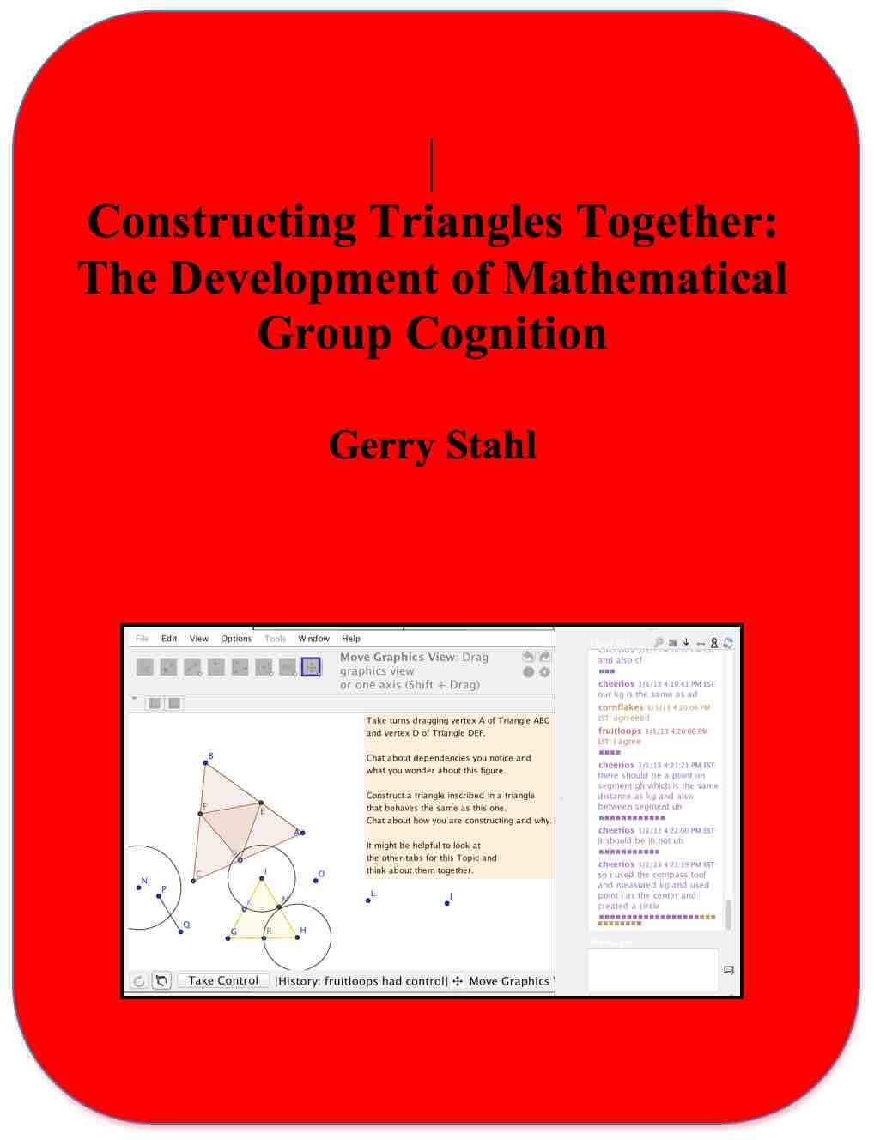
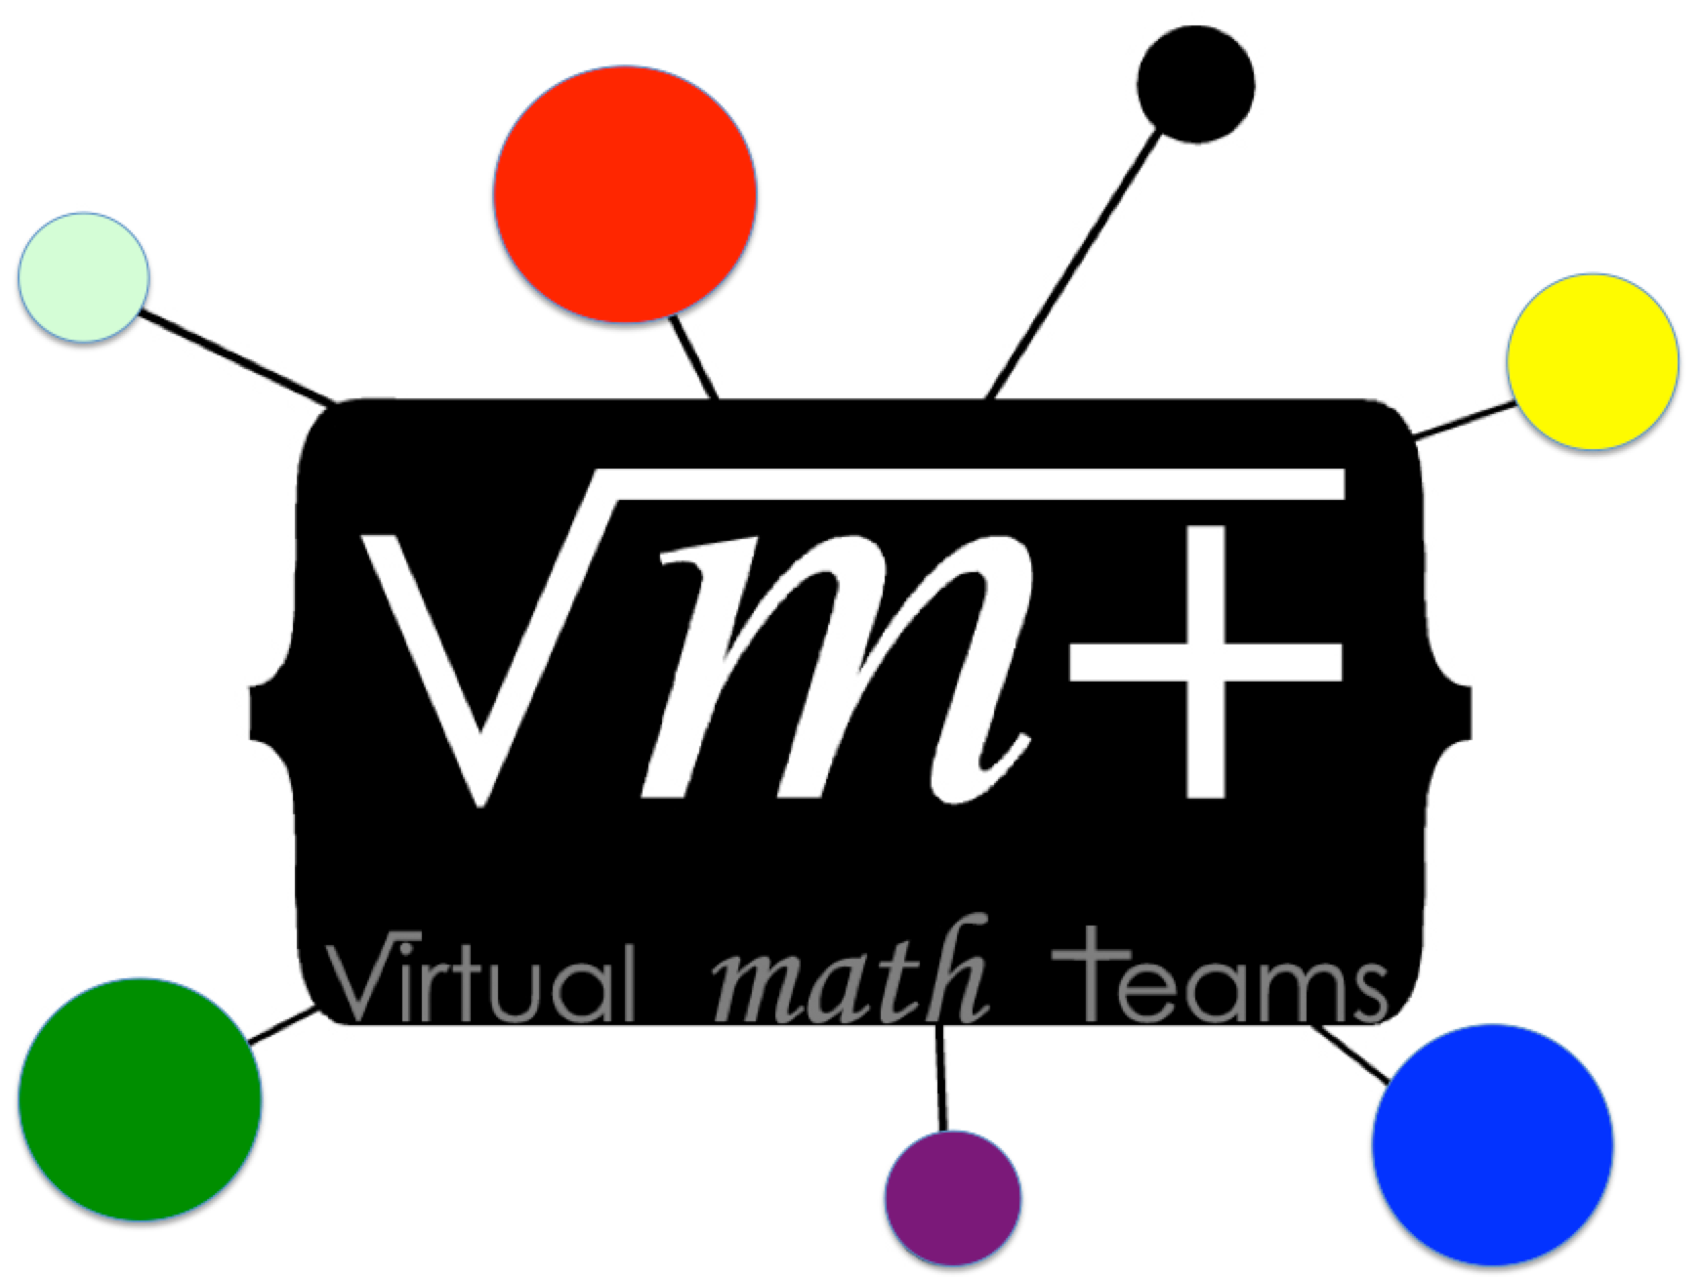
The Virtual Math Teams Quartet
Constructing Dynamic Triangles Together:
The Development of Mathematical Group Cognition
(2015)
Cambridge University Press, 250 pages
www.GerryStahl.net/elibrary/analysis
See www.GerryStahl.net/elibrary for access to these books
Notes:
The VMT Project is now documented in a quartet of books from 2006, 2009, 2013 and 2015.

