Slide 1
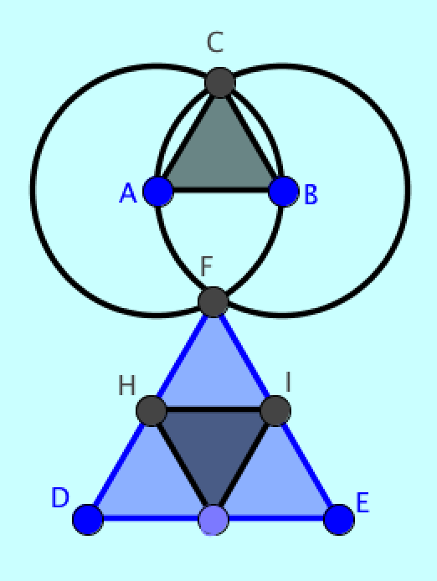
Didactics of human-centered dynamic geometry
LinCS Seminar, Göteborg
October 10, 2013
Gerry Stahl
Notes:
Yesterday we discussed the design processes involved in the development of an online environment for collaborative dynamic geometry education.
Today I would like to discuss more specifically the pedagogical design and how we are trying to support that

Slide 2
Didactics of human-centered dynamic geometry
1. Introduction
2. Constructing geometric objects in GeoGebra
3. Abstracting dependencies in custom tools
4. Constructing propositions using dependencies
5. Proving propositions using dependencies
6. Creative-discovery as a human-centered approach
7. Teaching this approach to teachers collaboratively
8. Teaching this approach to students collaboratively
9. Analyzing how teachers and students learn this approach in their discourse and interaction
Notes:
My presentation covers these 9 points, which are inter-related

Slide 3
1. Introduction
Euclidean geometry has trained students for over 2,000 years in rational, deductive thinking and mathematical practices.
Computer-based dynamic geometry (Geometer’s Sketchpad, Cabri, GeoGebra, etc.) adds three dimensions:
Dynamic dragging,
Dynamic construction (including programming custom tools),
Dynamic dependencies.
With these, students can:
Drag figures to discover dependencies
As well as design the creation of dependencies
For the human-centered construction of figures
Notes:
How many of you are already at least a little familiar with dynamic geometry?
Have you tried one of the dynamic geometry systems?
Were you at my talk yesterday?

Slide 4
GeoGebra on an iPad
Notes:
This is a screenshot of Euclid’s first proposition – the construction of an equilateral triangle – done on my iPad
I can open GeoGebra on my laptop and show you this as an example of dynamic geometry

Slide 5
Rather than accepting geometric propositions as otherworldly truths, students can now conceive them as results of their own “creative discovery” within a local knowledge community.
How can geometry education be structured to incorporate this orientation to the social construction of geometric knowledge?
The VMT technology and curriculum adds an emphasis on significant mathematical discourse through support of collaborative learning by embedding multi-user GeoGebra in a collaborative-learning environment.
Notes:
Given the apparent potential of dynamic geometry to support student inquiry, exploration, discovery and creativity,
How can we design pedagogy to encourage this?

Slide 6
VMT with multiple GeoGebra tabs
Notes:
We have been developing an online environment called Virtual Math Teams (or VMT) since 2012
Now the VMT environment can include multiple GeoGebra tabs
They are integrated with the chat communication channel and many other features for collaborative learning.

Slide 7
2. Constructing geometric objects in GeoGebra
Point constructed as a location on a plane surface. Digital approximation to infinite, continuous surface.
Line constructed as linear equation passing through 2 points. Segment, ray and vector constructed similarly.
Circle constructed as equation of points whose distance from a center point is equal to the distance between the center point and a second point. Conics constructed similarly.
N-sided polygon constructed as defined by N points connected by segments joined at vertices.
Notes:
Open d2.ggb – check Points, Line, Circle
Everything is built up from the simple point at a location
But now the point can be dragged to other locations

Slide 8
Primitive objects of GeoGebra

Slide 9
Point can be constructed to be:
Free – able to be dragged to any location.
Constrained – confined to be dragged only along a line or conic.
Dependent – cannot be dragged; location determined by intersection of two lines and/or conics.
All constructed relationships are maintained under dragging:
If a point is dragged, any lines, conics or polygons constructed with that point are re-calculated.
If a line, conic or polygon is dragged, points defining it are dragged.
Dependency relations are maintained recursively.
Notes:
Still using d2.ggb – unclick Point, Line, Circle – check Free, Constrained, Dependent

Slide 10
Free, constrained, dependent points

Slide 11
3. Constructing propositions using dependencies
Euclid’s Proposition #1 as a dynamic construction procedure:
In Euclid’s construction of an equilateral triangle, he made the lengths of the three sides of the triangle dependent on each other by constructing each of them as radii of congruent circles.
Euclid’s proof of the equilateral triangle:
Then to prove that the triangle was equilateral, all he had to do was to point out that the lengths of the three sides of the triangle were all radii of congruent circles and therefore they were all equal. Of course, he had created this by his construction!
Notes:
Open d3a.ggb and drag

Slide 12
Constructing an equilateral triangle

Slide 13
Euclid’s Proposition #2:
Using his construction of an equilateral triangle, Euclid showed how to copy the length of a line segment to an arbitrary new endpoint. He used the equality of radii extensively as well as the transitivity of equality of length: if lengths x=y and y=z, then x=z.
I add another circle to allow the copied segment to point in any direction.
Then I define a GeoGebra custom tool equivalent to compass tool.
Given points A, B, C as input, the custom tool produces a circle around center C with radius =AB. This provides useful functionality while hiding a complicated sequence of 10 construction steps and several logical steps.
Notes:
Open d3b.ggb and drag

Slide 14
Copying a segment length

Slide 15
4. Abstracting dependencies in custom tools
The tools in GeoGebra consist of the following sets:
Tools to construct individual points, lines, conics, polygons.
Tools to construct figures consisting of dependent objects, such as perpendicular lines, equilateral triangles, centers of triangles.
Tools to modify the appearance of the interface.
Set (1) provides the primitive objects of GeoGebra (Euclid’s definitions and postulates).
Set (2) abstracts sequences of constructions with their dependencies. E.g., there are tools for an equilateral triangle, for copying a segment length to a given location, to bisect an angle, to locate the midpoint of a segment, to construct a perpendicular line from a point on or off the first line (Euclid’s propositions #1, 2, 9, 10, 11, 12).
Set (3) is for convenience and is not of mathematical relevance.
Notes:
Open d4a.ggb – add angle 90 and drag

Slide 16
Construct the midpoint & perpendicular bisector of a segment

Slide 17
Set (2) can be constructed by users from set (1) by defining custom tools – in theory.
(In fact, there are some limitations to the GeoGebra implementation of custom tools, in part due to a theoretical continuity problem.)
For instance, students can build their own tools for Euclid’s propositions #1, 2, 9, 10, 11, 12.
They can build tools to construct the different centers of triangles for exploring the Euler segment.
They could build their own geometries.

Slide 18
If students build their own tools, they may better understand the dependencies which are abstracted and hidden in the tools. The power of geometry consists in the dependencies, which are designed into various constructions. When these dependencies are hidden by hiding circles that constrain locations of points, using tools from set (2), providing students with pre-constructed figures to drag or just to view, the relationships among geometric objects are mystified. When dependencies are hidden behind ancient terminology and memorization based on accepted authority—rather than having students create and take ownership of the dependencies—the objects of geometry are alienated from the students.
Compare:
→ Drilling students on the definitions of “special” triangles (equilateral, right, isosceles) or “special” quadrilaterals (square, rectangle, rhombus, kite), with
→ Having students explore the dependencies that distinguish all the possible kinds of triangles or quadrilaterals (number of equal sides, equal angles, parallel sides, etc.).
Notes:
Open d4b.ggb and drag poly1 on top of others
Show constraints in others

Slide 19
A curricular unit on classifying kinds of triangles based on construction dependencies
Notes:
A typical topic for learning dynamic geometry
With prompts for collaboration and guided discussion or anchored reflection

Slide 20
5. Proving propositions using dependencies
Students of basic geometry are supposed to be surprised that a simple generic triangle has special properties of an “incenter” that can be discovered and proven.
Students of modern (post-1900) geometry are supposed to be surprised at the complex innate properties of a simple triangle associated with “Euler’s segment”.
But we can see that these are nothing but dependencies built in by our construction of the incenter and of Euler’s segment
Notes:
Open d5a.ggb

Slide 21
The incenter of triangle ABC with a radius of the inscribed circle
Notes:
Open d5a.ggb

Slide 22
A conjecture about the incenter
The three bisectors of the vertex angles all meet at a single point. (It is unusual for three lines to meet at one point. For instance, do the angle bisectors of a quadrilateral always intersect at one point? )
The incenter of any triangle is located inside of the triangle. (Other kinds of centers of triangles are sometimes located outside of the triangle. For instance, can the circumcenter of a triangle be outside the triangle?)
Line segments that are perpendiculars to the three sides passing through the incenter are all of equal length.
A circle centered on the incenter is inscribed in the triangle if it passes through a point where a perpendicular from the incenter to a side intersects that side.
The inscribed circle is tangent to all three sides of the triangle.
Notes:
Open d5b.ggb

Slide 23
Illustration of the conjecture
Notes:
Open d5b.ggb

Slide 24
If we construct the incenter as the meeting point of the angle bisectors using a standard or custom tool for bisecting the interior angles of a triangle, the conjectured properties appear as a surprise.
But if we just use the basic tools equivalent to straight-edge and compass, then we see how all these were constructed in the process of locating the incenter.
We construct the angle bisectors by constructing a line whose points are equidistant from the angle sides.

Slide 25
Constructing the angle bisectors for the incenter
Notes:
Point F is constructed to be equidistant from points D and E or sides AB and AC
Point H is constructed to be equidistant from points D and G or sides AB and BC
Then point I – on both these bisectors – will also bisect the other angle

Slide 26
We construct point I at the intersection of the bisectors of A and B. Then we know that I is also on the bisector of C by constructing the perpendiculars to the sides from I. IJ=IK and IJ=IL so IL=IK.
All the properties of the conjecture follow from this:
We can inscribe a circle with radii IJ, IK, IL, etc.

Slide 27
Inscribing the circle around the incenter

Slide 28
This construction involved the creation of 63 objects (points, lines and circles). It is becoming visually confusing. That is why it is often useful to package all of this in a special tool, which hides the underlying complexity.
GeoGebra has a tool for angle bisector.
We can define a custom tool for incenter.
It is wonderful to use these powerful tools, as long as you understand what dependencies are still active behind the visible drawing.
Notes:
Open d5e.ggb

Slide 29
All the dependencies to construct an incenter
Notes:
Open d5e.ggb
Drag to see all the dependencies

Slide 30
Euler’s work sparked a revival of interest in geometry. His proof that the centers of a triangle have certain relationships surprised people
E.g., the distance from the orthocenter (H, meeting point of the altitudes) to the centroid (G, meeting point of the medians) = 2GO (circumcenter, meeting point of the perpendicular bisectors).
Notes:
Open d5f.ggb

Slide 31
Explore the dependencies
Notes:
Open d5f.ggb
Drag to see the 4 centers move and still show Euler’s relationships and the 9-point circle

Slide 32
E.g., the distance from the orthocenter (H, meeting point of the altitudes) to the centroid (G, meeting point of the medians) = 2GO (circumcenter, meeting point of the perpendicular bisectors).
But these are not innate properties of a simple triangle; they are the consequences of the constructions of the centers. They can be proven based on the constructed dependencies.
Notes:
Open d5g.ggb

Slide 33
Proof that GH=2*GO based on construction of dependencies
Notes:
Open d5g.ggb

Slide 34
6. Creative-discovery as human-centered approach
Let’s move from math theory to math didactics.
Here are two resources that illustrate the combination of dragging to discover and constructing to create.
Given an existing dynamic figure, explore its dependencies by dragging its points.
Then design a construction process to create such a figure.
A typical team moves back and forth between such discovery and creation.
Notes:
Open d6a.ggb and drag A and D

Slide 35
The inscribed triangles resource
Notes:
Open d6a.ggb and drag A and D

Slide 36
Some generalization
When a team succeeds, they understand that they have discovered some interesting dependencies and they have learned how to create such dependencies and figures themselves.
The dependencies of the inscribed triangles can be generalized to square, hexagon and even an n-sided polygon. The proof follows closely from the understanding of the dependencies
Notes:
Open d6b.ggb and drag A and G

Slide 37
Notes:
Open d6b.ggb and drag A and G

Slide 38
7. Teaching this approach to teachers
We provide a professional development course to math teachers. In a semester, they have about 18 hour-long online collaborative sessions going through several GeoGebra tabs each session.
They discuss some readings about dynamic geometry and collaborative math discourse.
They reflect in their individual journals, in their group chat rooms and in the class discussion board about how their chat sessions went and how to present to their students.
Notes:
We have this course going on right now.
Maybe next year some of you will want to take it.

Slide 39
The approach
Collaborative learning
Emphasis on increasing significant math discourse
Focus on design of dependencies
Constructivist, hands-on, student-centered
Creative-discovery: explore and design
Full use of GeoGebra: construction, custom tools, not just illustrative pre-constructed apps
Reflection on persistent record (chat room, logs, replayer)
Tuned to level of teachers or students

Slide 40
8. Teaching this approach to students
Last Spring, teachers organized 8 sessions for their own students, using VMT with GeoGebra.
Some teachers organized after-school sessions, some integrated in classroom or school computer lab
Used mainly topics supplied from beginning of “Topics” workbook.
Teachers were not prepared to define their own topics successfully.
It would be nice to have student teams across schools – or even across countries in English, like Facebook ☺ .

Slide 41
9. Analyzing how teachers and students learn this approach in their discourse and interaction
We have been analyzing online math teams for 10 years.
Have only looked at one team from last Spring so far.
Now have lots of interesting data.
We have complete logging of interactions (chat and GeoGebra actions) and can replay sessions for analysis.
More on course design and data analysis in coming days
Notes:
We will hold a data session to analyze this data further tomorrow
And then hopefully an all-day data session at ICLS 2014 in Boulder next June

Slide 42
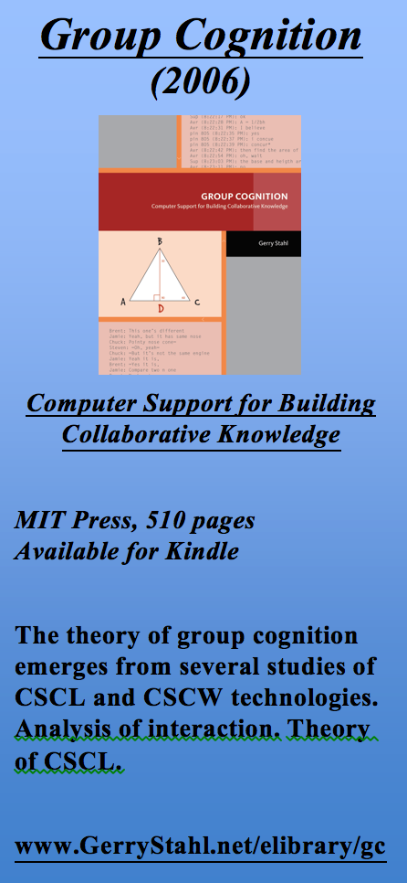
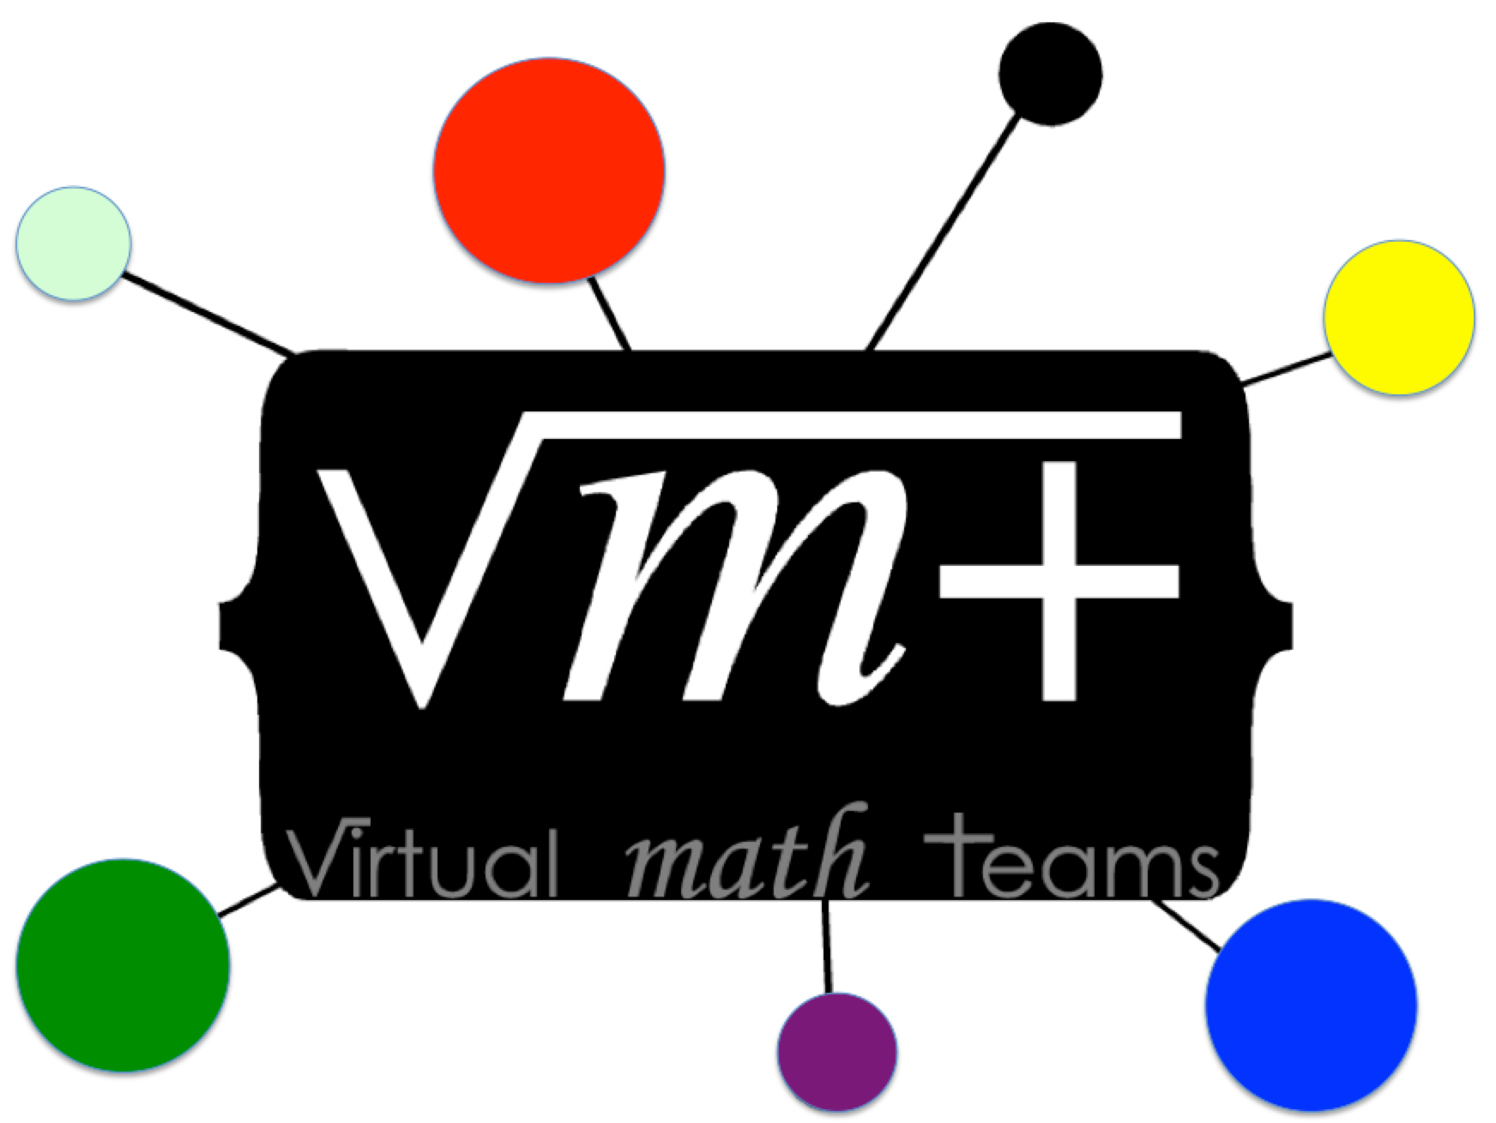
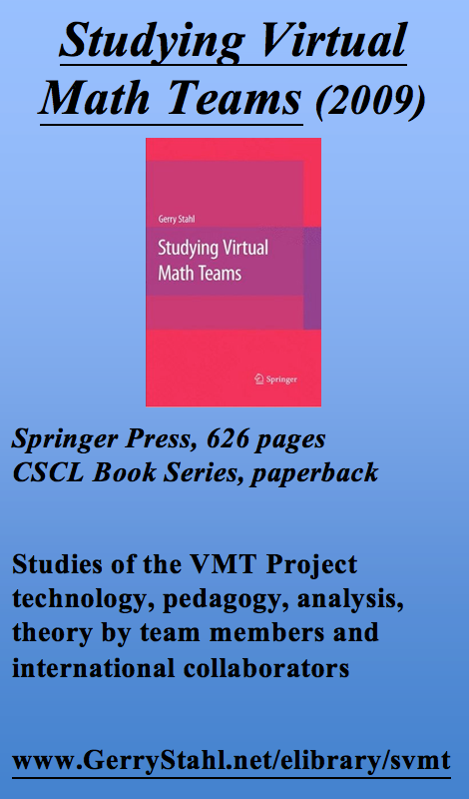
The VMT trilogy
Notes:
Here is more information on the VMT Project:
Its conception published in 2006, initial reports in 2009 and current status in 2013

Slide 43
For further info…
Email:
Gerry@GerryStahl.net
Website:
www.GerryStahl.net
Topics in Dynamic Geometry for VMT:
www.GerryStahl.net/elibrary/topics
Translating Euclid:
www.GerryStahl.net/elibrary/euclid
Studying Virtual Math Teams:
www.GerryStahl.net/elibrary/svmt
Group Cognition:
www.GerryStahl.net/elibrary/gc
Slides:
www.GerryStahl.net/pub/didactics.pdf www.GerryStahl.net/pub/designing.pdf www.GerryStahl.net/pub/analyzing.pdf
Notes:
Here are links for following up, including copies of the slides for my presentations here

