Slide 1
Theories of Collaborative Cognition: Foundations for CSCL and CSCW together
Gerry Stahl
Notes:
Theories of collaborative cognition.
In this paper, I try to reflect on the theories of cognition that underlie current and future CSCL and CSCW research.
I propose that the theoretical basis of the two fields is the same, suggesting a bringing together of the two fields, as in CSCL@Work.
In particular, I argue for the need to conduct analyses at the group unit of analysis as well as at the individual and community levels.

Slide 2
“Computer support has focused on organizations and individuals.
Groups are different.
Repeated, expensive groupware failures result from not meeting the challenges in design and evaluation that arise from these differences.”
-- Grudin, Eight Challenges (1994, p.93)
Notes:
The problem I want to address was pointed out 17 years ago in a well-read paper by Jonathan Grudin.
Yet this problem has still not been addressed well
[read quote]
I want to argue that certain aspects of CSCW support should be designed around the nature of group cognition

Slide 3
Groups are not just sets of individuals, cognitively speaking.
“Cognition” is defined in the dictionary as the process involved in coming to know, or the act of knowing, particularly using reasoning as opposed to feeling or willing.
Its definition has been dramatically expanded by post-cognitive philosophy, distributed-cognition theory and AI.
Notes:
People assume that cognition is necessarily reducible to acts of individual minds.
But that is an outmoded view, as we shall see.
The definition of “cognition” does not necessarily imply that only individuals can accomplish cognitive tasks.
Knowledge building can be accomplished by groups, communities, activity systems and possibly computers.
[read slide]

Slide 4
“The group performing the cognitive task may have cognitive properties that differ from the cognitive properties of any individual”
-- Hutchins, Cognition in the Wild, p.176
Notes:
Group cognition may not even be well reflected in the individual cognition of the members of the group, whether the individual cognition is expressed during or after the group interaction in think-alouds, interviews or surveys
As Ed Hutchins put it, [read quote]

Slide 5
“Small groups are the engines of knowledge building.
The knowing that groups build up in manifold forms is what becomes internalized by their members as individual learning
and externalized in their communities as certifiable knowledge.”
-- Stahl, Group Cognition, 2006, p.16
Notes:
I believe that in many contexts group cognition actually should be granted a priority status
Because small group interaction often underlies individual cognition and community cognition -- rather than the other way around
As I claimed in my book on group cognition,
[read quote]

Slide 6
Today’s talk
The question of cognition in CSCL & CSCW
History of theory: extending the cognitive unit of analysis
Seminal theories for CSCL & CSCW
Theories of individual, community and small-group cognition
Findings from Virtual Math Teams research
A multiplicity of theories
Notes:
In today’s talk, I want to focus on the question of “cognition” in theory and methodology for CSCW
I will start by briefly reviewing how the unit of analysis of cognition has been systematically extended in the past 200 years
In particular, this can be seen in foundational texts of CSCW theory
The centerpiece of my talk will distinguish individual, group and community cognition
And I will illustrate the study of group cognition from my own recent research
Then I will conclude with my recommendations

Slide 7
1. The question for CSCL@ Work
What is cooperation?
Who does it – small groups?
How can we support it with networked computers?
Can we facilitate new forms of group cognition?
Do we need new theories of cognition?
Do we need new research methodologies?
Notes:
Consider these basic questions about CSCW as a research field [read slide]

Slide 8
If CSC@W is about designing computer support for CL at work, then what new forms of cognition can we support in computer-mediated group interaction? Are new forms of group cognition possible in the age of ICT that are distinct from both individual cognition and community practices?
Notes:
Here is the driving question for my talk:
[Read the question]

Slide 9
2. Theory: extending the unit of analysis
Theories of cognition began in Western philosophy
They developed a conception of the isolated (fundamentally non-cooperative) individual mind
Kant’s fixed mind constructed the nature of reality
Hegel traced the development of mind from primitive consciousness to the social Zeitgeist
Marx, Heidegger, Wittgenstein, etc. transformed theory into science: social, situated, linguistic
Notes:
I begin by arguing that the concept of “cognition” has been developed historically
In classical philosophy, peaking with Descartes and culminating in Kant, cognition is a function of a fixed individual mind.
Hegel’s dialectical philosophy extended the cognitive unit of analysis, opening it up to scientific investigation in many domains

Slide 10
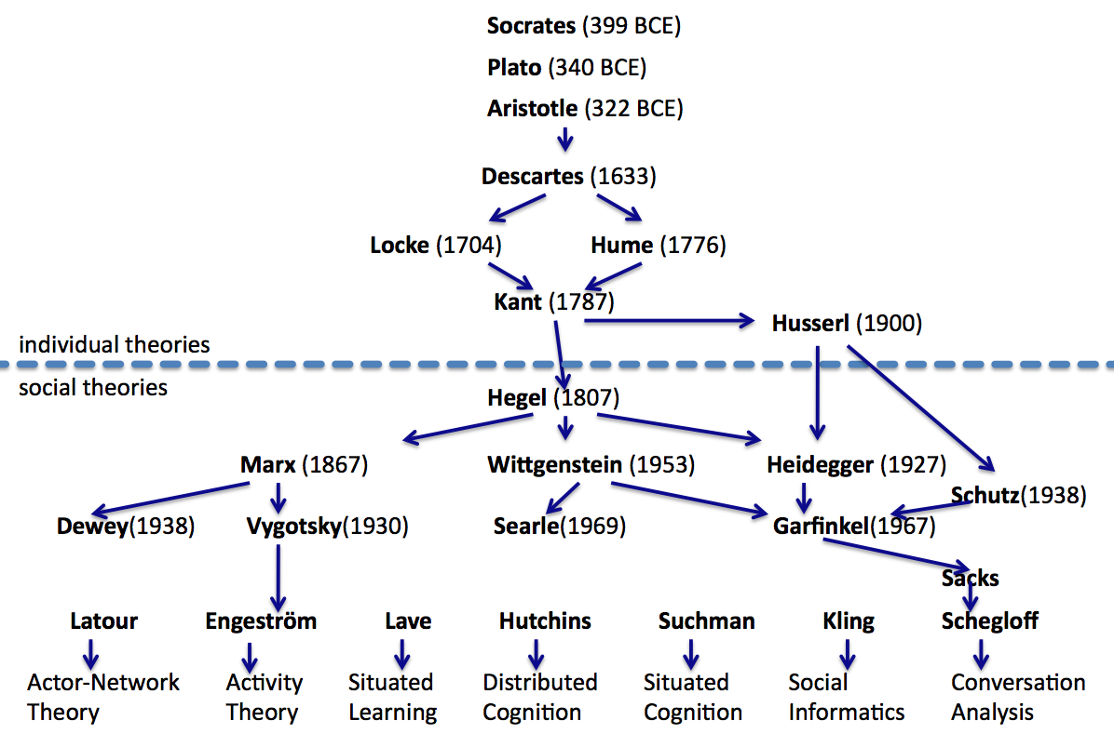
A brief history of theory
Notes:
Here we see a watershed event in the history of theory about 200 years ago – indicated by the line separating individual and social theories. Hegel’s massively developmental approach traced the development of cognition through individual, small group and community cognition. His early work looked at the family unit as primordial small group and his later work highlighted the master-slave dialectic as a socially-situated prototypical small-group interaction. Marx of course provided a revolutionary social reading of cognition as a product of socio-historical institutions. Heidegger situated human existence in the world, unfortunately stopping short of a full analysis of being-in-the-world-together. Wittgenstein reflected on the linguistic aspects of cognition, stressing the use of language in interaction. The diverse pantheon of theories influential in CSCW is largely derivative of these philosophic developments. And they conceive of cognition as much broader than the individual cognition of a solitary mind. This has, of course, been recognized in CSCW previously: Pelle Ehn reflected on the expansive visions of Marx, Heidegger and Wittgenstein, writing here in Aarhus. And Paul Dourish cited them as setting the space where the action is.

Slide 11
3. Seminal theories for CSCW
Building on Marx, Heidegger, Wittgenstein:
Mind in Society (Vygotsky, 1930/1978),
Situated Learning (Lave & Wenger, 1991),
Lectures on Conversation (Sacks, 1962/1995)
Understanding Computers and Cognition (Winograd & Flores, 1986).
Notes:
If we look at these 4 seminal books, we see the strong and explicit influence of Marx, Heidegger and Wittgenstein
Vygotsky adopted a Hegelian developmental approach and argued that individual cognitive faculties derived from small-group interactions, through the internalization of group cognition
Lave & Wenger adopted a Marxian focus on social relations and how workplace practices are enacted, transmitted and transformed through local small-group interactions of situated learning
Conversation analysis, influenced by ethnomethodology, focused on how language was used in interaction, following Wittgenstein.
Winograd and Flores critiqued the rationalist, pre-Hegelian philosophical roots of AI using Heidegger’s analysis of human being-in-the-world.
They all point to individual cognition as a by-product of group interaction and stress the need to extend the unit of analysis to groups in order to study the development and nature of cognition

Slide 12
The local locus of group cognition
While cooperative work may be coordinated across large communities of practice, the cognitive tasks are typically accomplished by small groups:
Mind in Society: family, peer dyads, mentor/student
Situated Learning: master & apprentice or small group of apprentices
Lectures on Conversation: Dyads or small groups talking
Understanding Computers and Cognition: Communicator or email may link communities, but specific commitments of discussion threads involve just a couple people
Notes:
If we look at concrete case studies of cognitive tasks like decision making, problem solving, working out design ideas, we typically see small groups of people interacting.
Marx’ analysis of the development of the capitalist economic system starts with two people exchanging a commodity, a yard of linen.
Wittgenstein’s analysis of the logic of language starts with two builders asking each other for slabs and blocks
In a large industry, decision making often takes place in meetings of several people or through gathering advice from a couple advisors
Hutchins looks at the work of the Navy in terms of the small navigation team and analyzes their troubleshooting in the discourse of a dyad
A CSCW system like email has to link large communities of practice (with features like global compatibility and addressability) and individuals (with search, contact lists, archives, etc.), but it should also particularly support small groups to discuss topics, pursue threads, build on each other’s ideas and reach decisions.

Slide 13
4. Theories of individual, community & small-group cognition in CSCW
Commonsensical folk theories based on classical philosophy and on the observation of the bodies of individuals and on personal introspection, conceives of cognition as an individual mental process. Cognitive science posits mental models and internal representations. Psychological research uses indirect measures to analyze hypothesized mental processes.
Small-group interaction makes thinking visible to enable shared understanding – and help researchers.
Community artifacts, practices and institutions preserve and disseminate cognitive accomplishments.
Notes:
Cognition is different on the different levels of individual, group and community – requiring very different methods of analysis.
Research on >individual< cognition requires complex procedures, such as pre/post test comparisons, control groups, random sampling, statistical manipulations, to get at hidden processes.
>Group< cognition can be studied by replaying computer-mediated interactions and using human interpretation of meaning-making group processes.
>Community< cognition can be studied by analysis of how people use artifacts, engage in practices and enact institutional rules.

Slide 14
Notes:
Here I have sketched a diagram of the constraints on small-group interaction or group cognition.
You can see that resources, tools and influences come from phenomena, objects and processes
at the individual, small-group and community levels.
The diagram is not intended as a model to explain the relationships among the levels,
But rather as a picture to raise the question of the relationships for future CSCW theory and research.
The analytic focus is on the sequential small-group interaction, through which cognitive tasks can be accomplished.

Slide 15
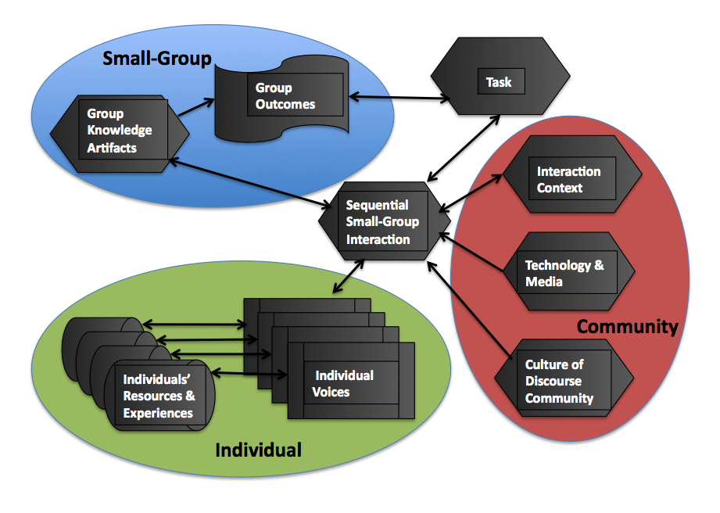
Highlighting a hexagon array and pointing to a smallest hexagon
Notes:
Here I have sketched a diagram of the constraints on small-group interaction or group cognition.
You can see that resources, tools and influences come from phenomena, objects and processes
at the individual, small-group and community levels.
The diagram is not intended as a model to explain the relationships among the levels,
But rather as a picture to raise the question of the relationships for future CSCW theory and research.
The analytic focus is on the sequential small-group interaction, through which cognitive tasks can be accomplished.

Slide 16
5. Findings from Virtual Math Teams research
The Virtual Math Teams Project (VMT) explores how small groups of people build knowledge collaboratively
In the learning process, one can observe the genesis of group cognition
The structure of the problem solving is made visible in the logs of interaction, where group cognition emerges
A recent case study illustrates some features of group cognition
Notes:
I have been directing the VMT Project since 2003. My book on “Group Cognition” documents the motivation of the project in failed attempts to support group cognition in my earlier CSCW and CSCL prototype systems. A later edited volume, “Studying Virtual Math Teams”, documents some of our major findings, as well as our theory, methodology and technology.
I will illustrate this research in the next few slides from a more recent case study.

Slide 17
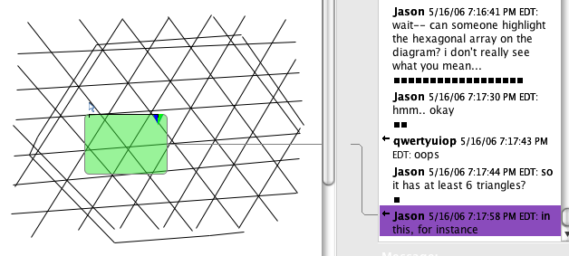
Highlighting a hexagon array and pointing to a smallest hexagon
Notes:
In this case study, 3 people are discussing math online
Prior to the excerpt shown, a student with the online name “137” proposed in the chat that they analyze a “hexagonal array”
Another student, Qwertyuiop, has drawn an array of lines on their shared whiteboard, as we see
Jason now stops the action and asks for help in seeing what 137 and Qwertyuiop see in these lines
He says, WAIT – I don’t really see what you mean!
The work of the group cannot continue until everyone in the group sees the same object.
137 outlines a large hexagon in the array using whiteboard tools
Jason then proposes a feature of the mathematical pattern
Jason points from his chat posting, so the others can see what he is talking about the same way he sees it,

Slide 18
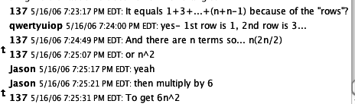
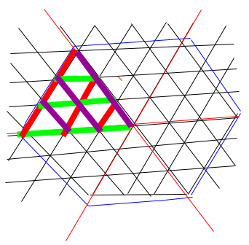
Building Knowledge Together
Notes:
Together – in the log at the top of the slide -- the 3 participants co-construct an algebraic expression that gives the number of small triangles in any size hexagonal array.
Note that each person contributes an important step in assembling this symbolic artifact, based on the graphical analysis that the group had accomplished.
Later – in the drawing on the slide -- they want to count the number of line segments in the large and visually complex hexagon
They use colored lines to break it into visually simple patterns, where the optical systems of their eyes can do the counting.
Then they will again build on each other to construct the general formula for any size array.
The cognitive accomplishment was accomplished by the group – using contributions of individuals and resources of the math community – but the accomplishment itself must be attributed to the small group and analyzed at the group unit of analysis in terms of their cooperative interactions.

Slide 19
The mediation of group cognition through digital interaction in VMT
Open a digital world with interaction through text, graphics, external representations
Co-construct, maintain, repair a joint problem space by building on each other’s proposals & questions
Share the world and co-attend to objects in it by dialog, pointing, questioning, visually sharing
Accomplish multi-step problem solving at the group unit of analysis (interaction among group members)
Notes:
Here are 4 observations from the case study:
1. There is a specific form of >digital co-presence<
2. There is >cooperation< in a strong sense of intimate co-construction of knowledge
3. The students bring and create group practices to maintain >shared understanding< of a shared world, shared objects, shared views of the objects
4. They achieve a >group-cognitive< result that is not attributable to any one group member alone
These are characteristics of effective online group cognition, in which the group co-constructs a task, a joint representation, a common way of looking at it,
a shared understanding, a sequence of problem-solving steps and a group cognitive accomplishment, carried out in their interaction

Slide 20
6. A multiplicity of theories in CSCW
The idea of a universal science is outdated
We need different theories, methods, sciences, discourses for different levels of description, time periods, research questions
Even for a specific object, we need multi-vocal approaches and analytic perspectives
We need to also recognize commonalities across levels and domains – e.g., common group phenomena in CSCW and CSCL
Notes:
We need to update our theory of science to be able to analyze these group phenomena.
Many of our preconceptions harken back to Galileo, Hume, Locke or Kant – over 200 years ago.
The idea of a universal, mechanistic, quantifiable, objective analysis of everything does not even work in today’s physics,
let alone in the social sciences, where human interpretation of meaning is central.
We need to be open to the many sophisticated ways in which people interacting in dyads and small groups co-construct meaning.
We need to have multiple theoretical and methodological approaches.

Slide 21
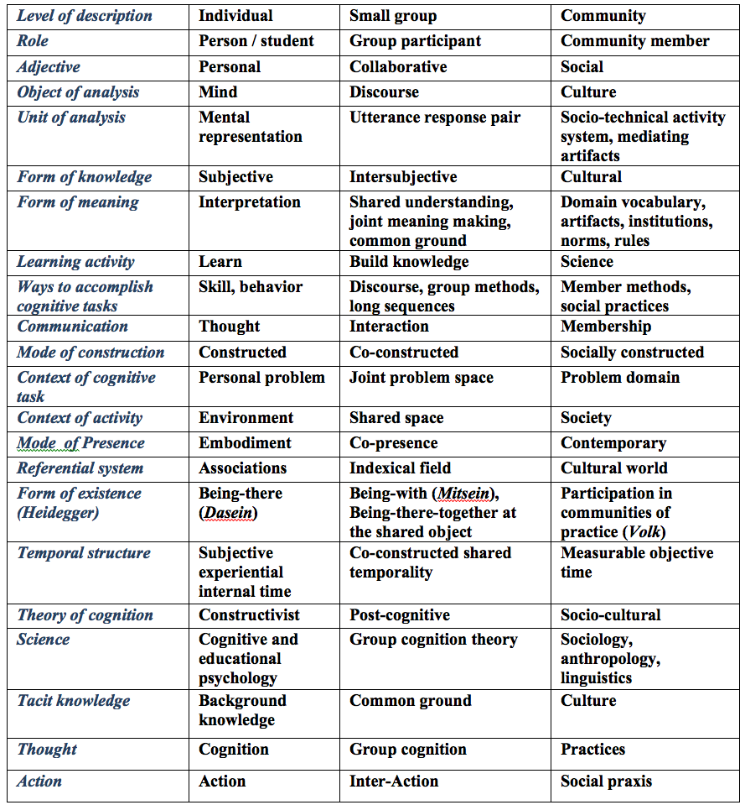
Orienting to a Shared Object
Notes:
In this table, I have tried to distinguish systematically three vocabularies for discussing cognitive phenomena at the individual, small-group and community level of description.
For instance, the term “social” has been a great source of muddied understanding. Even Vygotsky or Hutchins refer to dyadic or small-group phenomena as “social”
But there is a world of difference between interactions among three people and culturally established institutions
Socio-cognitive theory recognizes influences from other people and society, but reduces them all to individual mental models.
We need to first be clear about what level we are analyzing before we can theorize their mutual constraints and relationships

Slide 22
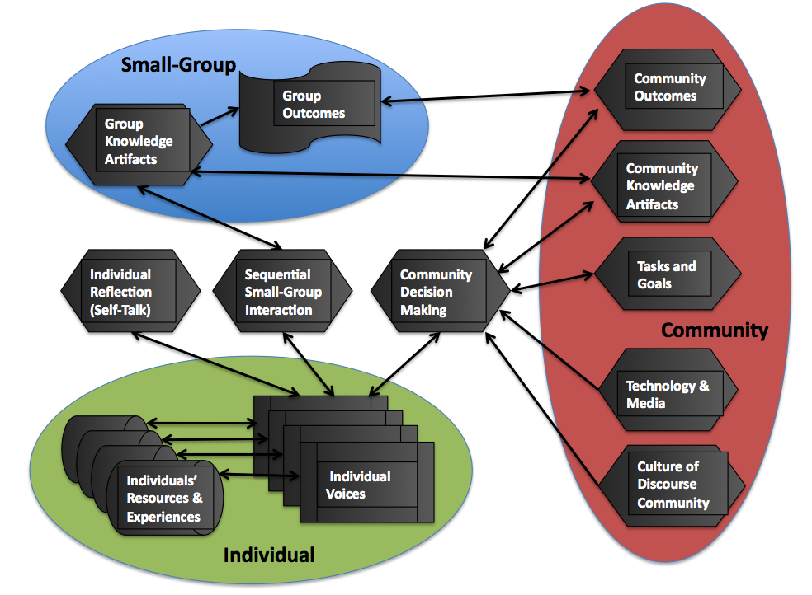
Notes:
Here, I have tried to sort out graphically the configuration of
Individual, group and community cognition
Along with their major constraints and products.
Again, this is not intended as an explanatory model,
But as a visualization to help us distinguish and think about different topics for analysis

Slide 23
Recommendations
Many attempts to support groups in CSCW have assumed that group cognition is reducible to individual cognitions:
  E.g., theories of group psychology or common ground reduced analysis to individual beliefs
  E.g., systems for Group Decision-Support Systems supported exchange of ideas and voting on opinions, not building joint knowledge
  But group cognition has its own characteristics, group practices, potential achievements
Notes:
I have been looking for theories, research methods and computer supports for group cognition in the research literature for 20 years
Most of what I have found or been pointed to by others is philosophically outmoded in assuming that all cognition is fundamentally based in the solitary individual mind of the 18th century
Where this is not the case, there is terminological ambiguity that fails to clearly distinguish the small-group phenomena from the community practices or societal institutions.

Slide 24
Many theories claim universality, but we may need multiple theories for different levels of description, units of analysis, time periods, research questions
Many methods claim universality, but we may need multiple research methods for different objects
Notes:
I do not want to deny the importance of individual cognition or of social factors,
Rather, I want to argue for a distinct research domain of group cognition on an equal theoretical footing.
I have tried to illustrate such a domain, some appropriate methods and some initial findings in my case studies.

Slide 25
There may be many possible levels to distinguish in CSCW studies, but 3 seem natural and important: individual, small group and community
  The quantitative research paradigm of social psychology focuses on individual cognition
  The qualitative research paradigm of social sciences focus on social practices and cultural artifacts
  We need theories and methods appropriate to analyzing group cognition, such as interaction analysis as part of design-based research
Notes:
It seems clear from previous research that a productive distinction is into the three levels of individual, small-group and community cognition.
Beyond that, there is evidence for a certain priority to group cognition -- suggested by Vygotsky’s developmental approach, by theories of human cultural evolution and by my own research of group cognition in learners.
To conclude, in addition to traditional methods of studying individuals and communities. we need theories and methods appropriate to analyzing computer-mediated group cognition, such as interaction analysis as part of design-based research.

Slide 26
Group cognition is the future
  Small groups are the engines of knowledge building
  The potential of group cognition awaits our innovative CSCW & CSCL systems of support
Notes:
Workplace trends in the past century indicate an increasing role of small-group interaction in the social relations of prevailing productive forces.
My hope is that CSCW and CSCL can develop systems of support to facilitate new and powerful forms of group cognition.
Today I have tried to summarize the argument of my paper on theory; but the real argument for focusing some CSCW analysis on group cognition would be to demonstrate that important results arise from such an approach. In my other recent writings, I am trying to do this in learning situations, where one may see the development of new practices most clearly.
I engage in design-based research in naturalistic settings, using a form of ethnomethodologically-informed interaction analysis adapted to online text chat to see how group processes can be mediated by new designs of computer support of collaborative work. To go into this work would require another paper or two. So I will stop now for today.

Slide 27



For Further Information:
“Group Cognition” (2006, MIT Press)
“Studying Virtual Math Teams” (2009, Springer)
Gerry Stahl’s e-Library (collections of papers free for iPad, Kindle, PDF or low-cost print-on-demand): GerryStahl.net/elibrary
This paper: http://GerryStahl.net/pub/group2012.pdf
These slides: http://GerryStahl.net/pub/group2012.ppt.pdf
website: GerryStahl.net
email: Gerry@GerryStahl.net
Notes:
This related work and the slides from today’s talk are available on my website

