Slide 1
Connecting Levels of
Cognition in the Wild
Gerry Stahl

Slide 2
Central Claim
Cognition is a fundamentally cultural, intersubjective, inter-personal process; it can be analyzed at different levels of analysis, which interact with each other.

Slide 4
Centrality of Small-Group Unit of Analysis
“Small groups are the engines of knowledge building.
The knowing that groups build up in manifold forms is what becomes internalized by their members as individual learning and externalized in their communities as certifiable knowledge.
At least, that is a central premise of this book.” (Stahl, 2006, p.16).

Slide 6
The Scenario
In his book on “Group Genius” (2007), Keith Sawyer describes an act of group genius from Ed Hutchins’ (1989) “Cognition in the Wild.”
A large naval ship navigating the tricky entrance to the San Diego port suddenly lost power. To avoid a major disaster, the navigation team of the ship’s bridge had to calculate the ship’s position and bearing every couple of minutes without use of the electronic tools that they normally rely on. Hutchins observed and recorded how they did this.

Slide 7
The Analysis
After a careful analysis of the interaction, Hutchins concluded that the solution they arrived at through considerable trial and error was “clearly discovered by the organization itself before it was discovered by any of the participants.”
Sawyer drew the lesson that “when people improvise together, they develop innovative responses to unexpected events even though no one it consciously aware of exactly what the group is doing or why it works?”
(Sawyer, p.28).

Slide 8
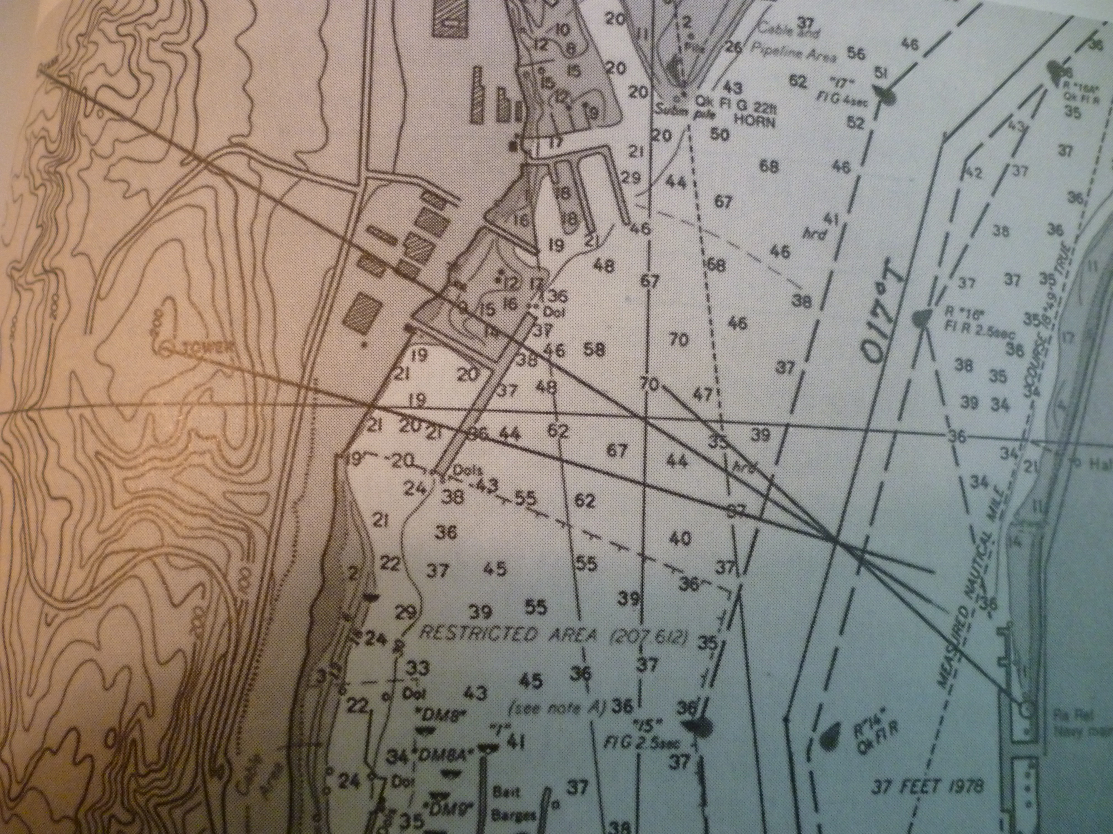

Slide 9
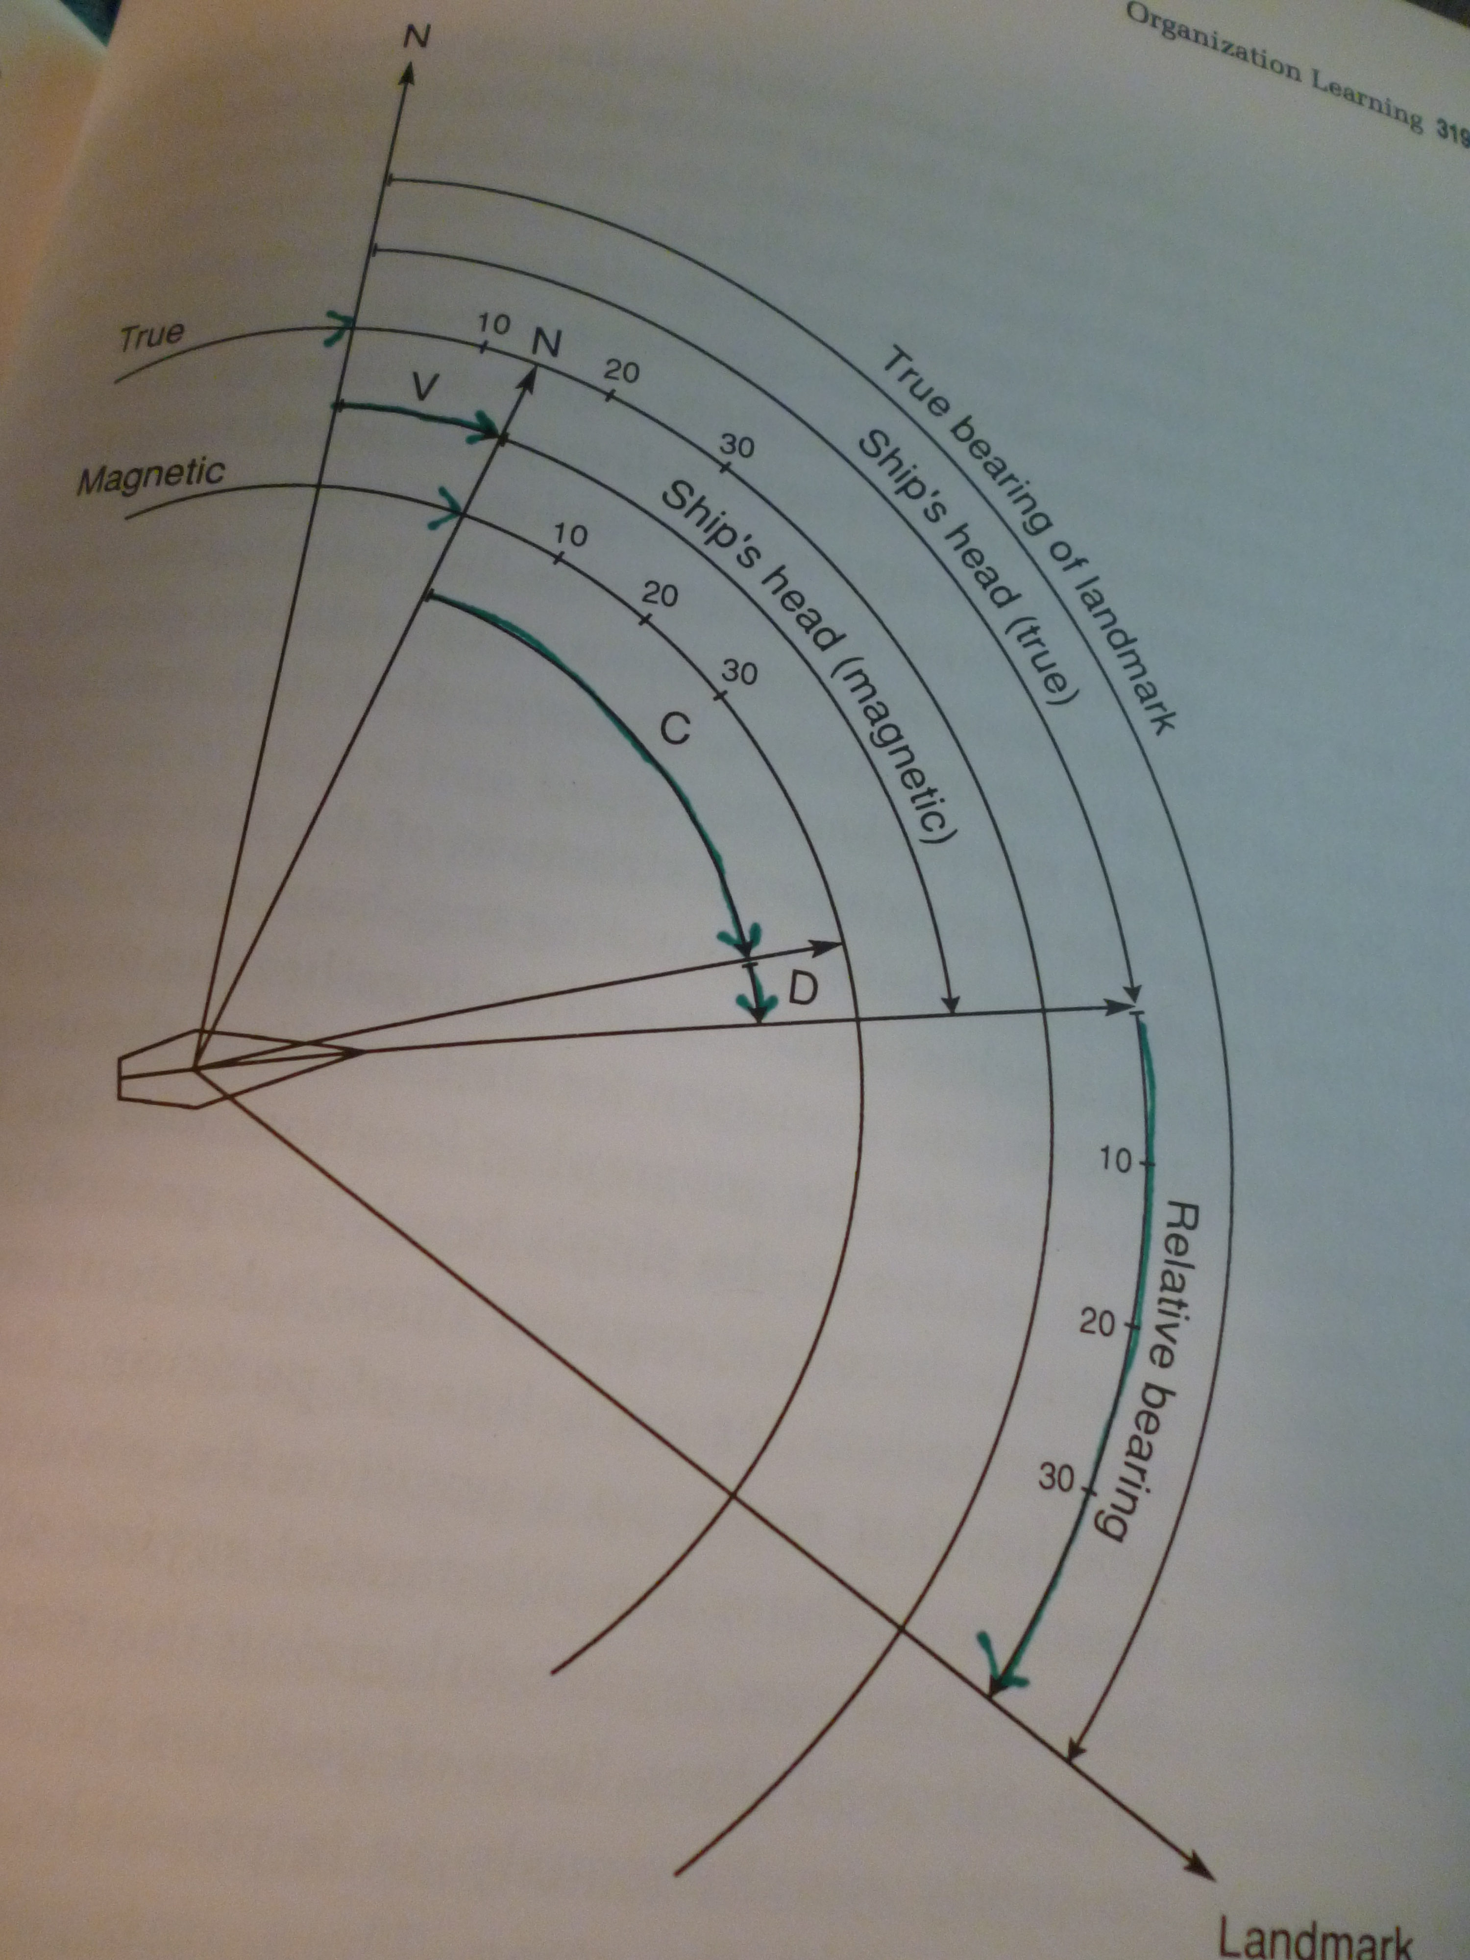

Slide 10
The logical computation is: (C + D + V) + RB.
But the bearing recorder gets RB from the people taking the sightings. And the plotter gets the C from the magnetic compass.
So they often start from the data they have in STM or are given by the other one (e.g., in all of the first 15 fixes).
They did not even include D for the first 24 fixes, until they realized it was causing a huge error in some fixes.

Slide 11
After the 12th fix, the plotter could not keep up with the mental arithmetic and got a calculator.
During the 16th fix, the plotter gave the calculator to the bearing recorder and told him what to add.
Hutchins remarks, “we see that using the calculator the team was neither faster nor more accurate than without it! The important contribution of the calculator was that it changed the relation of the workers to the task” (p. 332).

Slide 12
After 30-some fixes, the team started to consistently add (C + D + V) and save that intermediate result, which did not change for the 3 sightings from a given position. So they only had to add on the 3 relative bearings to get the triangulated fix. During fix 42, they started to call the intermediate result “total”.
Hutchins concludes: “The processes by which work is accomplished, by which people are transformed from novices into experts, and by which work practices evolve are all the same processes.” (Group interaction = individual learning = organizational change.)

Slide 13
Org learning thru evolution, no one person had overview of optimal design (vs trad org mgmt. rational planning)
Individuals could have recited rules in an interview, but embedded in the world they responded to each other and to availability of physical resources and their own cognitive limitations (e.g., STM) (vs trad view of indiv cognition)
Dyad members did not exchange beliefs, but built shared knowledge in interaction (vs trad view of common ground)

Slide 14
Indiv level: overwhelmed with task, made mistakes, failed to complete bearings, needed help, struggling, responding, not thinking about overview or reflecting much explicitly
Dyad level: building results together through division of labor, trial and error, evolving gradually (40+ trials) toward optimal effective organization of work
Cultural level: Dyad relied on established procedures and understandings and struggles to fill in for missing artifact. Coined term (“total”) for intermediate result that organized things efficiently

Slide 15
The interaction analyzed at the dyad level solved the indiv problem, joined the individuals in a group work-flow structure. The term “total” could potentially be incorporated in indiv and cultural level learning.
Episode when “calculate this” brought in to re-structure socio-technical arrangement to relieve indiv failure.

Slide 16
“It is possible to identify a number of cognitive systems, some subsuming others. One may focus on the processes internal to a single individual, on an individual in coordination with a set of tools, or on a group of individuals in interaction with one another and with as set of tools” (p.373).

Slide 17
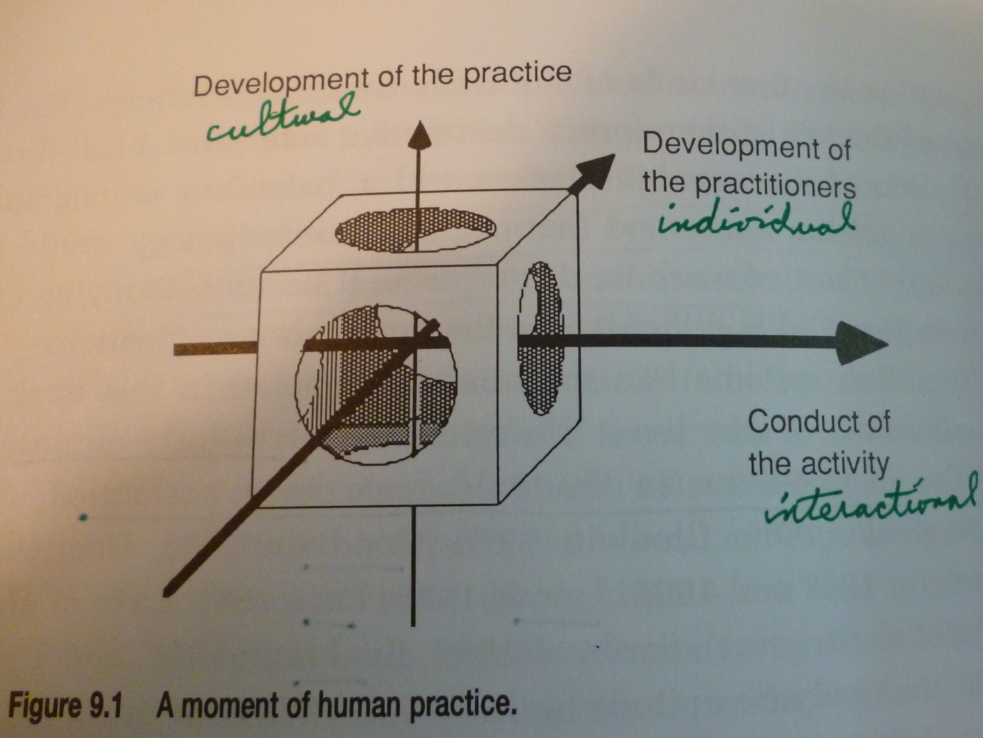

Slide 18
“The setting of navigation work evolves over time as partial solutions to frequently encountered problems are crystallized and saved in the material and conceptual tools of the trade and in the social organization of the work. The very same processes that constitute the conduct of the activity and that produce changes in the individual practitioners of navigation also produce changes in the social, material, and conceptual aspects of the setting.”

Slide 19
“Culture is not any collection of things [artifacts, individual’s ideas], whether tangible or abstract. Rather it is a process. It is a human cognitive process that takes place both inside and outside the minds of people. It is the process in which our everyday cultural practices are enacted” (p.354).

Slide 20
The example of the “total” illustrates the creation in interaction of a new concept. “The microgenesis of the cultural elements that make up the navigation setting is visible in the details of the ongoing practice. All this happens simultaneously in cognition in the wild. It is in this sense that cognition is a fundamentally cultural process.”

Slide 21
Central Claim
Cognition is a fundamentally cultural, intersubjective, inter-personal process; it can be analyzed at different levels of analysis, which interact with each other.

Slide 22
What are the implications of “Cognition in the Wild” for CSCL?
If “cognition is a fundamentally cultural process,” how do we analyze the interaction of individual development, group cognition and community practices within computer-supported collaborative learning?

