Slide 1
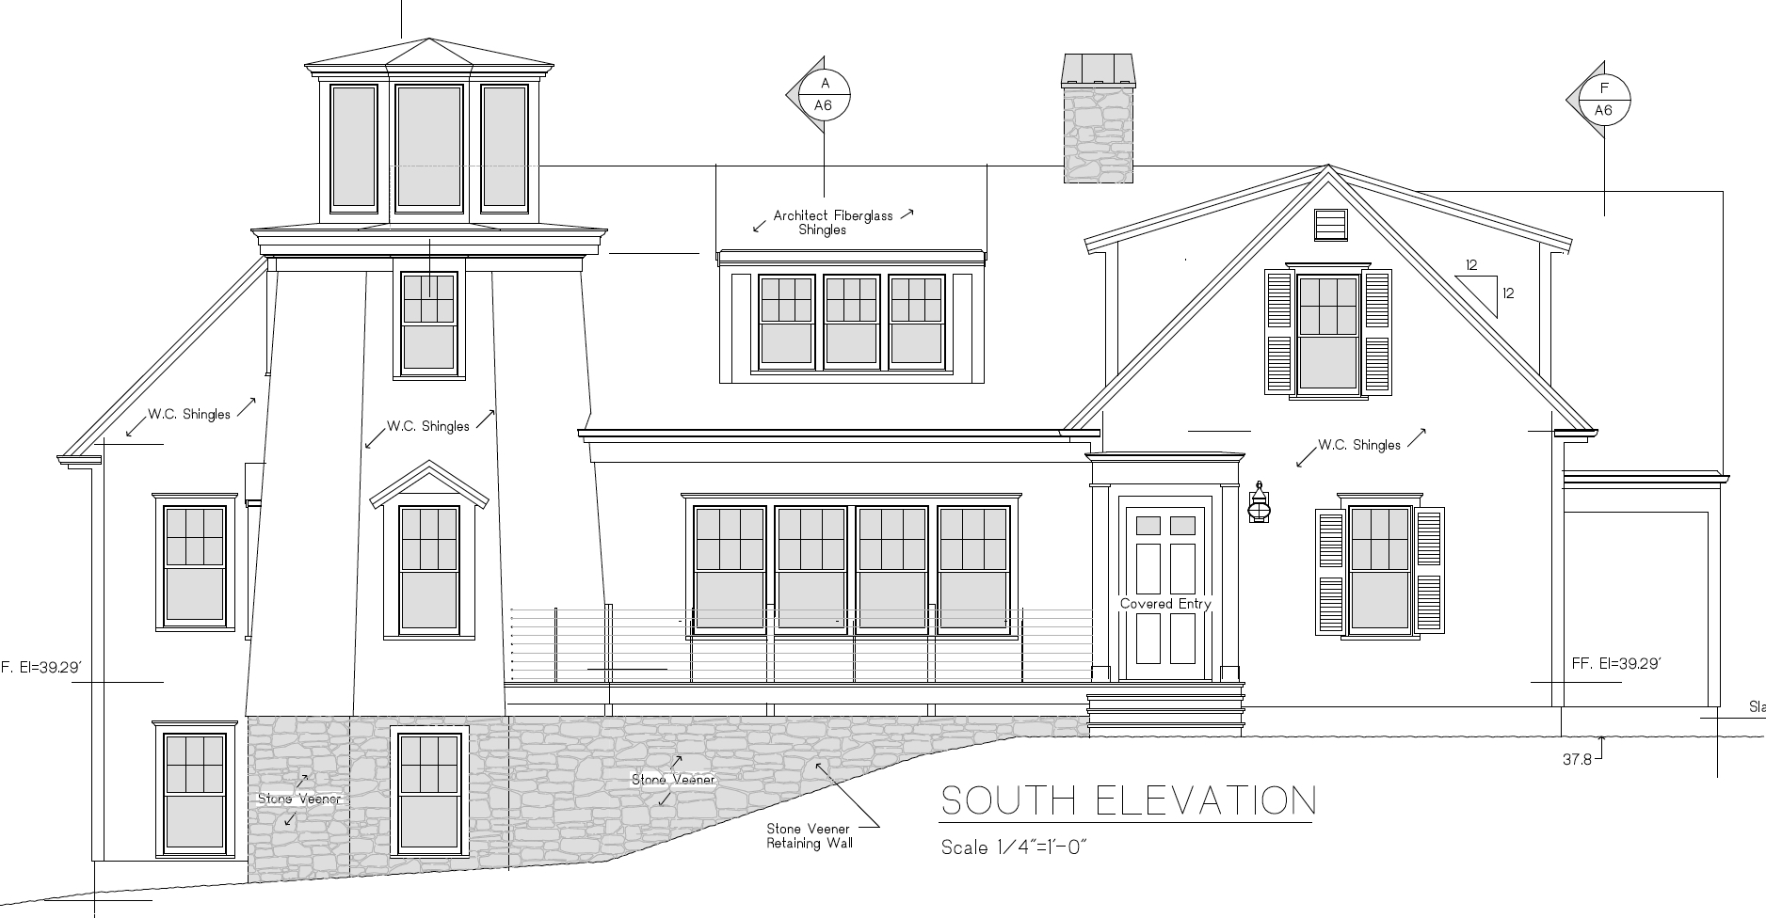
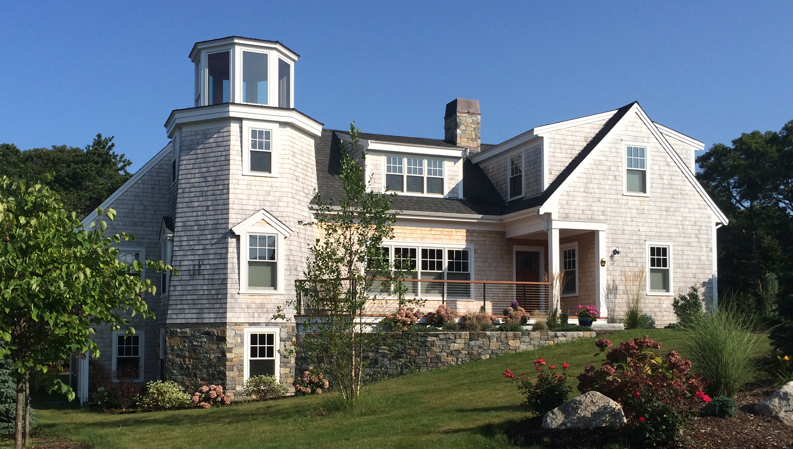
Designing for Quality of Life
Gerry Stahl
Gerry@GerryStahl.net
http://GerryStahl.net/pub/discussant.pdf
Notes:
I have found that it is relatively easy to design for one’s own individual quality of life;
But, it is harder to design for global factors affecting the worldwide quality of life.

Slide 2
What is our QoL?
QoL is now about the globe’s life, not individual life – see these recent publications:
Economic inequality (Ekbia & Nardi, 2017) – need for democratic economy & just global world order
Climate change (Latour, 2017) – need for ecological sustainability
Fake news (Trump, 2017) – need for knowledge-building communities (Bereiter & Scardamalia, 2018) and deliberative reasoning (Schwarz & Baker, 2017)
Notes:
Current QoL matters of concern focus on global issues – as seen in insightful publications this year – 3 prime issues are:
1. Economic inequality. – 2. Climate change. – 3. Seeing through fake news.

Slide 3
Consequences of: technology design &/or of capitalism?
Automation leads to unemployment for many & unimaginable wealth for a couple of CEOs
Climate change is a consequence of industrialization
Fake news is the new communication by social media
Automation is driven by the attempt to minimize labor time in production
Climate change is an external cost of capitalist production and consumption
Fake news is a phenomenon of fetishism of commodities and the ideology of individualism (including destruction of global world order)
Notes:
One can understand these global issues either as consequences of technology progress
Or as consequences of international capitalism.
In either case, they threaten design for global QoL

Slide 4
Beyond CSCL’s affordances
Cindy’s impressive cataloging of affordances researched by CSCL to date! ….
BUT: How to respond to major issues of our world, which determine our QoL?
BUT: Vision of CSCL for the world of the future?
BUT: Philosophical response to Pelle Ehn’s call for decentering and thinging?
BUT: Methods to analyze impact of the CSCL tools Cindy & Heisawn compiled, for our QoL?
Notes:
In the past CSCL researched affordances of technology designs for learning primarily at the individual unit of analysis. Today, I want to raise 3 issues for discussion of design for QoL in the global future: 1. Do we have a visionary paradigm of CSCL for group cognition? 2. Do we have a 21st century theory or philosophy of CSCL? 3. Do we have an adequate research methodology for CSCL?

Slide 5
CSCL for Group Cognition
Knowledge Forum – writing and inscriptions as building knowledge collaboratively – support for collaborative knowledge building (Bereiter & Scardamalia, 2018)
Argunaut & Digalo – support for deliberative discourse in various historical cultures through argumentation (Schwarz & Baker, 2017)
Virtual Math Teams (VMT) – support for collaborative dynamic geometry as contemporary form of classic reasoning about dependencies in world (Stahl, 2017)
Notes:
New CSCL publications describe efforts to design for a world of thinking at the group, team or community level:
To prepare students for the kind of thinking required for global sustainability, equality, democracy, rationality, mutual understanding

Slide 6
A diversity of theory & methods
Decentering away from individual unit of analysis – Latour actor network theory – look at temporal sequences of words, gestures, configurations of visible artifacts, group practices, active roles of artifacts, inscriptions, immutable mobiles, practices, knowledge artifacts
Not just mental representations, but new causality and agency thru group interaction, group practices. Technological artifacts as “ANT agents”, as “used instruments”, as “thinging things”
Notes:
The methodology issue for CSCL is not quantitative vs. qualitative, but decentering from the individual to interactions among groups, texts, artifacts, diverse human and non-human actors. We need new 21st century philosophy of how to analyze, as in Latour’s actor-network theory and Rabardel’s instrumental genesis or Heidegger’s thing-ing

Slide 7
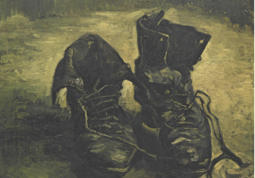
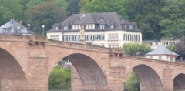
Analyzing how things act as agents– not affordances as Aristotelian attributes, but as opening worlds of activity
Thing-ing in VMT, KF, Argunat: Discourse has life of its own. Structuring into perspectives, forums, arguments, drawings creates meaning. Dynamic-geometry app provides feedback about design of mathematical constructions, entering into dialog with learners and introducing knowledge from before Euclid
Notes:
Digital worlds can open new ways of interacting with other people, ideas, artifacts. Heidegger and Latour view paintings, bridges, inscriptions, tools and knowledge artifacts as active agents shaping our QoL – as Pelle Ehn suggests.

Slide 8
Design-Based Research
Not design by designer intentions or models of learner psychology, but by how agents actually take up designed world in DBR
Each kind of actor can be analyzed by some methodology: establishment of tacit group practices through explicit negotiation, conversation analysis, sequential analysis, animations of drawings, ANT….
Conversation Analysis of discourse and gesture as artifacts/agents. Interactions among semantics or affordances etc.. Reception or take up. Open-ended and ambiguous meaning-making processes
Group practices as tacit behaviors at group unit of analysis
Instrumental genesis (Rabardel & Beguin, 2005; Rabardel & Bourmaud, 2003)
The thing-ing of socio-material assemblies that evolve over time.
User dialogs with “the materials of the design situation” (Schön, 1992)
In CSCL, shared group practices for using new artifacts and meanings mediate between individual and social units of analysis or the construction of social order thru structuration (Giddens, 1984). See Essays in Philosophy of Group Cognition (Stahl, 2015).
Notes:
The new philosophy or ontology requires a diversity of analytic tools within a general framework of exploratory design-based research
Here I list some starting points for a new approach to CSCL analysis:

Slide 9
CSCL to understand our world
Knowledge Forum involves and models deep collaborative knowledge building
Argumentation software structures democratic communicative competence (Dewey, Habermas)
List of 60+ group practices of collaboration & math thinking & dependencies in the world – adopted in VMT (Stahl, 2016)
CSCL collaborative learning may help prepare groups for surviving in a world of global economic interdependencies, climatic ecologies and obfuscatory fake news
Notes:
CSCL can prepare students for the kinds of group cognition required for our new world where global issues “trump” individual rights and mental ideas.

Slide 10
Conclusions
Our QoL is subject to global forces and crises. Traditional philosophy, technology and design do not escape these forces, but are part of them. To improve our QoL, CSCL must help us understand our world in networked groups by supporting critical, insightful “group cognition” (Stahl, 2006) and shared understanding of complex global issues.
CSCL needs a 21st century theoretical framework, incorporating Heidegger’s ontology of thing-ing, Latour’s actor-network theory, group-cognition….
This involves more than simply selecting from existing CSCL technological affordances – exploring ways to support group cognition using many forms of fine-grained analysis of real-world instrumental genesis, including tracking the adoption of valuable group practices during design-based CSCL research (Stahl, 2013).
Notes:
To stimulate discussion, I have tried to suggest that CSCL should design student worlds to prepare for global issues. The challenges for CSCL and for the world will require new forms of collaborative action. This requires new philosophies and analytic approaches.

Slide 11
References
Bereiter, C., & Scardamalia, M. (2018). Foundations of knowledge building: Education for a knowledge-creating society: Routledge.
Ekbia, H., & Nardi, B. (2017). Heteromation and other stories of computing and capitalism. MIT Press.
Giddens, A. (1984). Elements of the theory of structuration. In The constitution of society. (pp. 1-40). U of California Press.
Latour, B. (2017). Facing Gaia: Eight lectures on the new climatic regime. Polity Press.
Rabardel, P., & Beguin, P. (2005). Instrument mediated activity: From subject development to anthropocentric design. Theoretical Issues in Ergonomics Science. 6(5), 429–461.
Rabardel, P., & Bourmaud, G. (2003). From computer to instrument system: A developmental perspective. Interacting with Computers. 15, 665–691.
Schön, D. A. (1992). Designing as reflective conversation with the materials of a design situation. Knowledge-Based Systems Journal, Special Issue on AI in Design. 5(1), 3-14.
Schwarz, B., & Baker, M. (2017). Dialogue, argumentation and education: History, theory and practice. Cambridge University Press.
Stahl, G. (1975). Marxian hermeneutics and Heideggerian social theory: Interpreting and transforming our world. Unpublished Dissertation, Ph.D., Department of Philosophy, Northwestern University. Web: http://GerryStahl.net/elibrary/marx
Stahl, G. (2006). Group cognition: Computer support for building collaborative knowledge. MIT Press. Web: http://GerryStahl.net/elibrary/gc.
Stahl, G. (2013). Translating Euclid: Designing a human-centered mathematics. Morgan & Claypool Publishers. Web: http://GerryStahl.net/elibrary/euclid.
Stahl, G. (2015). Essays in philosophy of group cognition. Philadelphia, PA: Gerry Stahl at Lulu. Web: http://GerryStahl.net/elibrary/theory.
Stahl, G. (2016). Constructing dynamic triangles together: The development of mathematical group cognition. Cambridge University Press. Web: http://GerryStahl.net/elibrary/analysis.
Stahl, G. (2017). Group practices: A new way of viewing CSCL. International Journal of Computer-Supported Collaborative Learning. 12(1), 113–126.
Notes:
I have referenced the recent publications I mentioned.
They are listed in the copy of these slides available on my website: discussant.pdf

Slide 12
Support for Learning & Life: Discussant
Gerry Stahl
Gerry@GerryStahl.net
http://GerryStahl.net/pub/discussant.pdf
Notes:
I have referenced the recent publications I mentioned.
They are listed in the copy of these slides available on my website: discussant.pdf

