Slide 1
Distinguished Lecture
School of Communication and Information
Rutgers University--New Brunswick
Friday, February 24, 2012
Translating Euclid into CSCL
Issues in Design-Based Research on
Computer-Supported Collaborative Learning
of Significant Mathematical Discourse
Gerry Stahl
Notes:
Rebecca invited me to talk about CSCL--
Computer-Supported Collaborative Learning --
This is always a complicated task, since it necessarily combines the two cultures of humanities and science with its dual focus on computer technology and interpersonal collaboration
You can see from the lengthy title that this is a complicated business with several diverse facets.
Methodologically, I favor case studies
So I thought I would present CSCL by describing a particular CSCL project at a specific point in its development:
Namely the VMT project which I direct and the issues it is dealing with this week and this year.
My project is a collaboration with the Math Forum, so it is concerned with math education.
The project is also a collaboration with Drexel’s School of Education and with Arthur Powell at Rutgers-Newark’s Dept. of Urban Education

Slide 2
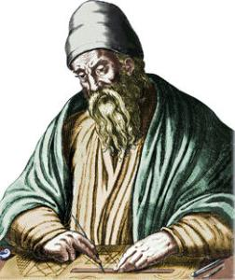
  Euclid constructing a right angle on a clay tablet
Notes:
Let’s start at the beginning.
In the golden age of classical Greece (500-300 BCE), geometry was invented and codified.
Here we see Euclid using straight-edge and compass on a clay tablet.
He is constructing a right angle as part of Proposition 1 in his book, the Elements.
This book was the basis of education in deductive reasoning for the next 2,000 years.
Along with Plato’s philosophy, it defined Western logical thinking.

Slide 3
  Dynamic Geometry in GeoGebra
Notes:
Fast forward to the titanium age of computers!
Here we see still images from dynamic geometry
GeoGebra is a computer application for constructing and manipulating geometric objects and configurations.
Here we see Euclid’s construction of a right angle
We can drag point D or point B to see that the angle at point A remains a right angle under any allowable manipulation of size and orientation
This provides visual and tactile evidence that the construction has imposed constraints that require that angle to be a right angle
We can also display symbolic or algebraic representations that confirm that angle alpha always remains 90 degrees
Note that in 2012 we still name the angle with the Greek letter that Euclid used and the construction has not changed in principle either

Slide 4
  Accountable Talk – (idealized) log of discourse with agent about construction
Sam: I drew a circle around A to find a point the same distance as B
Agent: Chris, can you check that Max is following Sam?
Chris: Hey Max, can you explain what Sam just did?
Max: Yeah, I think he found a point C such that AC = AB
Chris: But how do you know the lengths are exactly the same?
Max: Because all radii of a circle are equal
Sam: Now I am drawing circles around C and B
Notes:
In our project, we want to take advantage of computer technology to promote collaborative learning of math in ways that were not previously possible
Using dynamic geometry software is just one way to do this
Because we study collaboration, we see the importance of talk in small groups for building knowledge
That is the basis for what I call “group cognition”
One relevant theory of talk for learning is called “accountable talk”
It stresses that participants in a group should be accountable for making sure that everyone understand what the group is doing
We are exploring the use of software agents participating in online chats to facilitate accountable talk
Such agents are part of our current research in collaboration with Carolyn Rose at Carnegie-Mellon University
More generally, we want to explore and support productive mathematical discourse in small online groups

Slide 5
  Exploration & Discourse: VMT-with-GeoGebra construction & chat
Notes:
The VMT Project has been underway since 2002. It creates, supports and studies “Virtual Math Teams”
That is, online small groups of students exploring and chatting about mathematics
The VMT environment combines components for visualizing and exploring mathematical objects and components for communication
Here we see a multi-user version of dynamic geometry along with a chat tool for discussion of the math work
VMT provides the first multi-user version of dynamic geometry, where several users can actively manipulate a shared construction
As you will see, VMT includes additional components for synchronous and asynchronous work and communication, as well as for reflection and research

Slide 6
1. Translating Euclid
  Classic Education –constructing a right angle on a clay tablet
  Dynamic Geometry – constructing using GeoGebra tools
  Accountable Talk –discourse with agent about constructing
  Exploration & Discourse – constructing, visualizing, exploring in VMT-with-GeoGebra
Notes:
Our goal is to provide a technological medium and an integrated pedagogical approach to collaborative learning of mathematics
We are trying to translate Euclid’s static, individualistic presentation of geometry into a form that takes advantage of the potentials of computer support and collaborative learning
As I have just indicated,
We are moving from clay tablets to computers – and maybe iPads – while preserving the underlying principles of geometry
We are moving from having constructions play the role of static illustrations to engaging students in the construction of constraints or dependencies which ensure results like right angles or congruent triangles
We are especially concerned with the nature of the discourse that takes place around the mathematics, as this is central to both collaborative interaction and to cognitive understanding
We are structuring the pedagogy to emphasize student-centered exploration, noticing, wondering, manipulation, visualization, representation, etc rather than memorization of authoritative content
Our current specific focus is developing a document to serve as a curriculum for teachers and students – quite literally translating Euclid’s book of constructions and proofs into a scripted set of activities for dynamic constructions and collaborative reflections by small groups of online students

Slide 7
The VMT Project Today: Intro
The Promise of CSCL: From clay tablets to iPads
The Domain of Geometry Education
The Role of Discourse
The Approach of Design-Based Research
The Enactment of Technology
Design Issues
The Use of Conversation Analysis
The Philosophic Issues
Notes:
CSCL has existed as an active multi-disciplinary field of research for almost 20 years
Yet it remains more of a promise than a reality.
This is not so surprising if one considers the complexity and vision of the CSCL undertaking – a complexity that is just becoming clear as the field advances
Consider the shift in literacy that accompanied Euclid’s contribution to Western thought: it took hundreds if not thousands of years and many people in the world today are still not fully literate in mathematical thinking
The shift to literacy in CSCL will similarly require social transformations and the development of many supportive educational and social practices
As an example, I will today touch on the following aspects of the VMT CSCL project:
1Because it is a vision rather than a widespread practice, we cannot conduct large randomized clinical trials to prove its effectiveness and efficiency – at best we can show case studies of what may be possible
2 We need to be expert in geometry education – one must understand a text well to translate it into a new form
3 We recognize the central role of discourse. Discourse is complexly situated in its unique contexts and is hard to study and generalize
4 To explore a promise, we have to gradually prototype new technologies based on cycles of trial and formative evaluation. This is a research cycle
5 For a complex technology like GeoGebra – and even more so for VMT-with-GeoGebra – the technical issues are subsidiary to HOW the users actually put the technology into use
6 The research cycle in which technology and pedagogy and collaboration co-evolve, raises a large number of design issues, which the VMT Project is currently addressing
7 For the analysis of what the users are actually doing in case studies and the nature of their discourse, we rely heavily on micro-analysis methods we have derived from Conversation Analysis
* 8 With its broad vision, CSCL raises a number of philosophic issues. I will touch on one or two in my conclusions today.

Slide 8
2. Math Education with Dynamic Geometry
  Guiding development of skills & tacit understanding
  Visualization
  Exploration
  Dependencies
  Multiple Representations
  Concrete & Abstract
  Math Talk
Notes:
We are trying to develop a set of activities that guide students to develop an understanding of the essential relationships in geometry
Tools like GeoGebra provide many ways to highlight and display focal objects
They allow students to observe and actually take control of the step-by-step construction, rather than just seeing the resultant diagram
Color, coordinates, values of lengths and angles, etc. can aid visualizations
Students can manipulate constructions, drag objects and observe the consequences
Students can explore variations in the construction and see what difference it makes
They can explore how objects behave given the dependencies on other objects that have been built in
Multiple representations show that a given fact can be seen and established in different ways: through lengths, coordinates, relationships, etc.
A point that is considered “an arbitrary point” can in fact be moved around to any position, not just sit in a particular spot like in a paper drawing
For instance, a concrete generic triangle can be dragged around to be any triangle located anywhere
The multiple representations provide multiple ways to talk about the math objects.
The collaborative setting and the guiding curriculum encourage math talk and articulation of what students see, notice and wonder about

Slide 9
3. Discourse
  Socialization in math community
  Language of math & practices
  Collaborative learning thru discourse
  Accountability to each other, to math domain, to math community standards
  Conceptualization & articulation
Notes:
The currently popular theory of situated learning views math learning as a matter of becoming socialized into the math community. There is a culture of school-math and to learn math is to become skilled at participating in the discourse and practices of this culture
Collaborative learning in particular can be defined this way.
Being a good citizen of the math culture involves accountability to other members, to the community in general and to the field and principles of mathematics (at the level of high school math)
It is also well established that the best way to learn a subject is to talk about it with others, to articulate ideas and explain them to others.
In fact, “deep understanding” of math can be defined and operationalized as the ability to talk about a math topic in multiple ways – e.g., in terms of geometric constructions, algebraic equations, spreadsheet columns, graph curves, drawings, physical models, etc.
The GeoGebra software provides multiple representations and our curriculum encourages multiple ways of talking about geometric relationships

Slide 10
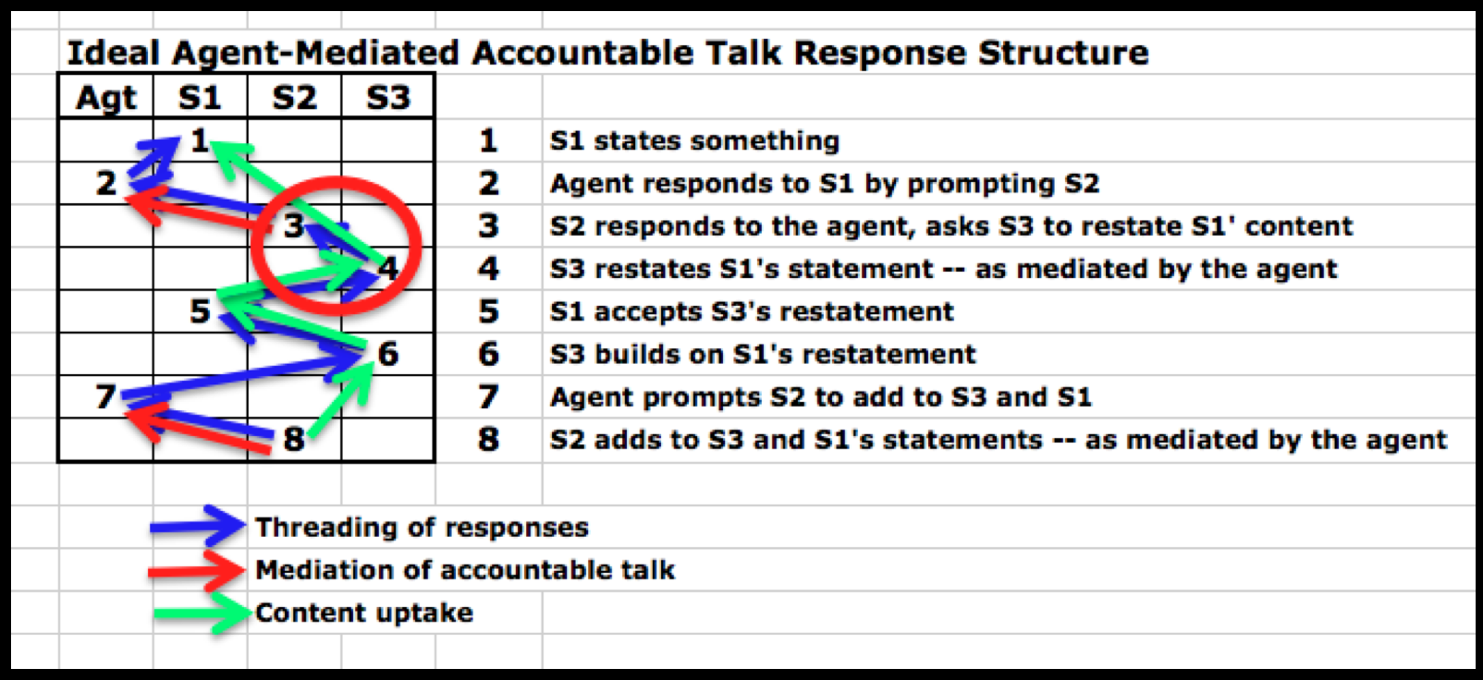
Accountable Talk:
Model or Software Agent
Notes:
In our project, we will be focusing on “significant mathematical discourse” as the primary empirical indicator of collaborative and individual learning. Among the forms of discourse we will be looking for are forms of accountable talk related to math content.
Here we have a response structure involving a software agent that facilitates accountable talk moves among a group of three students – chat postings of each participant are listed in a different column
This is a representation of the conversation analysis of responses and up-takes of math content within the group. This is an ideal that we would like to find in our data in a couple of years from now.

Slide 11
4. Design-Based Research
  Innovation – nothing fully known or fixed
    Technology, Practices of usage, User needs, user skills, hypotheses, central concepts, assessment methods
  Start simple; explore in iterative cycles of trial, evaluation, re-design
  Evaluation of technology & scaffolds: observe use and enactment by non-designers
Notes:
While some research in CSCL is done following a traditional experimental design, with a controlled variable, a control group, randomized subjects and quantitative measures, most CSCL research follows more of a DBR approach. This is partially because it involves the design of new technologies. The CSCL technologies change the whole learning and task paradigm, so it is not possible to compare with a control group holding everything but one variable the same. Also, research in classrooms is so highly situated that conditions are not reproducible.
But at a deeper level, so much is unknown that many facets have to be explored simultaneously: theory, technology, pedagogy, analysis method, etc. So we begin at some starting point and allow everything to develop and co-evolve through exploration.

Slide 12
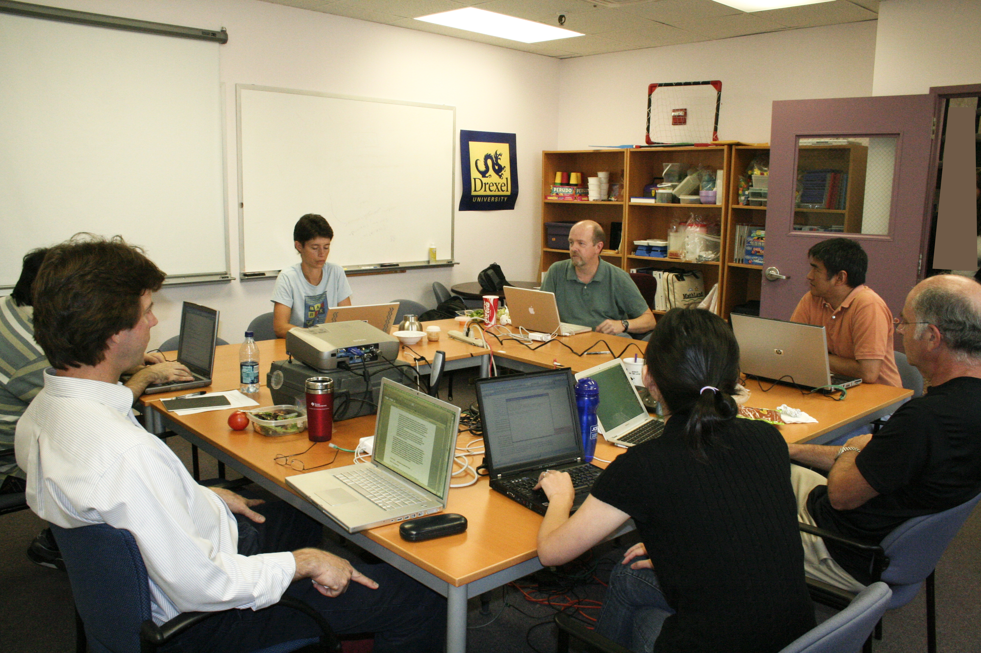
Design-Based Research
User trials
evaluate
Re-design
Interaction analysis
Theory
Methods
Notes:
Here we see the cyclical nature of DBR. Above is a “data session” of the VMT Project team meeting at the Math Forum and collaboratively analyzing data from a trial.

Slide 13
5. “Virtual Math Teams” Computer Support
An integrated socio-technical environment for individual, group and community cognition
Lobby: find rooms, social networking, teacher administrative tools, activity overview tools
Chat room: group chat, Web browser, Wiki editor, Topic viewer, Help manual
GeoGebra: group and individual construction areas
Notes:
In the following slides, I will show some of the computer support components of the VMT environment

Slide 14
The VMT Lobby

Slide 15
VMT chat room with multiple tabs

Slide 16
Summary whiteboard: textbox with mathML, referencing, history
Wiki page for activity of group – for Activity – for group – for community
Logs and Replayer
Integrated curriculum of activities
Professional development and training in individual intellectual, group collaborative and community accountable practices – primarily in terms of significant mathematical discourse.

Slide 17
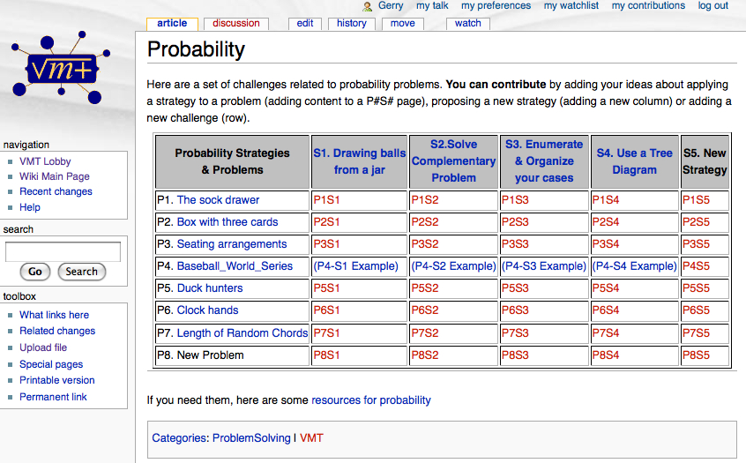

Slide 18
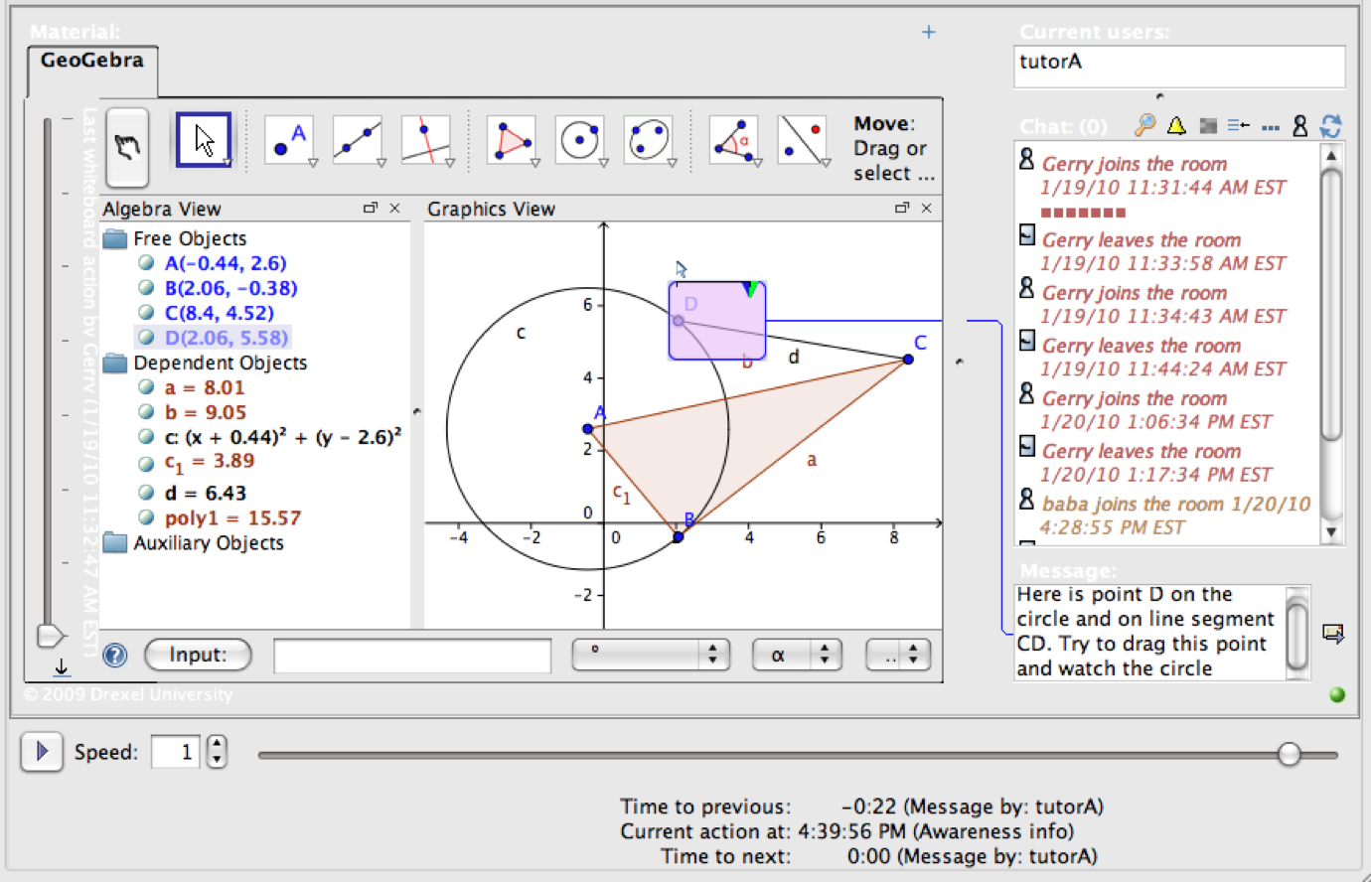
The VMT Re-Player

Slide 19
6. Current “Hot” Design Issues
Instruction vs. exploration: explaining interface vs. notice and wonder
Synchronous/collaborative chat vs. asynchronous/individual read and try vs. class replay and reflection
Custom perspective for all, community, class, group, individual?
Custom tool for all, community, class, group, individual?
Agent intervention: scripting vs. help agent
Curriculum design criteria
Design-based research agenda
Notes:
In the following slides, I will discuss these seven issues that are currently at the forefront of the VMT project: [summarize each]

Slide 20
More exploration, less Instruction

Slide 21
Shared & personal spaces; synch/asynch

Slide 22
Custom perspectives tool

Slide 23
Custom right triangle tool

Slide 24
  Accountable Talk – (idealized) log of discourse with agent about construction
Sam: I drew a circle around A to find a point the same distance as B
Agent: Chris, can you check that Max is following Sam?
Chris: Hey Max, can you explain what Sam just did?
Max: Yeah, I think he found a point C such that AC = AB
Chris: But how do you know the lengths are exactly the same?
Max: Because all radii of a circle are equal
Sam: Now I am drawing circles around C and B

Slide 25
Math Education Design Criteria
  Guiding development of skills & tacit understanding
  Visualization
  Exploration
  Dependencies
  Multiple Representations
  Concrete & Abstract
  Math Talk

Slide 26
Design-Based Research
User trials
evaluate
Re-design
Interaction analysis
Theory
Methods

Slide 27
7. Conversation Analysis:
for Formative Evaluation
  Careful micro-analysis of discourse of users engaged in computer-mediated tasks
  From complete chat logs of interaction
  And replaying of technology usage
  Analysis of group interaction and problem-solving processes
  Based on visible evidence, not inferences about mental events or reliance on self reporting
Notes:
Conversation Analysis is an approach to the study of communication, which was developed starting in the 1960s by Harvey Sacks and his colleagues. It adopts the approach to social science of ethnomethodology, which was developed around the same time by Harold Garfinkel. CA took advantage of tape-recorder technology to study the tacit verbal practices of people engaged in informal face-to-face conversation. We have adopted it to chat analysis, taking advantage of computer logs from VMT and the Replayer. Chat is quite different from talk, but can be analyzed in similar ways. We use this as a primary way to understand what is going on in online collaborative learning. We postulate that group cognition takes place primarily though discourse and can be studied through micro-analysis of the discourse.

Slide 28
Notes:
Here I have tried to represent the constraints on sequential small-group interaction from the levels of the individuals, small group and larger community (such as a classroom).
The small-group discourse is in the center, mediating the individual cognition, the group cognition and the community knowledge building. Driven by curriculum tasks, this produces knowledge artifacts. As researchers, we can analyze the discourse and the artifacts to see how collaborative learning, group cognition and community knowledge building take place. We are not so much interested in documenting that CSCL results in better test scores, but in understanding how groups in CSCL settings actually interact. Because CSCL is pursuing a vision of a different kind of learning than test scores based on a pedagogy of content memorization measure.

Slide 29
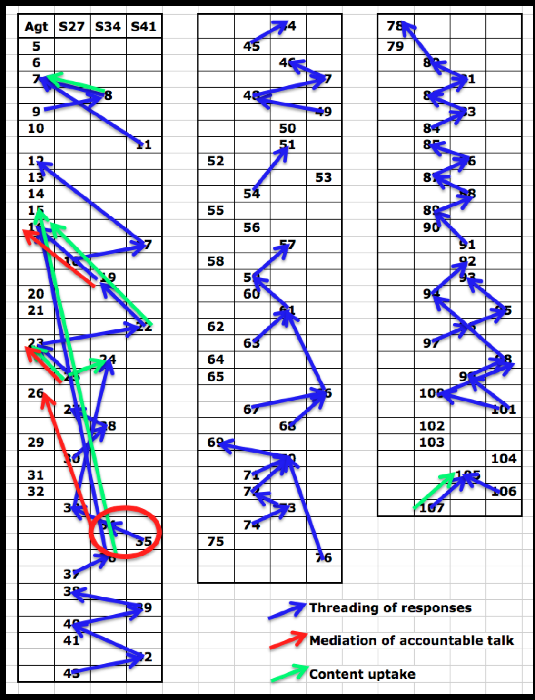
Notes:
Here we see the actual responses of students to the facilitation of a software agent.
The agent postings are in the first column. We see that in the beginning, the agent dominates and there is no interaction among the students. Later, the students are ignoring the agent and gradually start to interact – first two students and then all three.
So already in this simple representation, we can visualize some interesting results of the interaction – enough to know we need to go back and redesign the agent’s invasive interventions

Slide 30
Group cognition in math:
The longer-sequence structure
Log 1. Open the topic
Log 2. Decide to start
Log 3. Pick an approach
Log 4. Identify the pattern
Log 5. Seek the equation
Log 6. Negotiate the solution
Log 7. Check cases
Log 8. Confirm the solution
Log 9. Present a formal solution
Log 10. Close the topic
Notes:
In a recent paper, I did a more detailed analysis of the response structure of students working in VMT at the end of four hour-long sessions. Most Conversation Analysis studies focus in very brief interactions in which one person responds to another. I was interested in longer sequences that could accomplish math work.
I found a sequence of 10 short response interactions and I looked at the math content of each. I found that they accomplished the 10 tasks listed in this slide. In other words, this longer sequence of 10 short interactions solved a math problem that the students had (a) come up with themselves earlier, (b) been unable to solve earlier and (c) were extremely excited to solve now. As a group engaged in chat with shared drawings, they solved an authentic math problem that none of them were able to solve individually.
The CSCL vision is that this can take place with the proper technological and pedagogical support.

Slide 31
8. Philosophic Issues
  How can dynamic-math support enhance geometric cognition by individuals, small groups and classrooms?
  How can it integrate:
    Rational planning of geometry, dependencies, software functions, scripts, curriculum, software agents
    Normative social practices of collaborative learning, accountable talk, human motivation, undistorted communication

Slide 32
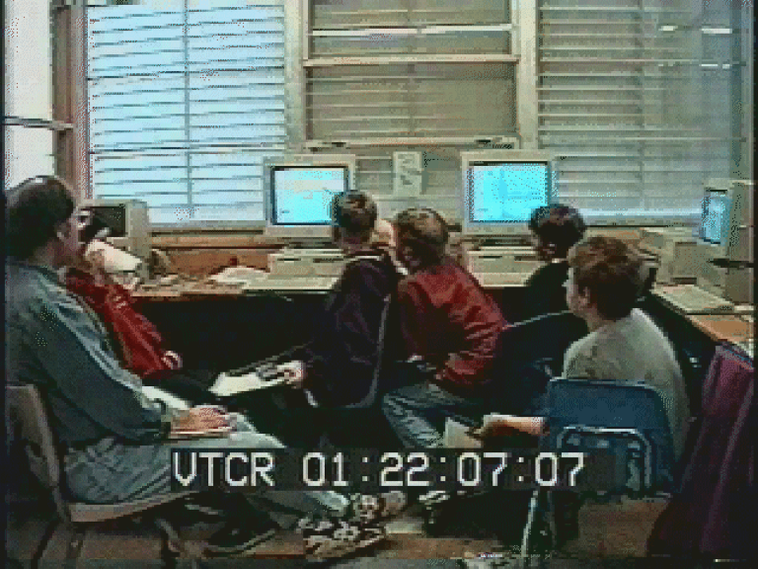
Face-to-face with computer simulation: Seeing an artifact as meaningfully structured
Stahl, 2006, Group Cognition, p. 242

Slide 33
Geometry is the paradigm of purposive-rational calculation. The structure of the classic proof is:
    Statement of conjecture to be proven
    Construction of deduction
    Restatement of that which was to be proven
This is the general form of planning:
    Goal, implementation, reflection checking on completion
This is also the form of computer programming:
    Requirements, programming, testing
Like computer programming, dynamic-geometry construction is a matter of assembling a (ideally optimal) set of constraints among dependent objects to achieve the desired realization.

Slide 34
  Group geometric cognition can integrate purposive-rational thinking and social-normative interaction. According to Habermas, there is a duality of the logic of efficient work and the logic of social interaction. By integrating geometric construction with collaborative discourse, we combine these.
  The proper balance is the precondition of democracy.

Slide 35
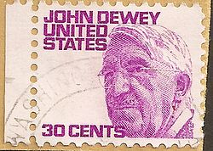
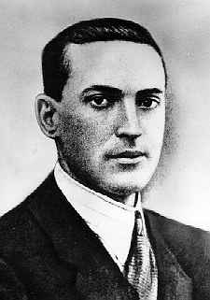
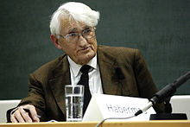
Vygotsky, Dewey, Habermas
Notes:
So I think these people would support the goals of the VMT Project

Slide 36
Classical geometry epitomized a literate world-view, dominated by factual propositions and fixed truths. This logical, deductive, abstract view began with the early geometricians, was extended by Socrates, Plato and Aristotle, was codified by Euclid and was rigidified by Roman thought.
Dynamic geometry can translate fixed views of formal truths into exploratory, temporal, human-constructed systems of visible dependencies. Truths are seen to be socially constructed, understandable and modifiable. Proofs are not eternal and God-given; rather, students can construct systems of dependencies with designed consequences.

Slide 37
Conclusion
  Euclidean geometry pointed the way for rational thinking in literate Western society, culminating in CS and AI
  A CSCL approach to dynamic geometry learning can integrate such rational thinking with interpersonal understanding and can show the socially constructed and negotiable nature of rationality
  But successful implementation and deployment require meeting a complex and ill-defined set of diverse challenges

Slide 38


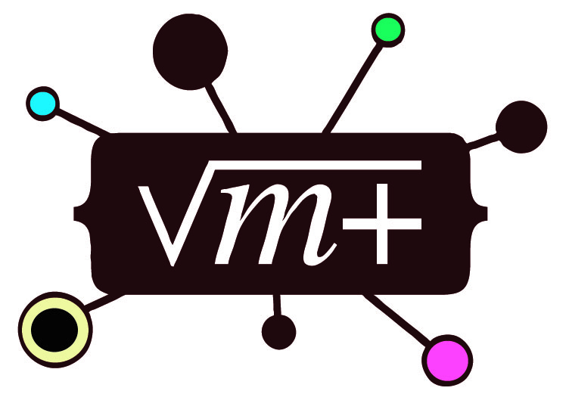
For Further Information:
“Group Cognition” (2006, MIT Press)
“Studying Virtual Math Teams” (2009, Springer)
Gerry Stahl’s e-Library (collections of papers free for iPad, Kindle, PDF or low-cost print-on-demand): GerryStahl.net/elibrary
These slides: GerryStahl.net/pub/rutgers2012.ppt.pdf
website: GerryStahl.net
email: Gerry@GerryStahl.net

